Slide 1
Smoke and Mirrors: How PLCs Can Mimic Honeypots to Enhance ICS Security
Dr Sam Maesschalck
nexovagroup.eu

Slide 2
Operational Technology Security Challenges
The increasing digitalization and connectivity of operational systems bring enhanced efficiency and control, but also introduce new and complex security challenges across the OT landscape.
Expanding attack surface
Legacy system vulnerabilities
IT/OT convergence risks
Insider threats and human factors
Focus on availability

Slide 3
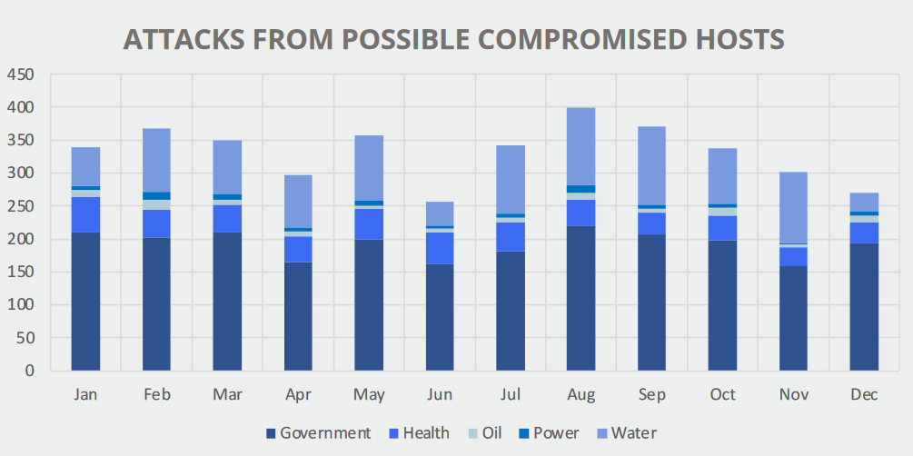
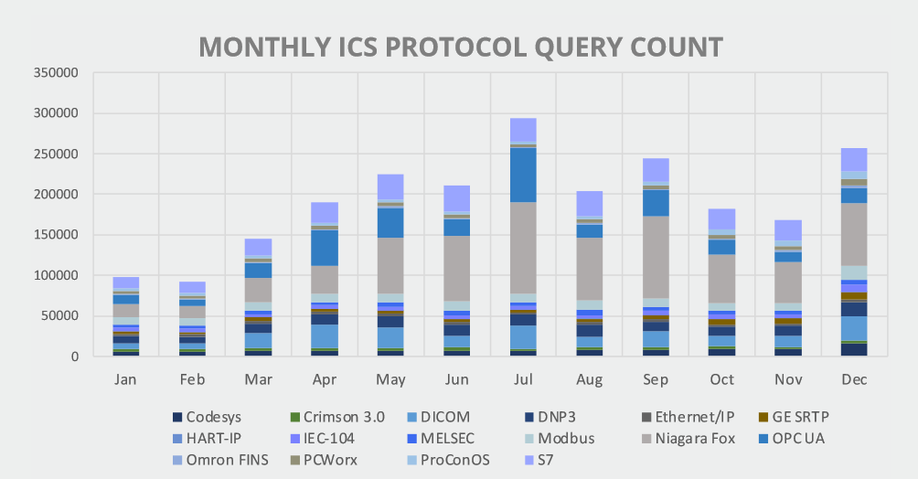
Security Trends Threat Hunting
nexova.com
graph 1
graph 2
Attacks from Possible Compromised Hosts
Attacker Protocol Usage in ICS
Systems we might consider secure are used to launch attacks.
Protocols such as Niagara Fox, S7 and HART-IP are popular with attackers targeting ICS.
Source: TXOne ICS/OT Threat Hunting Report

Slide 4
Honeypots What are they?
Mimics Real System
Detection & Analysis
Decoy

Slide 5
Advancements in security technology are essential to match the evolving threat landscape of ICS/OT.

Slide 6
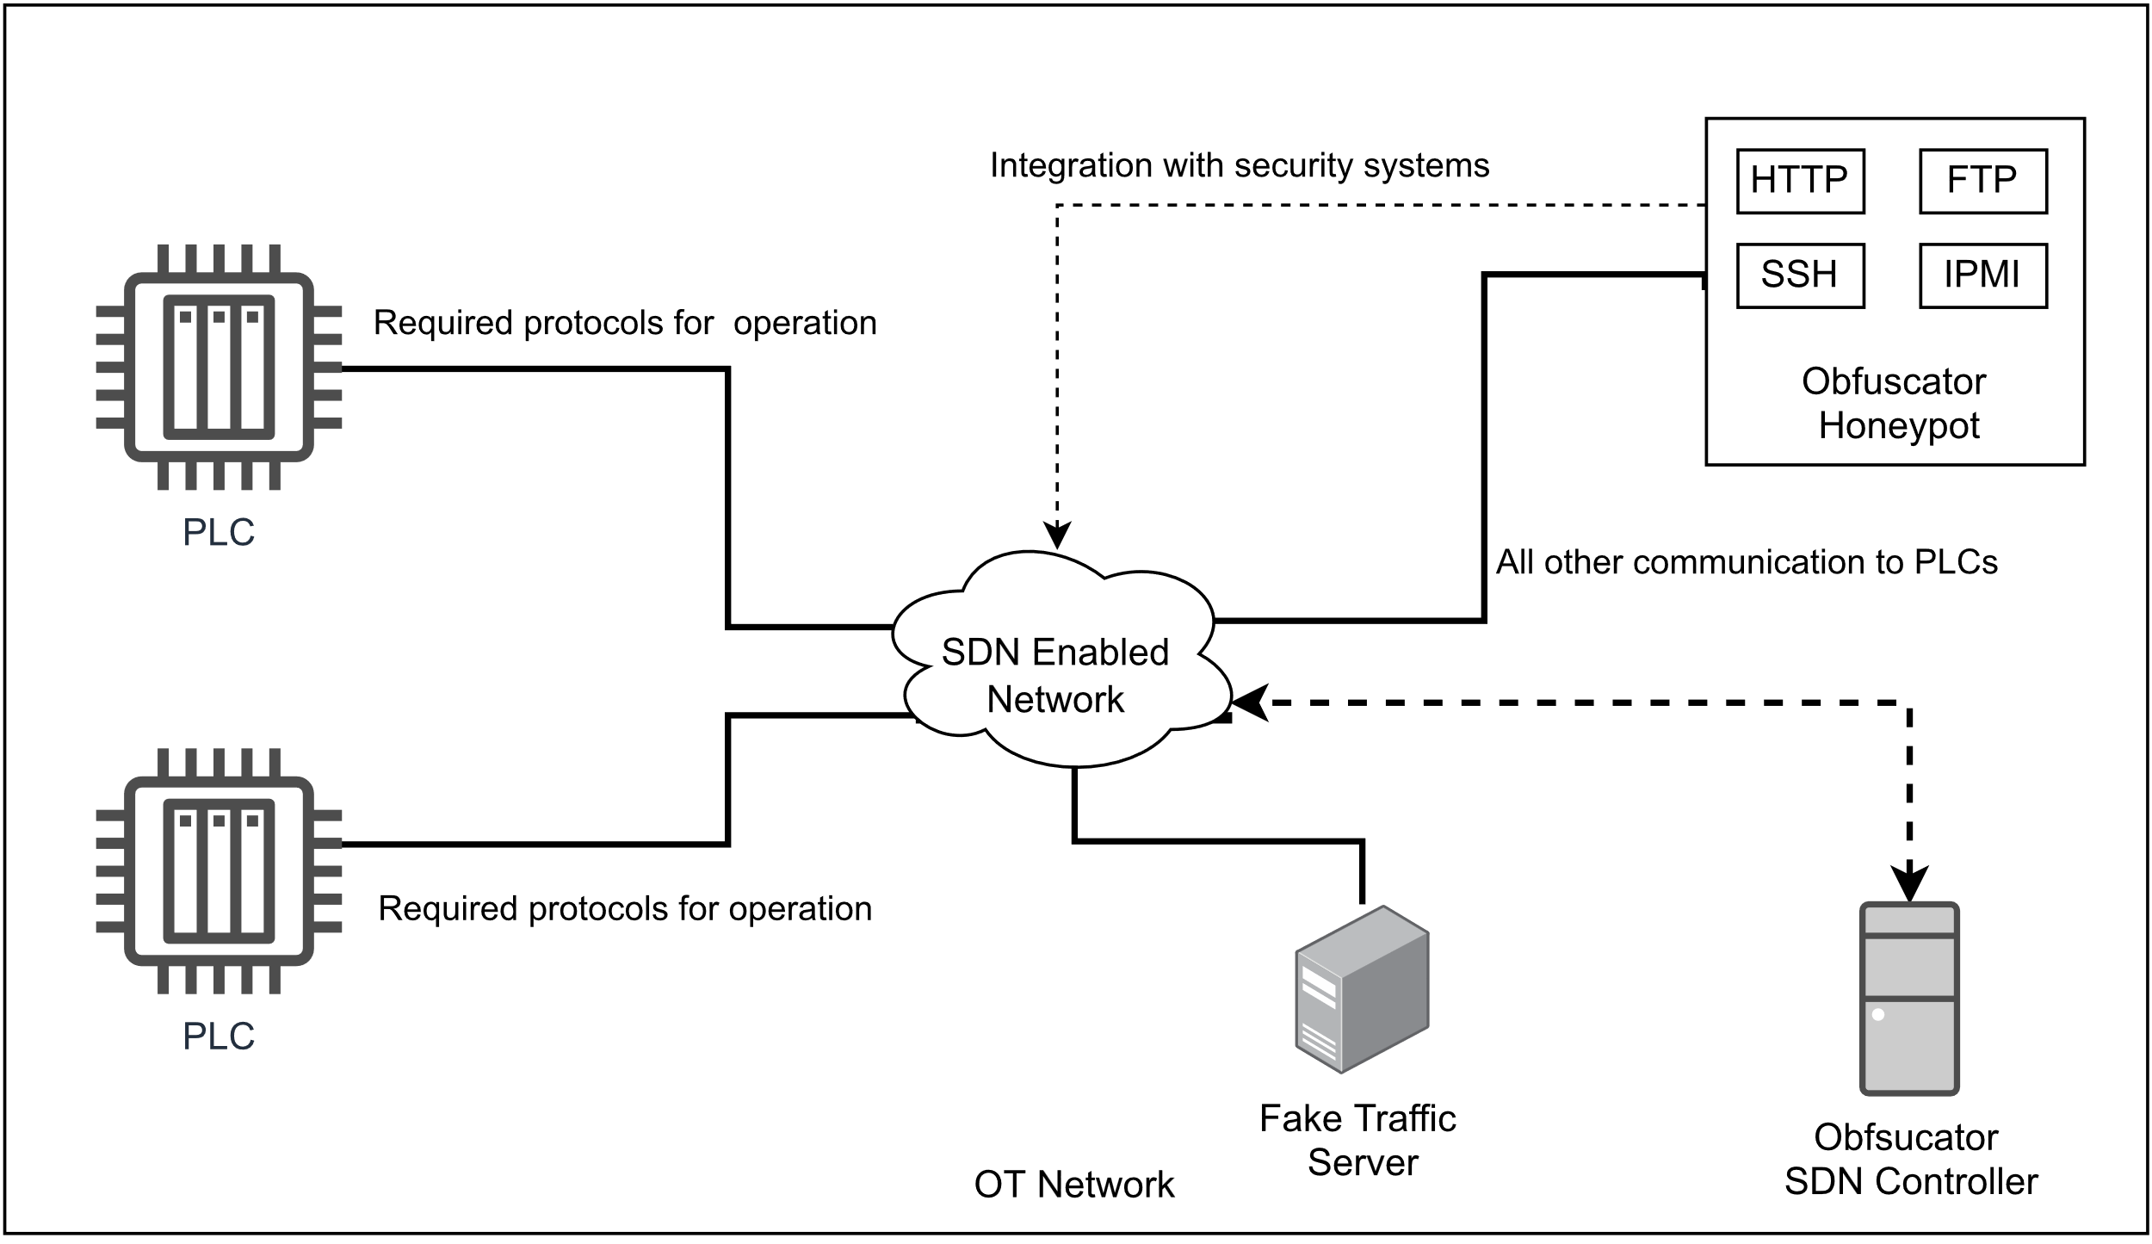
ICS Obfuscator
A tool for enhancing the benefits of honeypots
Obfuscation
Adds a ‘check’ before traffic hits the system
Redirects traffic to another system (obfuscator)
Plays on the attacker’s mind
Makes a real system pose as a honeypot
An attacker focused on remaining undetected
Does not impact the operations of ICS systems
Runs separate from the operational systems
Interruption falls back to normal functionalities

Slide 7
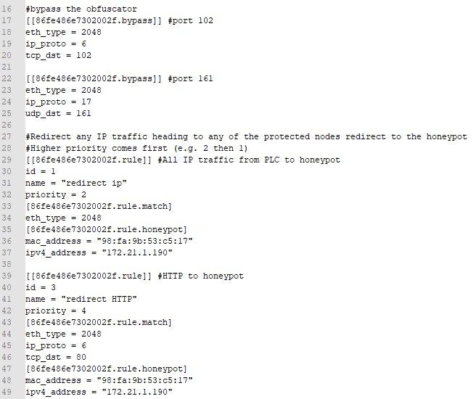
How the obfuscation works
Obfuscator Controller is a middle-man
Set traffic is allowed to bypass the obfuscator
Other traffic is redirected
Packets can be dropped
IP and MAC addresses are adapted to show the original system on return

Slide 8
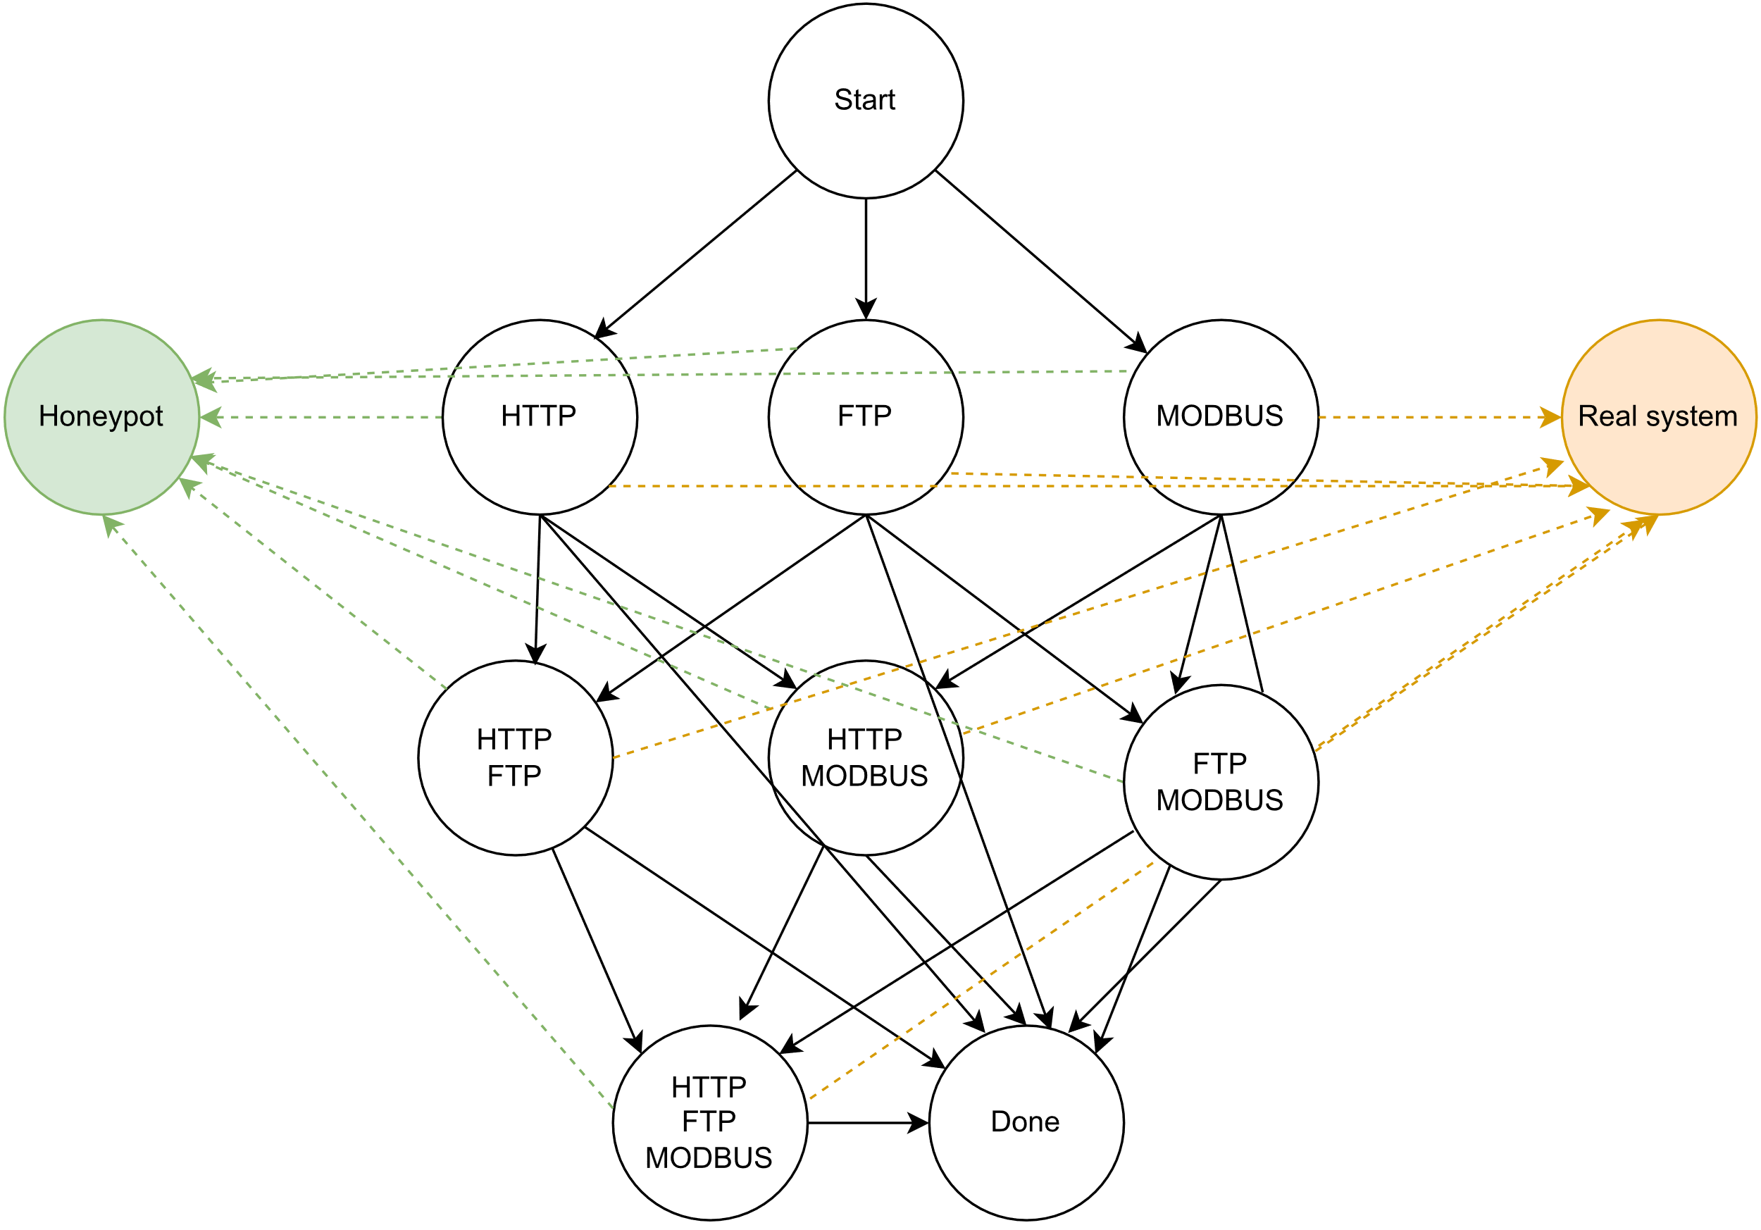
Mind Games Playing the Attacker
Graph 1
Honeypot Belief
What makes an attacker think a system is a honeypot or not?

Slide 9
Our setup
ICS Obfuscator Evaluation

Slide 10
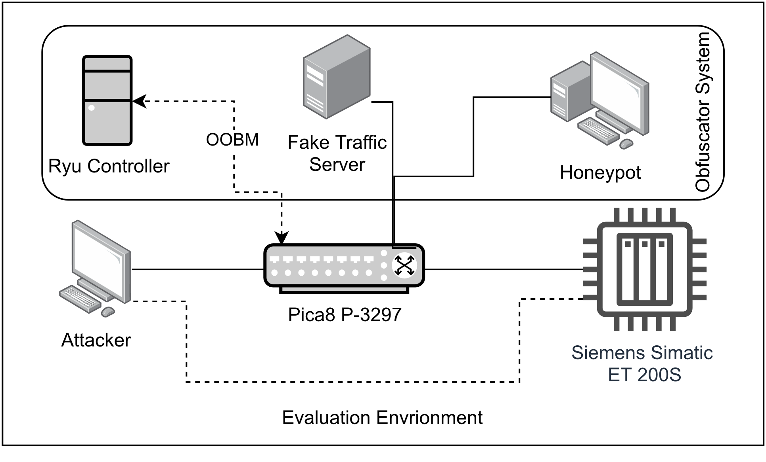
Evaluation Scenario Diagram & Tools
Penetration Testing | Networking
Nmap | Wireshark
Nessus | Snap7
PLCScan | Ping
S7Scan | Httping
 | hping3

Slide 11
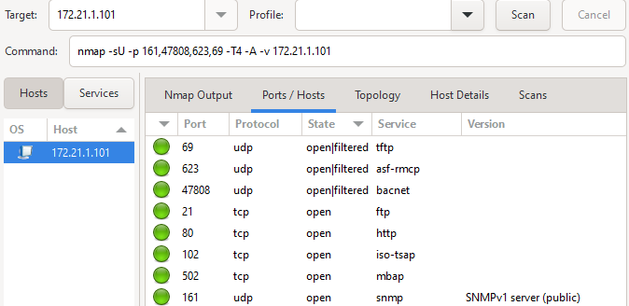
Nmap & Snap7
CONNECT:
True
CPU:
<snap7.snap7types.S7CpuInfo object at 0x11052580>
CONNECT:
2002-02-25 03:15:39
READ:
bytearray(b'\x00\x00\x00\x00\x00')
UPLOAD:
bytearray(b'\x00\x00\x00\x00\x00\x00\x00\x00\x00\x00\x00\x00@\xb3\x15\xee\x00\x00\x00\x00\x00\x00\x00\x00\x00\x00\x00\x00\x00\x00\x00\x00\x80m\x1b\x00\x00\x00\xfe\x19thisismyemail@address.com\x00\x00\x00\x00\x00\x00\x00\x00\x00\x00\x00\x00\x00\x00\x00\x00\x00\x00\x00\x00\x00\x00\x00\x00\x00\x00\x00\x00\x00\x00\x00\x00\x00\x00\x00\x00\x00\x00\x00\x00\x00\x00\x00\x00\x00\x00\x00\x00\x00\x00\x00\x00\x00\x00\x00\x00\x00\x00\x00\x00\x00\x00\x00\x00\x00\x00\x00\x00\x00\x00\x00\x00\x00\x00\x00\x00\x00\x00\x00\x00\x00\x00\x00\x00\x00\x00\x00\x00\x00\x00\x00\x00\x00\x00\x00\x00\x00\x00\x00\x00\x00\x00\x00\x00\x00\x00\x00\x00\x00\x00\x00\x00\x00\x00\x00\x00\x00\x00\x00\x00\x00\x00\x00\x00\x00\x00\x00\x0

Slide 12
S7Scan & PLCScan
s7scan v1.02 [Python 2] [Scapy-based]
TCP/IP network scan started
Scanning 172.21.1.101...
Connected to ('172.21.1.101', 102) with tsap 0100
Tsap 0100
Module identification:
Module
Order number: 6ES7 151-8AB00-0AB0
Version: 2.0.1
Basic hardware
Order number: 6ES7 151-8AB00-0AB0
Version: 2.0.1
Basic firmware
Version: 2.7.1
Unknown index 129
Boot Loader
Version: 16650.13.11
Module protection:
CPU type: Standard CPU
Protection level set with the mode selector: 1
Protection level set in parameters: 0 (no password)
Valid protection level of the cpu: 1
Mode selector: 2 (RUN-P)
Startup switch setting: 0 (undefined)
Component identification:
PLC name: ET200S_1
Module name: FIELD SITE 1 ET200S_1
Stamp: Original Siemens Equipment
Serial number: S C-B2VW09582011
Module type name: IM151-8 PN/DP CPU
Memory card serial number: MMC 1D5C9319
Manufacturer ID: 42; ptofile ID: 62976; profile specific type: 1
OEM copyright ID: ; OEM ID: 0; additional OEM ID: 0
Module ethernet details:
Logical base address: 7FF
IP address was configured in STEP 7
IP address: 172.21.1.101/255.255.255.0
Default gateway: 172.21.1.1
MAC address: 00:0e:8c:f5:12:af
Physical status of ports: 8f8f8800000000000000000000000000
172.21.1.101:102 S7comm (src_tsap=0x100, dst_tsap=0x102)
Module: 6ES7 151-8AB00-0AB0 v.0.2
Basic Hardware: 6ES7 151-8AB00-0AB0 v.0.2
Basic Firmware: v.2.7.1
Unknown (129) : Boot Loader A
Name of the PLC: ET200S_1
Name of the module: FIELD SITE 1 ET200S_1
Plant identification :
Copyright: Original Siemens Equipment
Serial number of module : X X-XXXXXXXXXXXX
Module type name: IM151-8 PN/DP CPU

Slide 13
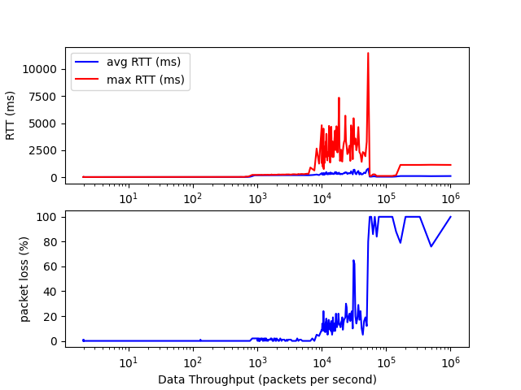
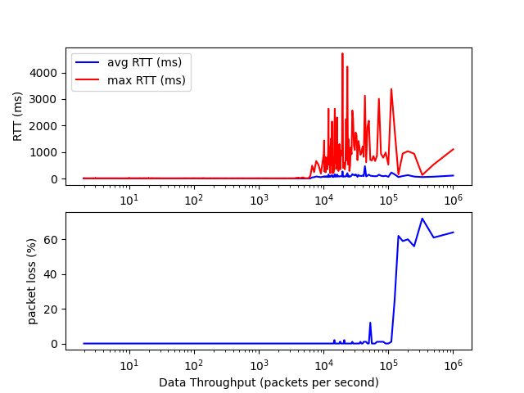
Performance Evaluation
PLC
Obfuscator

Slide 14
Expert Evaluation
Expert 1 (Penetration Tester, OT Security Expert, OSCP)
Initially cautious based on knowledge of honeypots
Believed the system was a honeypot
Found no evidence of two separate systems
Noted advanced S7 implementation
Expert 2 (Penetration Tester, OT Security Engineer)
Identified the system as Conpot honeypot
Found no indication that S7 was running on separate system
Noted advances S7 implementation
Both experts concluded the obfuscator could be effective in a real environment

Slide 15
Obfuscator Evaluation Results
Successfully presented honeypot and PLC as one system
No interference with PLC operations
Better performance than PLC alone
Expert evaluators found no evidence of second system

Slide 16
Benefits and Considerations
Discourages attackers from interacting with real PLC
Increases chances of capturing attackers on the network
Integrates with other security mechanisms (e.g., IDS)
Flexible deployment options (e.g., SDN, P4…)
Need for risk assessment

Slide 17
Thank you for your attention
Paper
s.maesschalck@nexovagroup.eu
/in/sammaesschalck/
Nexova Cyber Place de l’ESA 1 6890 Redu (Belgium)
+32 (0)10 48 72 60 nexovagroup.eu info@nexovagroup.eu

