Slide 1

Services and Innovation for Industry 4.0
Enhancing IoT Security and Privacy Through the Federated IoT Testbed
Anna Maria Mandalari
This work is licensed under a Creative Commons Attribution 4.0 International License.

Slide 2
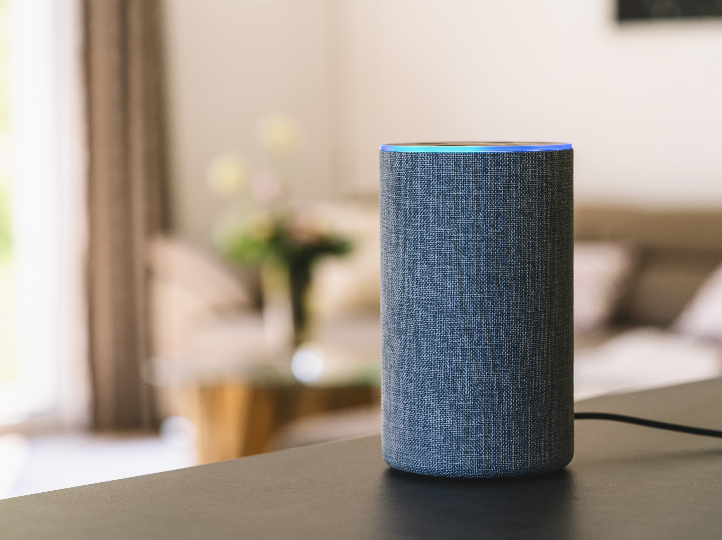
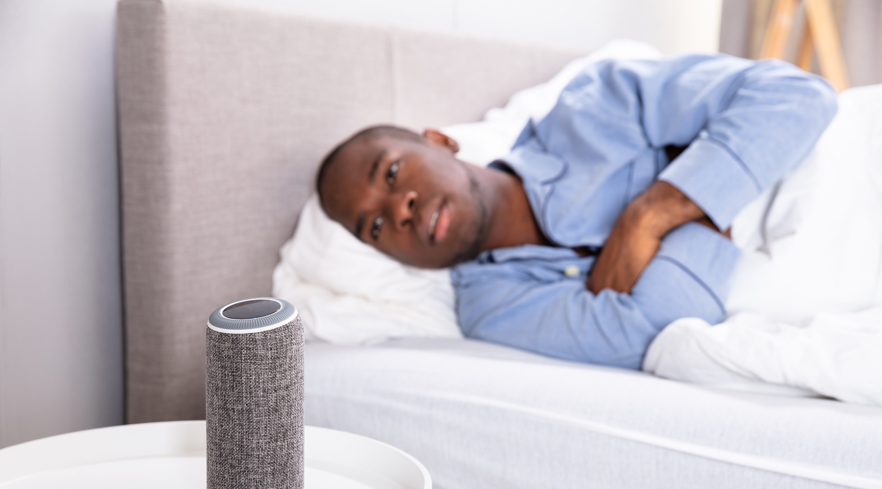

Notes:
We know that any object nowadays can be connected to the internet from smart speakers to cameras , even your fridge can be connected to the Internet. We call this Internet of Things devices.
And they are great… we can ask them to shop for us, think about Alexa, they play music for us.
Today, these systems are even more in-demand due to the low touch experience of them.
But why are they so cheap and what is the real value they give back to us.
This is where my research journey started, I wanted to know what we are invisible trading in exchange for these devices.

Slide 3


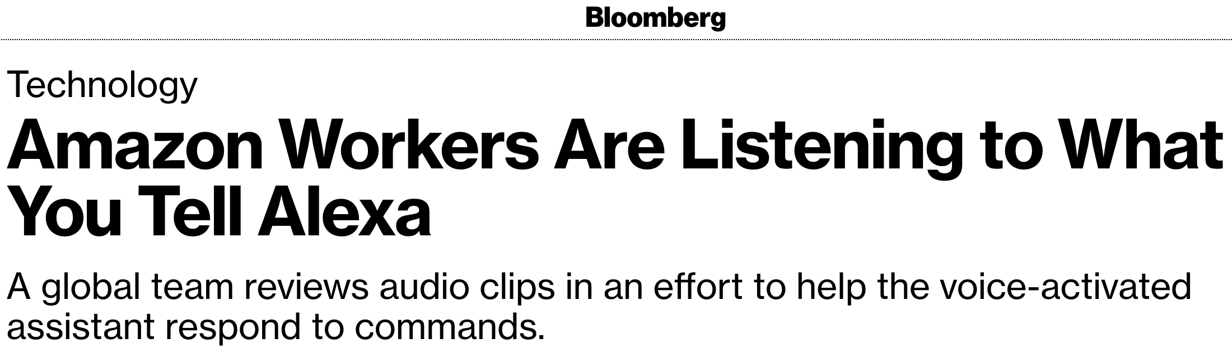



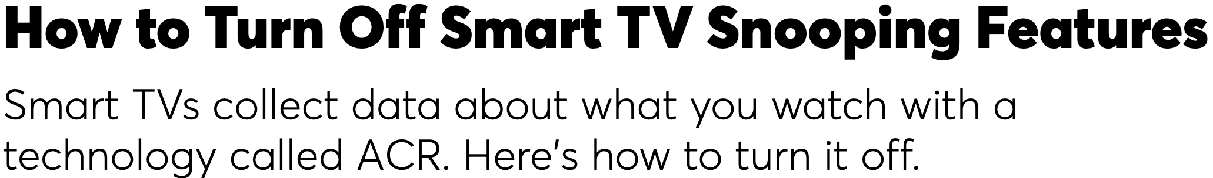
Why were we interested in this?
They can (by definition) access the Internet and therefore may expose private information
Lack of understanding on what information they expose, on when they expose it, and to whom
Lack of understanding of regional differences (e.g., GDPR)
They may watch you
(e.g., smart doorbells)
They may know what
you watch (e.g., smart TVs)
They may listen to you
(e.g., smart speakers)
Notes:
The reason of my research is that the main problem is that these devices are like a black hole
They can (by definition) access the Internet and therefore may expose private information
Lack of understanding on what information the IoT devices expose, on when they expose it, and to whom
Lack of understanding of regional differences in regulations (e.g., GDPR we have here in Europe it is not available overseas )
It s time to act and quickly

Slide 4
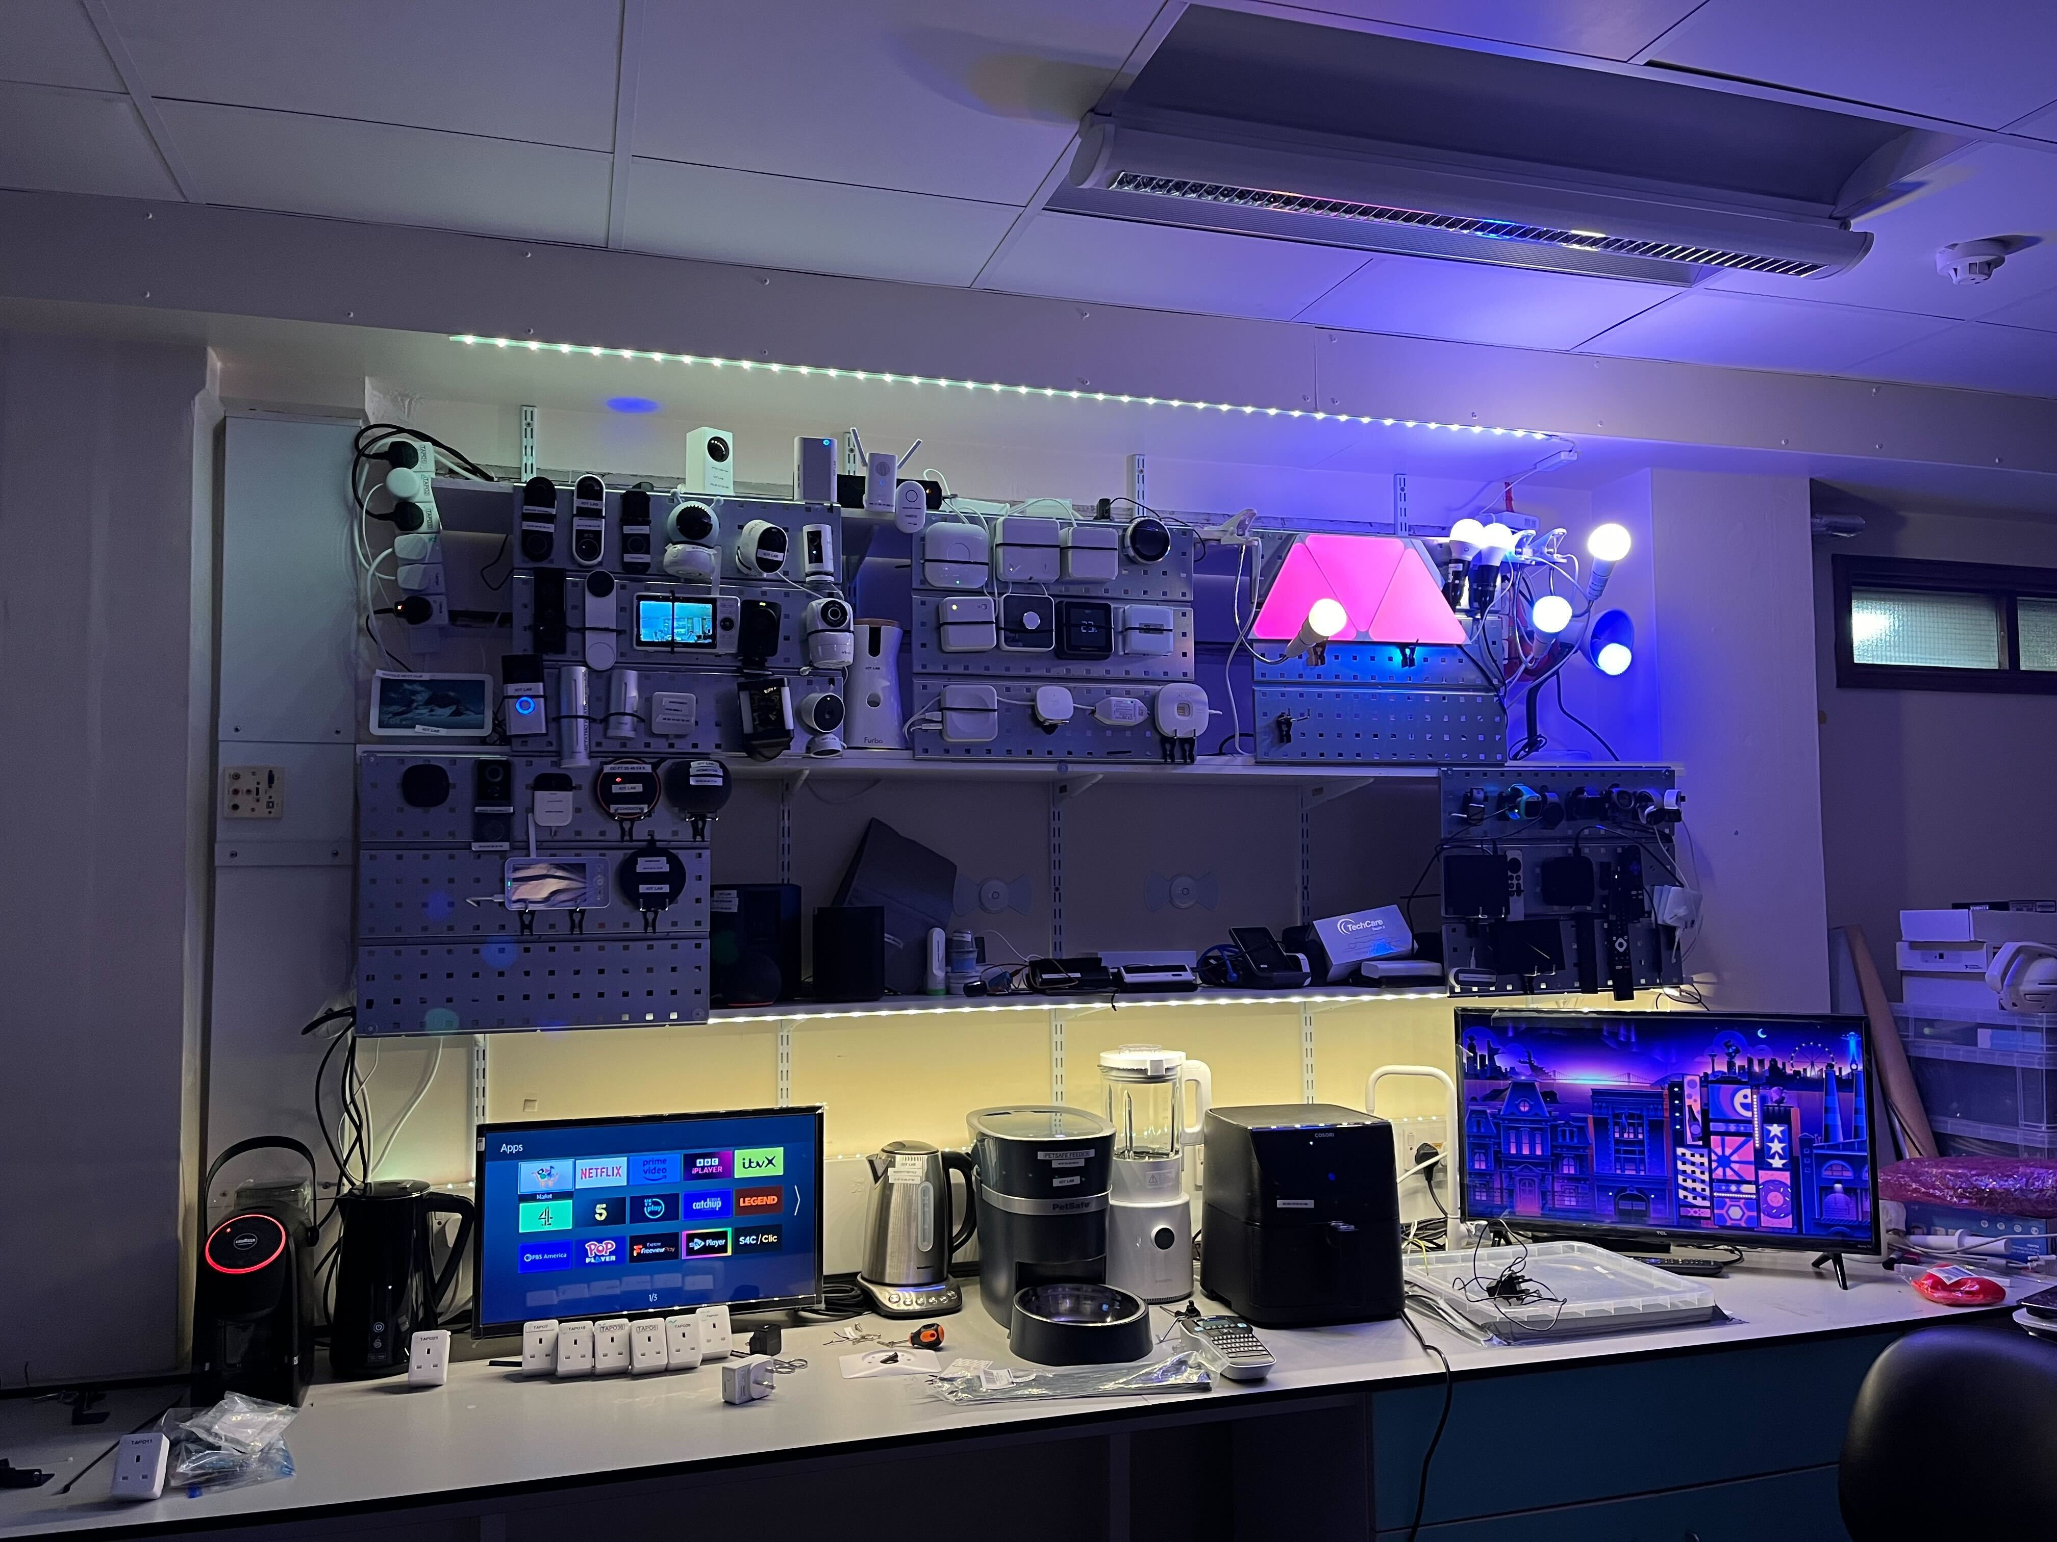
210 devices in
different countries
Notes:
…And it was pretty hard, because we needed to basically own all these devices. We located the devices to the basement of the Dyson Building at Imperial and in one room of the NEU, We bought 123 different devices from appliances to smart cameras to smart hubs and other home automation devices. From the most expensive to the cheapest one and we located in two different countries US and UK and we started testing them to see if we could answer these questions that we had on the devices. We capture all the traffic these devices are exchanging over the internet and we are keep capturing after two years
Our main contribution is a testbed for running repeatable automated IoT experiments at scale.

Slide 5
Design of Experiments
>200k Experiments
Activity | Description
Power | power on/off the device
Voice | voice commands for speakers
Video | record/watch video
On/Off | turn on/off bulbs/plugs
Motion | move in front of device
Others | change volume, browse menu
Controlled interactions
  Automated (repeated 30 times)
    Text-to-speech to smart assistants (Alexa/Google/Cortana/Bixby)
    Monkey instrumented control from Android companion apps
Idle: background traffic
Notes:
How did we use the testbed and devices for doing the experiments.
We have controlled experiments, in which we automate the interaction with the device using a companion app or we use speakers for automatically asking questions the device.
And then we capture all the idle traffic, the traffic when the device is not used.

Slide 6
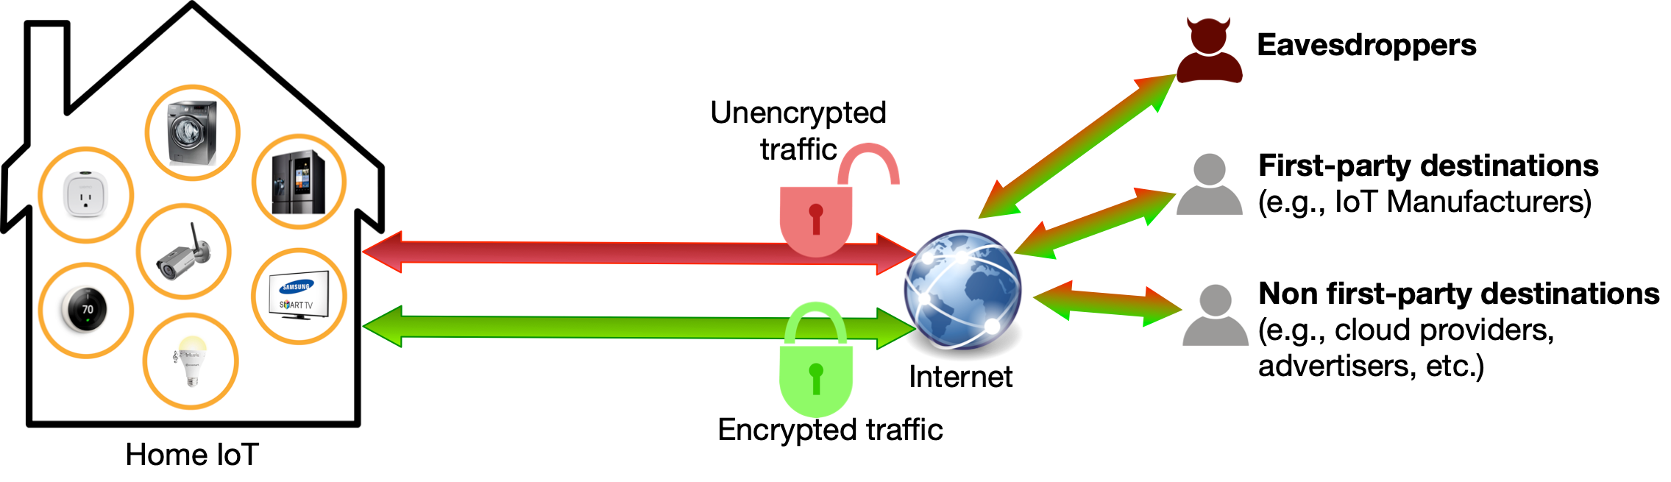
Data Collection Methodology
Router
PCAP
Internet traffic is the only signal that (by definition)
all IoT devices produce
Monitor all traffic at the router
  per-device
  per-experiment
Notes:
Data collection happens on the router, the router distinguish the traffic per device and per experiments, so the behavior of the device is isolated.

Slide 7
Cross-Device Ad Targeting in Smart TVs
Cross-device ad targeting is a dynamic and personalized marketing strategy that leverages interconnected devices to deliver highly relevant content to consumers
Smart TVs play a crucial role in this process. For instance, it is possible to receive ads on our computer related to the content we watch on our smart TV

Slide 8
Goals and Challenges
Automatic Content Recognition (ACR) is a technology that gathers data from a user of an Internet-enabled TV, or Smart TV, to help in identifying and gathering TV viewership data

Slide 9
Methodology

Slide 10

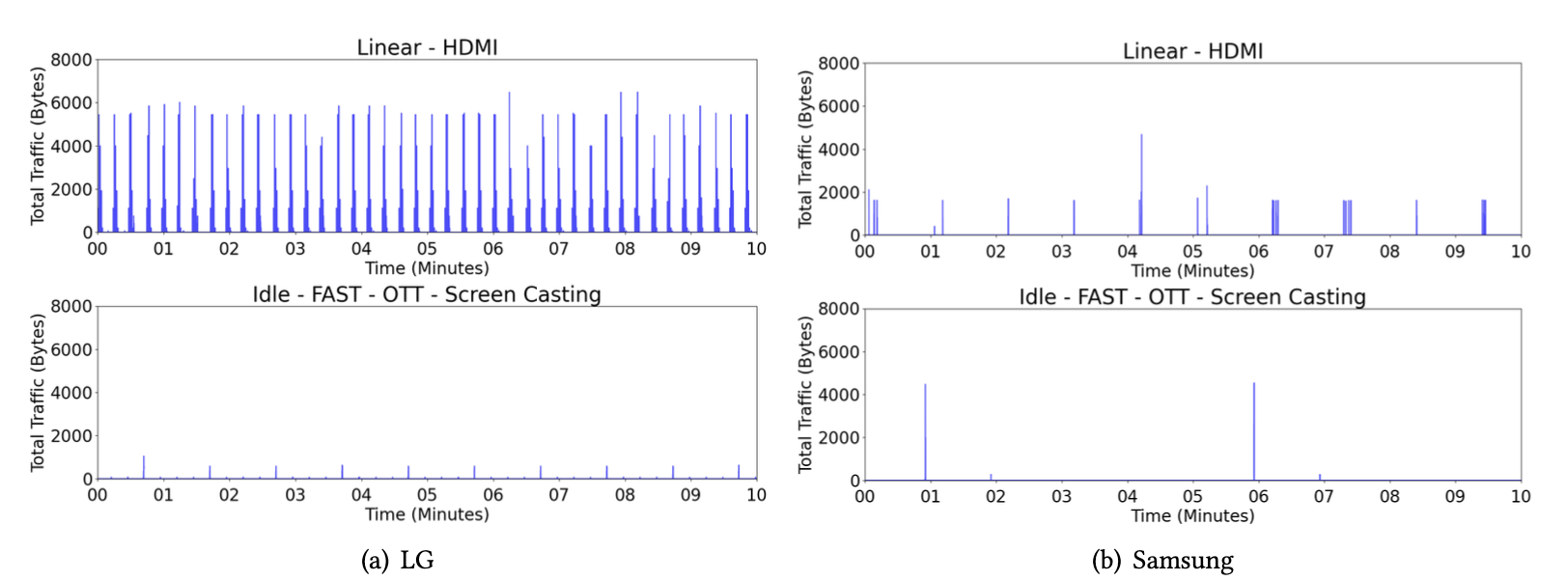

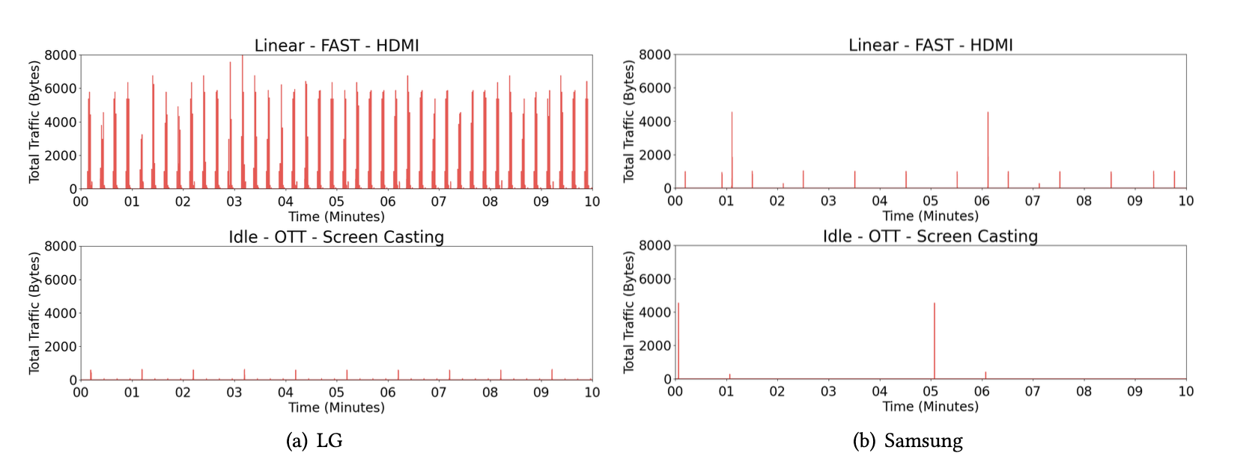
Results
(1) ACR operates even when it is used as a “dumb” display via HDMI; (2) opt-out mechanisms stop ACR traffic; (3) ACR works differently in the UK as compared to the US.

Slide 11
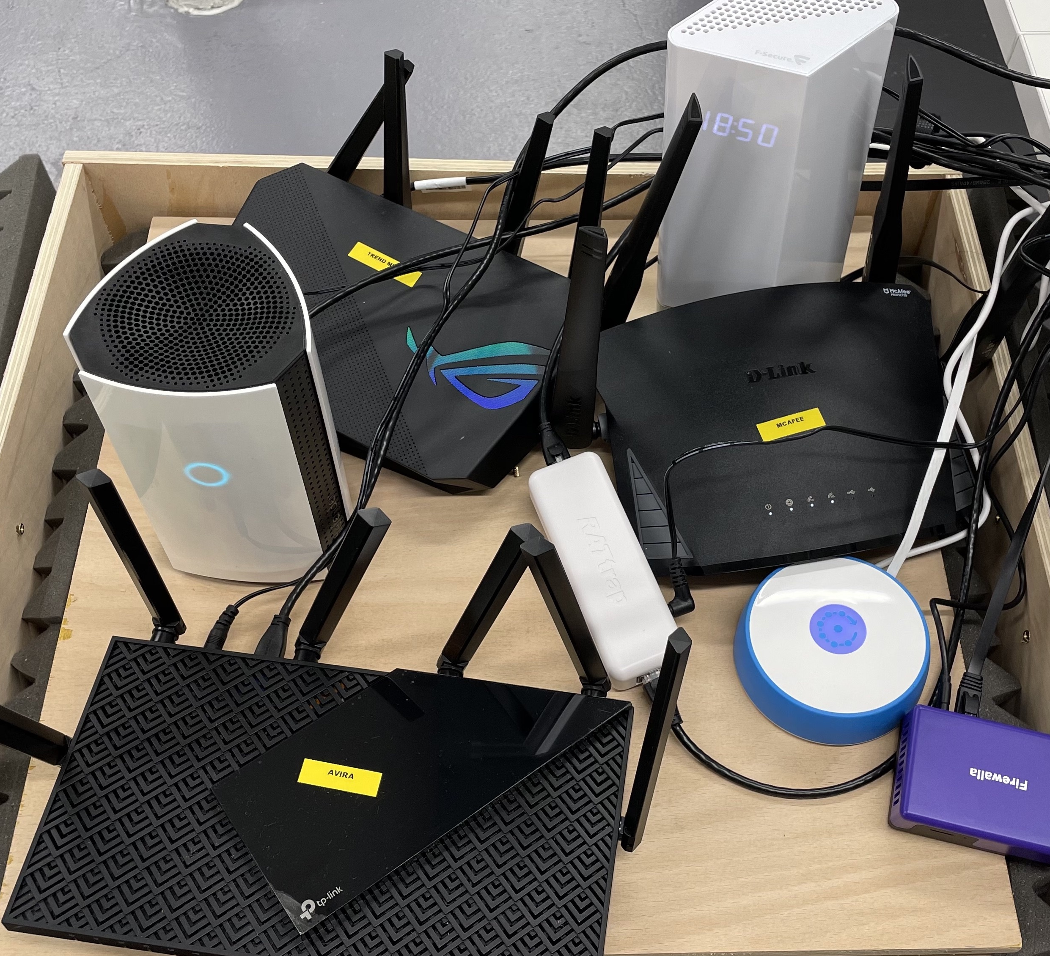
BENCHMARKING IOT PROTECTION SYSTEMS: SAFEGUARDS
Notes:
Recently, a number of commercial hardware routers have become commercially available claiming to protect against these threats.
We call them IoT safeguards.

Slide 12





Challenges for Measuring IoT Safeguards
Closed systems
Blackbox approach
Lack of automation and emulation tools
Lack of standard testbed
Difficult to automate the testing of commercial IoT safeguards
Difficult to perform IoT experiments and generalize
?
Our contribution: a large IoT testbed used to test IoT safeguards in real-world scenarios (software and data available online).
Notes:
However, the blackbox nature of the safeguards, the complicated nature of IoT devices, their associated apps and services, and lack of availability of IoT virus/malware databases, makes it challenging to independently and rigorously measure them.
The main challenge we overcome in this work is the creation of a methodology that enables us to automate the testing of commercial IoT safeguards for the first time.

Slide 13
Testbed
Notes:
In order to have a controlled environment for testing the safeguard, we build an IoT testbed.
The testbed consists of
a gateway that provides IP connectivity from the ISP to the safeguard and captures all the network traffic between the Internet and the safeguard;
the safeguard
An IoT bridge, which acts as a Layer-2 bridge bridging together the IoT-LAN interface of the safeguard with all the IoT devices
the IoT devices under test, We have hundreds of them.
an Android phone, connected to the LAN, with the companion apps of the safeguards installed, and controllable via the Android Debug Bridge at the gateway
threat scripts, run at the gateway and/or at the IoT bridge to execute IoT threat detection experiments.

Slide 14
Testing Threat Detection Capability
Security
Privacy
Threats
Anomalous behavior
Open Port
Weak Password
Device Quarantine
DoS attacks
Port/OS Scanning
Malicious Destinations
Threats
PII Exposure
Unencrypted Traffic
DNS over HTTPS
Safeguard Destinations # Cloud # and list of Support/3rd Parties
Safeguard Destinations # Cloud # and list of Support/3rd Parties
Notes:
To do so we create threat simulation scripts that are specific to each simulated threat to reproduce the threats that the safeguards claim to detect.
For example to emulate the behaviour of anomalous traffic we instruct the IoT bridge to simulate the traffic patterns of a smart camera that is uploading a video coming from a smart speaker of another brand.
We design a script for emulating privacy leakage. We use the IoT bridge capability of spoofing the Google Home device and inserting, using tcpreplay, some plaintext traffic that includes PII.

Slide 15
Threat Detection Experiments
Notes:
We use threat detection experiments to first simulate a threat, and then check whether such threat has been detected or not in a automated way.
Step 1: We execute the threat simulation script corresponding to the threat detection capability we want to test.
Step 2: We wait a fixed amount of time to give the safeguard enough time to detect the threat. We have empirically found that 20 minutes are enough since the longest time to detect a threat among all safeguards has been 3 minutes.
Step 3: We execute the threat detection script to determine whether the threat was detected by the safeguard under test. If the threat is detected in at least one iteration, we consider the detection capability satisfied.

Slide 16

Evaluation of Threat Detection Capability
 | Threat | Avira | Bitdefender | F-Secure | Fingbox | Firewalla | McAfee | RaTtrap | TrendMicro
Security | Anomaly ON/OFF | - | ✗ | ✗ | - | ✗ | ✗ | ✗ | -
 | Anomaly Traffic Pattern | - | ✗ | ✗ | - | ✗ | ✗ | ✗ | -
 | Abnormal Upload | - | ✗ | ✗ | - | ✗ | ✗ | ✗ | -
 | Open Port | ✗ | ✓(30s) | - | ✗ | ✓(30s) | ✗ | - | ✗
 | Weak Password | ✗ | ✗ | - | - | - | ✗ | - | ✗
 | Device Quarantine | - | ✓ | - | ✓ | ✓ | - | ✗ | -
 | SYN Flooding | ✗ | ✓(30s) | ✗ | - | ✓(40s) | ✗ | ✗ | ✗
 | UDP Flooding | ✗ | ✗ | ✗ | - | ✗ | ✗ | ✗ | ✗
 | DNS Flooding | ✗ | ✗ | ✗ | - | ✗ | ✗ | ✗ | ✗
 | HTTP Flooding | ✗ | ✓(3m) | ✗ | - | ✓(2m) | ✗ | ✗ | ✗
 | IP Fragmented Flood | ✗ | ✗ | ✗ | - | ✗ | ✗ | ✗ | ✗
 | Port Scanning | ✓(45s) | ✗ | ✗ | - | ✗ | - | ✗ | ✓(30s)
 | OS Scanning | ✓(45s) | ✗ | ✗ | - | ✗ | - | ✗ | ✗
 | Malicious Destinations | ✓ | ✓ | ✗ | - | ✓ | ✗ | ✗ | ✓
Privacy | PII Exposure | ✗ | ✗ | - | - | ✗ | - | - | -
 | Unencrypted Traffic | ✗ | ✗ | - | - | ✗ | - | - | -
 | DNS over HTTPS | ✗ | ✓ | - | - | ✓ | - | - | -
Time consistency
Take away: - only 3 out of 14 threats are detected by the safeguards. 3 out of 8 safeguards do not detect any threats at all, despite they claiming to do so in their specifications
- Some of safeguards take between 45 seconds and 3 minutes to detect a security threat.
Notes:
In general, we observe that the number of undetected threats tends to be larger than the number of the detected ones—on average, only 3 out of 14 threats are detected by the safeguards. 3 out of 8 safeguards do not detect any threats at all, despite they claiming to do so in their specifications.
Some of safeguards take between 45 seconds and 3 minutes to detect a security threat.
A key finding is that threats are not detected even when originating from the IoT device.
Moreover we repeat our experients over different periods of time, spread them in different months and we see that results do not change over time.

Slide 17
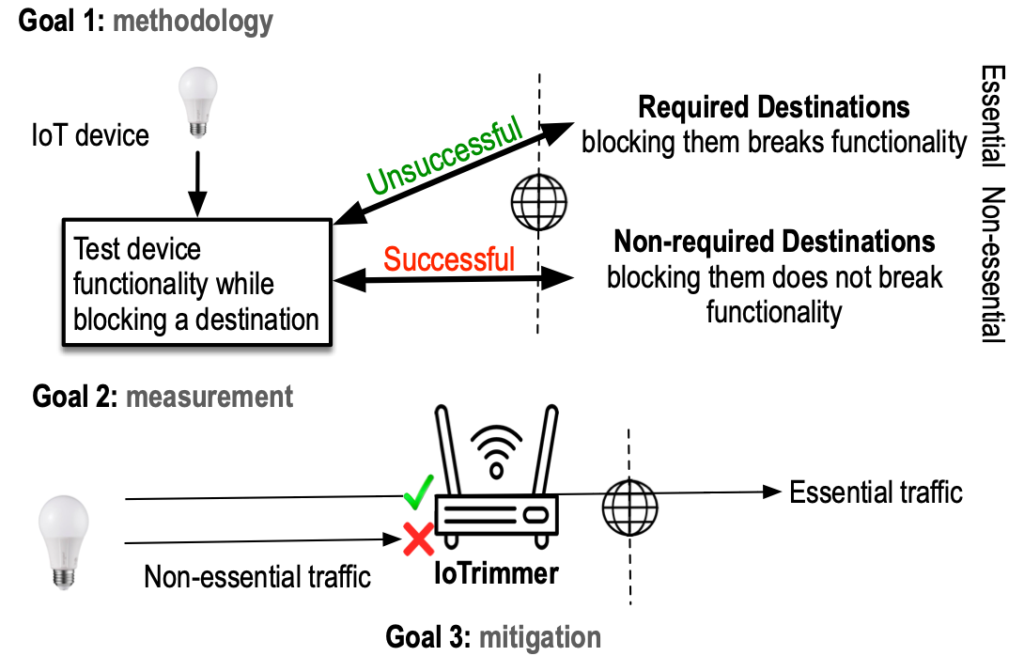
Solution at the Edge
/ Generalizable
/ Self adaptive
/ Accurate IoT blocker
Notes:
One of the critical steps that will enable this, is solutions at the edge and not only at home but also on our Internet service provider.
We need solution at the EDGE!, directly at people’s home and specifically for IoT devices.
We need an automated framework for detecting and isolating non-critical communications from IoT devices.
We are working on it and We called this IoTrimmer. In a way, Iotrimmer will works like a firewall or an ad-blocker for IoT devices that can be implemented on a home gateway
We start investigating this and we were able to block already 61% of destinations for 31 IoT devices without breaking the main functionality of the devices.
Iotrimmer will have a user interface where user can decide and control their privacy. Control will be back to the user.

Slide 18
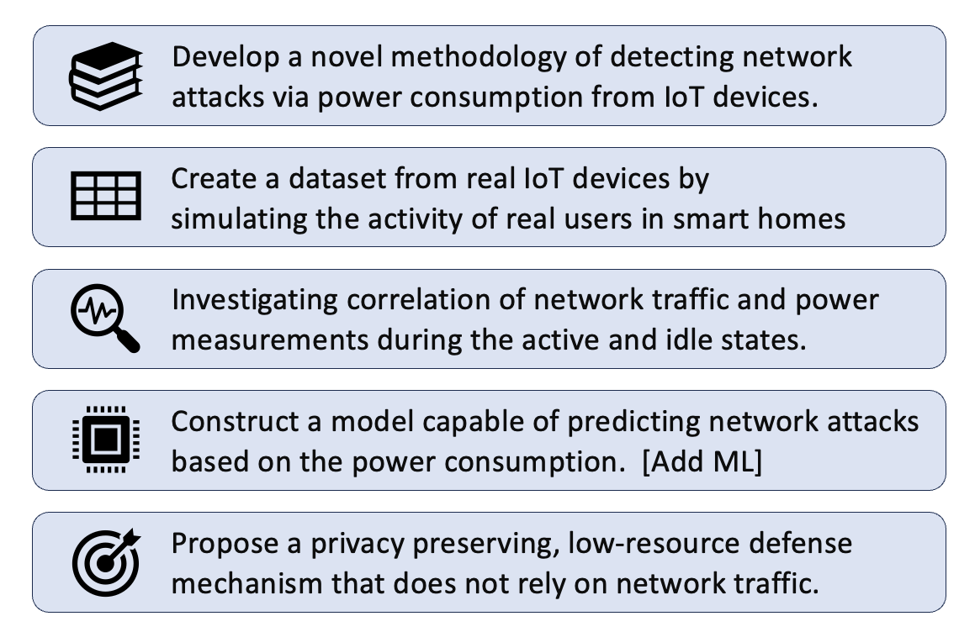
PowerGuard: An Intelligent Framework for the Identification of Network Attacks via Energy Consumption

Slide 19
PowerGuard : An Intelligent Framework for the Identification of Network Attacks via Energy Consumption

Slide 20
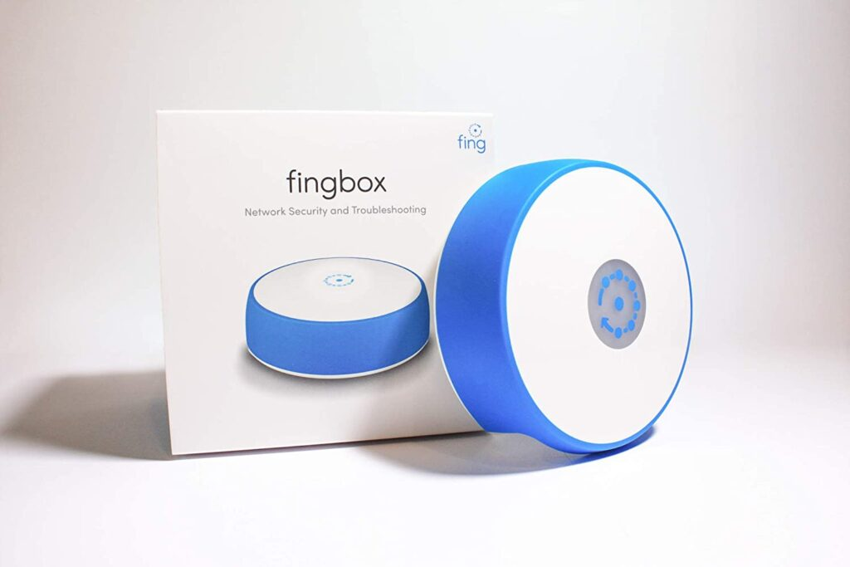
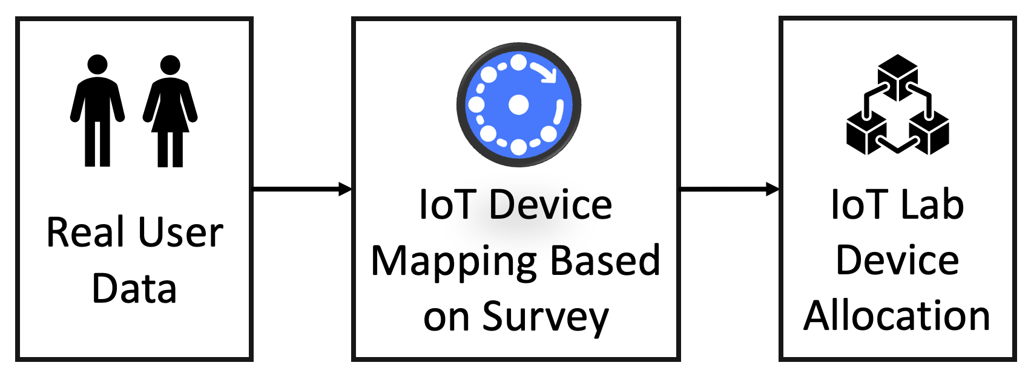
Data Collection Methodology

Slide 21
Experimental Setup

Slide 22
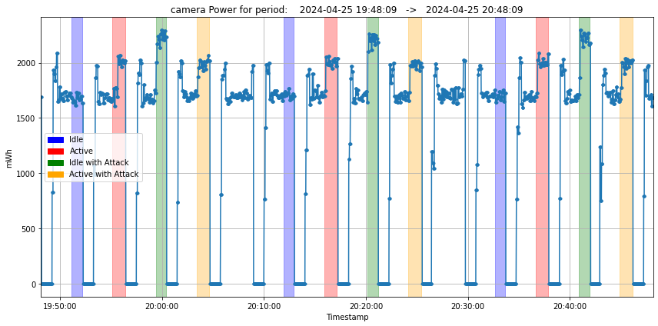
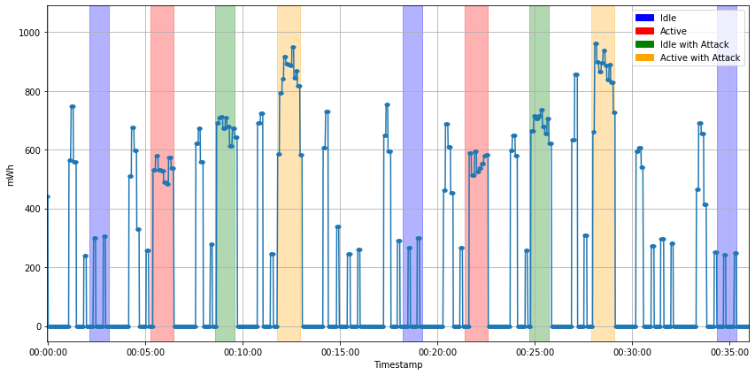
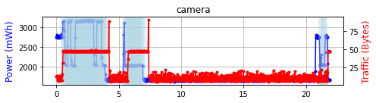
Results

Slide 23
COPSEC: Compliance-Oriented IoT Security and Privacy Evaluation Framework
Cybersecurity guidelines* such as ENISA, NIST, IoT Regulation Policy (UAE) have been released for improving IoT design practice
Privacy regulations** such as GDPR (in EU) and CCPA (in California)
There is a lack of understanding whether IoT devices comply with them
*NOT mandatory
**Mandatory

Slide 24

Motivation
In 2023 the Cyber Resilience Act (in EU) and the US Cyber Trust Mark (in US) make further step towards a certification program of smart devices
For consumer IoT devices, the certification process is thought as a self-assesment performed by the vendors themselves
Should we trust vendors?
Notes:
To be fair I have to mention that this year both Europe and US made a step forward to solve this issue by proposing a certification program of smart devices.
However, for consumer IoT devices the certification process is thought as a self-assesment performed by the vendors themselves. So the questions we ask ourselves is: shoul we trust vendors? Of course the vendors might deceive us by letting us believe that their devices are safe

Slide 25
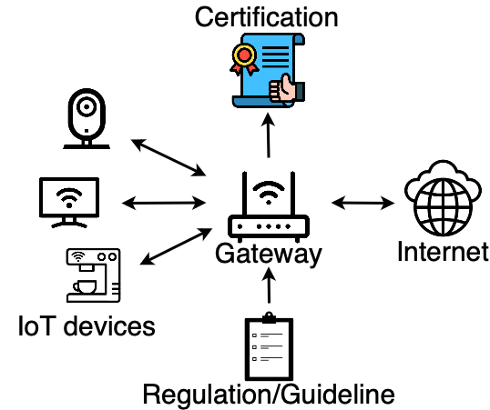
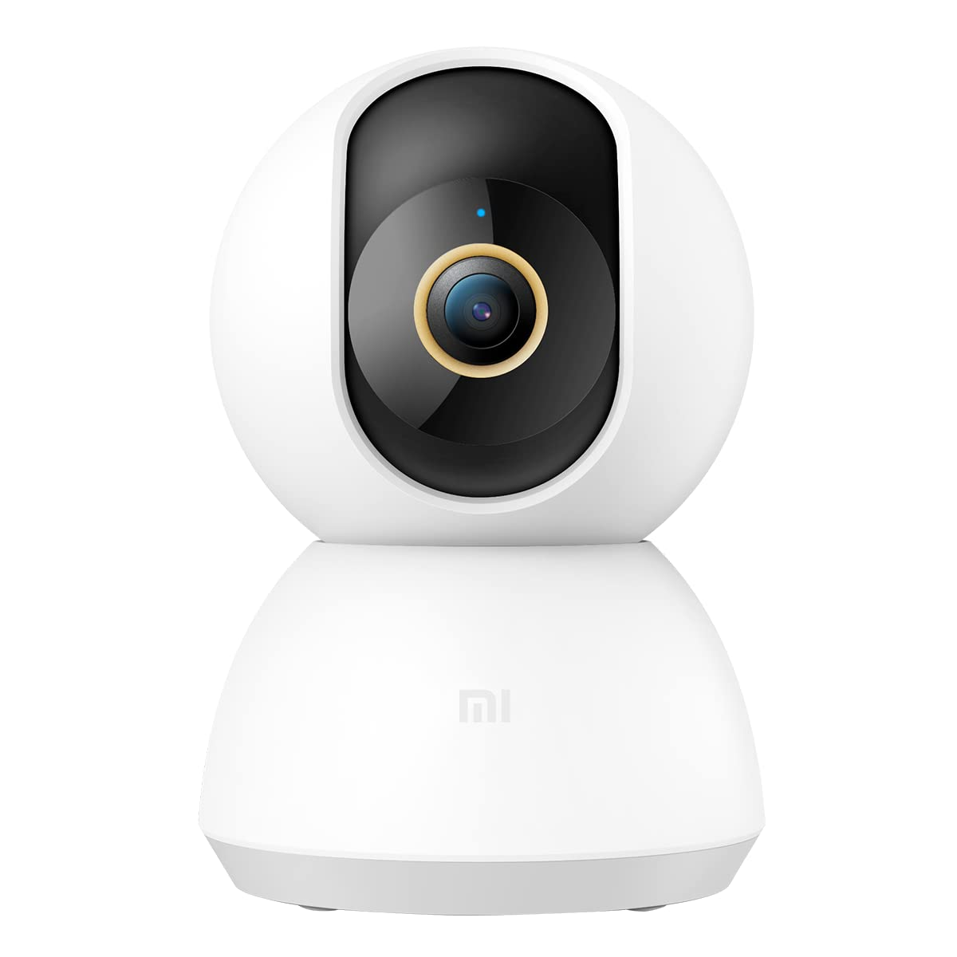
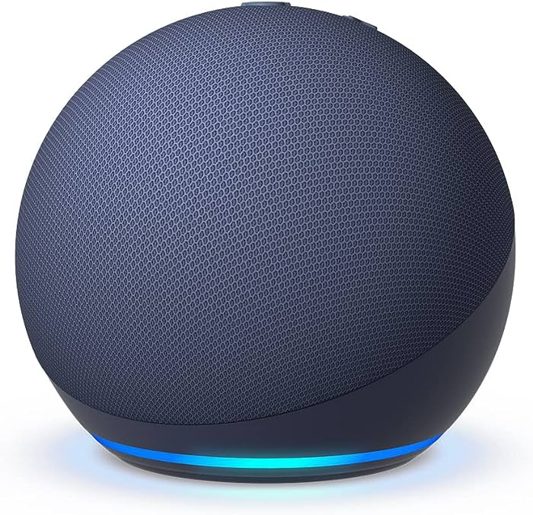
Methodology
Select security guidelines and
privacy regulations
v
Define experiments to test the extracted metrics on IoT devices
Produce a certification label for the tested device
Turn them into metrics
Notes:
Here, we report the methodology followed. First we select security guidelines and privacy regulations. Then these are turned into metrics. Subsequently, we desegned experiments to test the extracted metrics on IoT devices. Finally, from the results of the experiments we can produce a certification label for the device under test.

Slide 26


Results
Device | # of Unused Open Ports | # of Unrecognized Protocols | Compliant with GDPR Art. 32 (a)
Bose Speaker | (11 ports) | (0 protocols)
Echo Dot 5 | (5 ports) | (3 protocols)
Furbo Dog Camera | (0 ports) | (1 protocol)
Google Nest Cam | (3 ports) | (1 protocol)
Govee lights | (0 ports) | (0 protocols)
Ring Video Doorbell | (0 ports) | (2 protocols)
Sensibo Sky Sensor | (0 ports) | (0 protocols)
SimpliSafe Cam | (1 ports) | (0 protocols)
Sonos One | (5 ports) | (1 protocol) | (mac in the clear)
WeeKett Kettle | (1 ports) | (2 protocols)
Notes:
Here we report the results of our preliminary experiments. Our results show several non-compliance. Indeed we can see that more that one half of the devices expose ports which are not used, or adopt non standard protocols. Concerning the selected privacy rule, we can see that the Sonos One (which is a smart speaker) shows a non-compliant behaviour since the mac address of the device is exposed in the clear when the device communicates with the cloud.

Slide 27
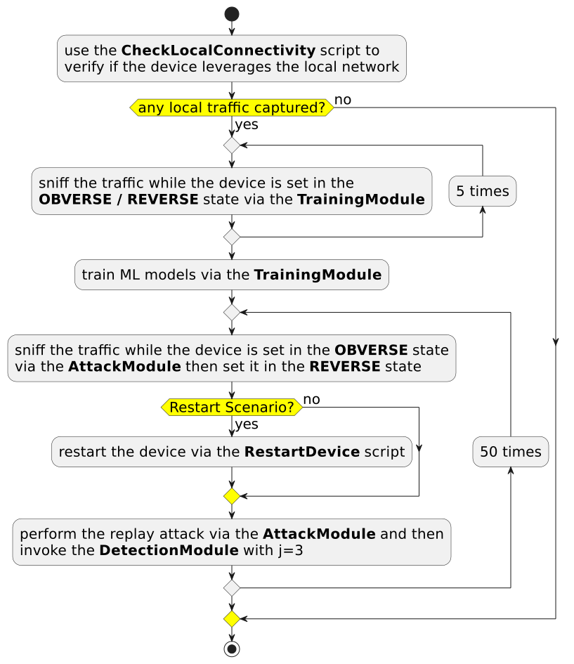
Using ML for inferring IoT behavior

Slide 28
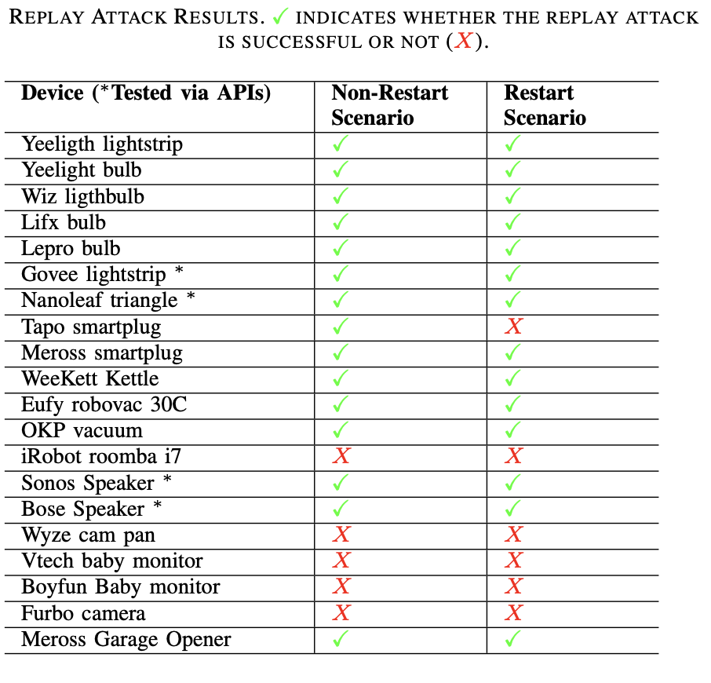
Results

Slide 29
Federated IoT Testbed
Testbed 1
Testbed 2
Control Server
User Portal
IoT devices/Compute Nodes
Networking and Storage
Testbed 3
Experimentation Support
Artifact Libraries

Slide 30
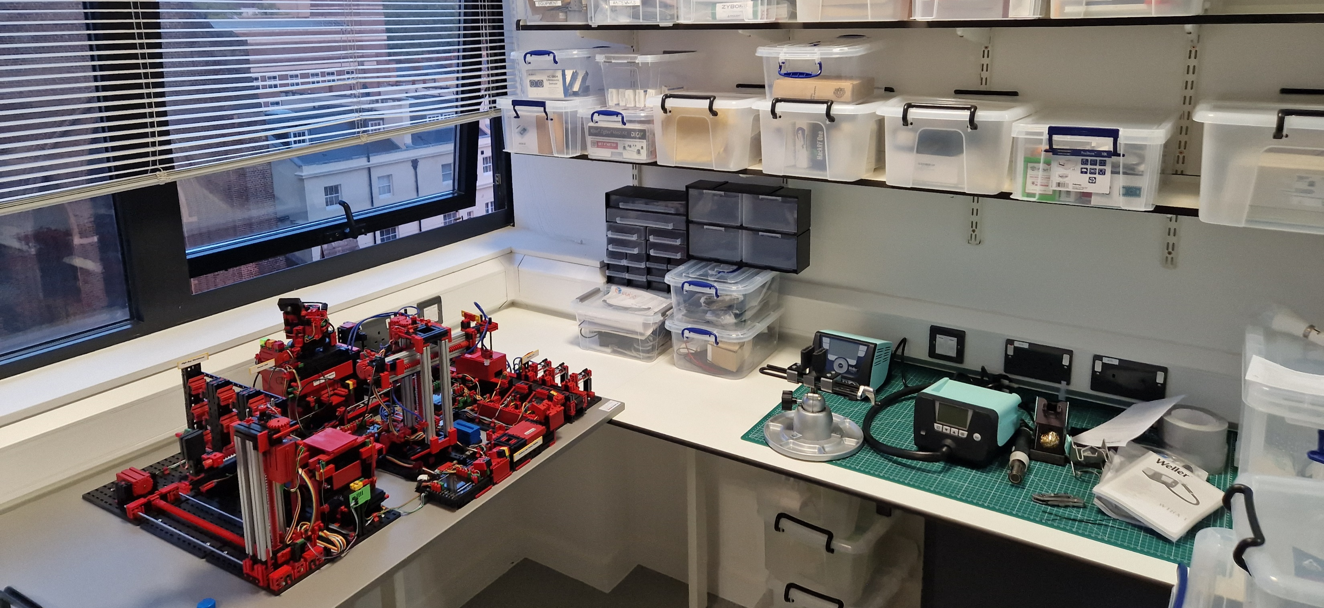
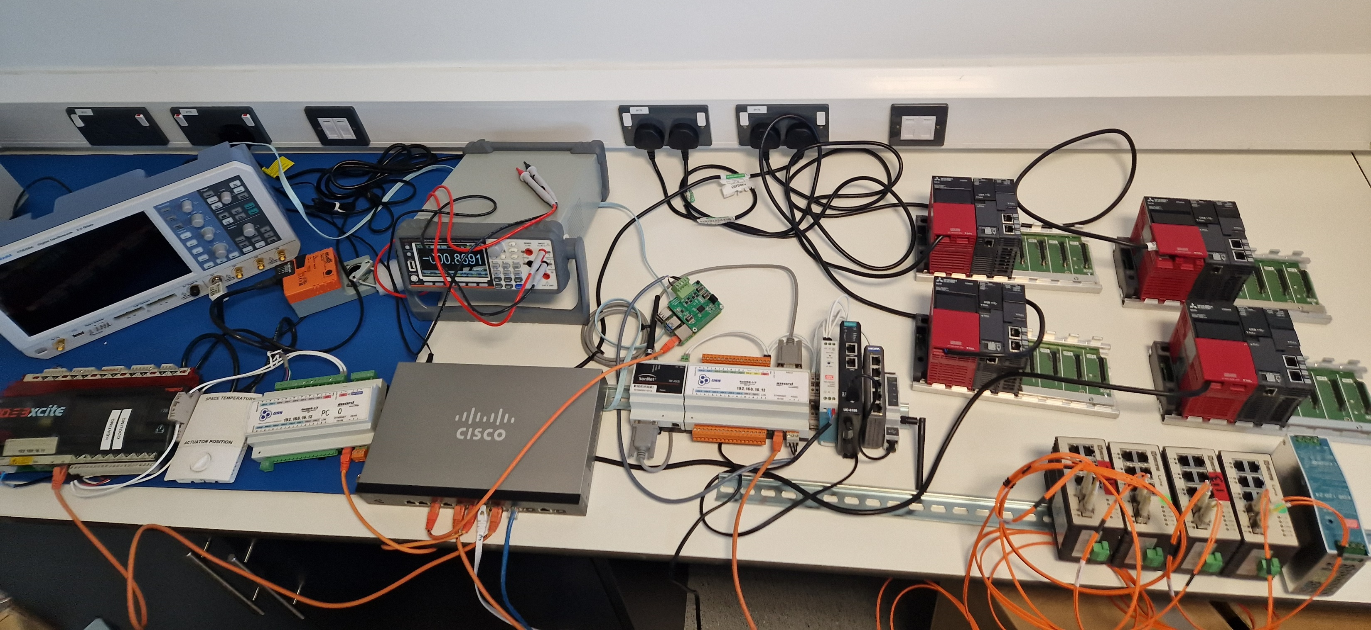
Operational Technology Lab
A new lab is been built at UCL (Lead by: Nilufer Tuptuk, Department of Security and Crime Science)
The lab will have testbeds related to manufacturing, water-treatment and building management systems.
The space will be used for security research and teaching.
  EPSRC Centre for Doctoral Training in Cyber-Physical Risk

Slide 31
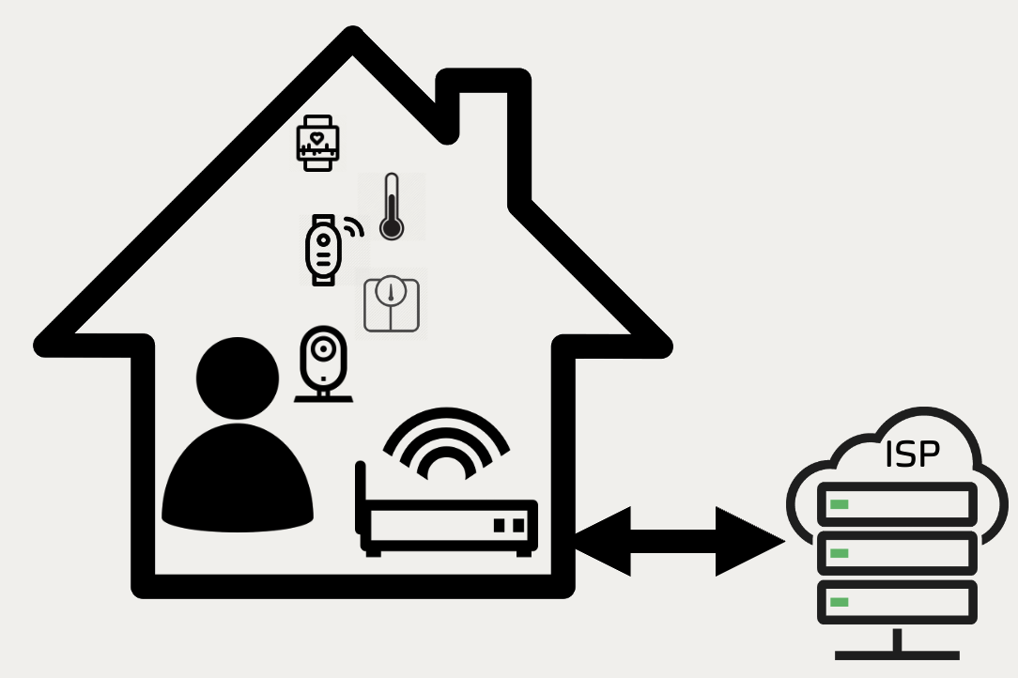










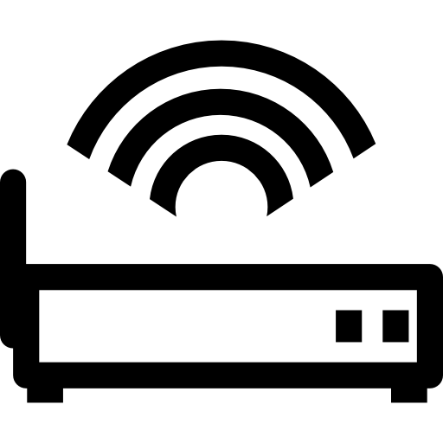

Federated IoT Testbed Use Case
INTERNET
Interconnectivity
Awareness, Authentication & Management
Trust
Interconnectivity
ISP
EDGE

Slide 32
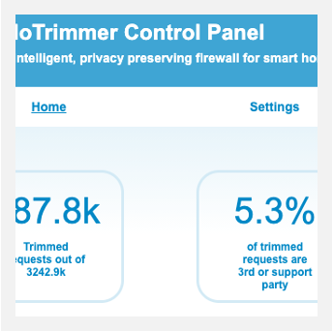
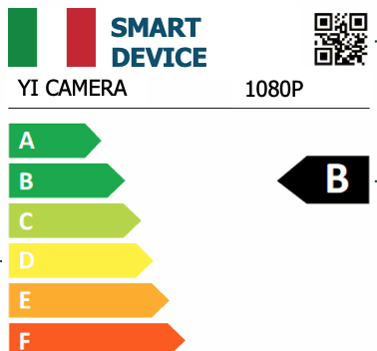
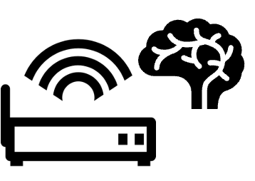
What’s Next?
Privacy Preserving IoT Security Management
• Real industrial gateway
• Medical IoT Devices
• Real-world trial
Mitigation
Real deployment and evaluation
Third party certification
Privacy and Security Label/Certification
Privacy and security by default
Shared Database privacy and security vulnerabilities of IoT
Notes:
How? in the next few years I will focus on understanding of real-world threats and driving secure system design. I will develop privacy-preserving systems using access networking tools, machine learning and binary code instrumentation to detect data leakage in real time for more sensitive devices like medical devices and wearable.
In the near term I’ll work with the NHS for enhancing privacy preserving techniques for medical IoT Devices.
In the long term I am planing to spin out my startup and provide concrete solutions to ISP, but also work closely with governments for adopting privacy labels.

Slide 33



Follow us
Twitter: @iotrim @ammandalari
https://www.youtube.com/watch?v=0fg0acuRbUA
annamandalari.com
Notes:
So here you have my links with my email and the details of our Sysal lab.
Get in touch with me, if you want to know more about our research.
Many thanks for your attention. I am happy to answer any question you may have.

