Slide 1
Role of Probabilistic Models in Designing Cyber-Resilient Safety-Critical Systems
Peter Popov, Aria Kosari
City, University of London, United Kingdom
12th September 2024

Slide 2
Talk outline
Overview of Safety Assessment/Assurance of Autonomous Vehicles (AV) and Motivation
  Safety cases: a brief introduction of the concept and of the history which led to adoption
An approach to safety assessment of AV based on road hazards
  Road hazards
  Operational Design Domain (ODD)
  Modelling the imperfection of AV perception (of road hazards) and of safety monitors and their effects on AV safety
  “Driving to safety” and related work
Probabilistic model of AV safety in the presence of road hazards and perception failures
  The studies (in collaboration with Intel Labs, Germany)
    A basic model of road hazards (published at ITSE’2022 in partnership with Intel Labs)
    A model of road Intersection (work in progress, close to completion)
  Findings and next steps
“Driving to safety” and accounting for ODD
  The model by RAND corporation
  “conservative Bayesian inference” with a black-box safety model
  Fixing the weakness of “black-box” models
Conclusions and future work

Slide 3
General approach to AV Safety assurance
Claim “safety risk with an AV is tolerable”
Assurance case to explain and justify decision
Explanation of decision based on Claim, Arguments and Evidence (CAE)
Assurance 2.0
Risk communication models:
Trade-offs, Decision support
“Evidence” from models (e.g., results from solving stochastic models)
Stochastic Models of an AV
Model of System architecture
(including safety mechanisms)
Models of perception (ML based)
Models of planning (ML based)
More detailed CAE case
Assurance case to justify trust in models
Models of the environment
Operational Design Domain (ODD)
External Hazards
…
Evidence from empirical studies
Evidence from simulations (e.g., CARLA, etc.)

Slide 4
But what is Safety (Assurance) Case
Informally:
A structured argument about assurance
Most common application—safety cases.
  Developed in the UK first
  Widely used in US and Europe
  Mandatory in many industries
    British Ministry of Defense for weapons systems
    Nuclear Industry in the UK.
    Adopted for (C)AV
  Core of British Defense Standard 00-56
Yet to become widely adopted for security
Applied outside the domain of computer systems, e.g., Yucca mountain nuclear waste repository, etc.

Slide 5
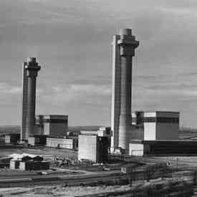
Windscale (U.K.), 1957
Fire in reactor #1 resulted in radiation discharge.
Improper fire-fighting caused 2nd discharge.
32 deaths, 260 cancer cases from radiation.
Poor plant design & procedures prompted safety case regime for nuclear industry.
Windscale reactors 1 & 2 circa 1950

Slide 6
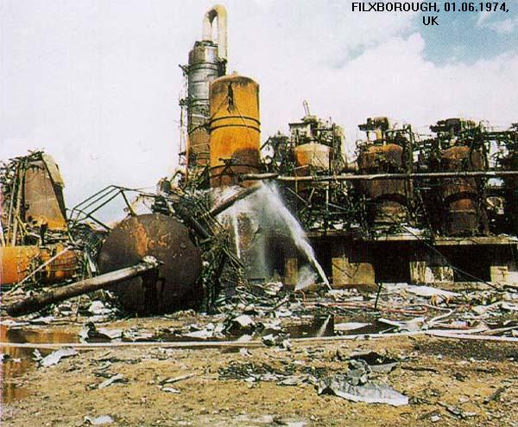
Flixborough (U.K.), 1974
Explosion at chemical plant following pipe rupture (maintenance error)
28 killed, 36 injured
Rupture attributed to nearby fire
Incident prompted safety case regime for chemical industry
Damage to the plant after the explosion

Slide 7
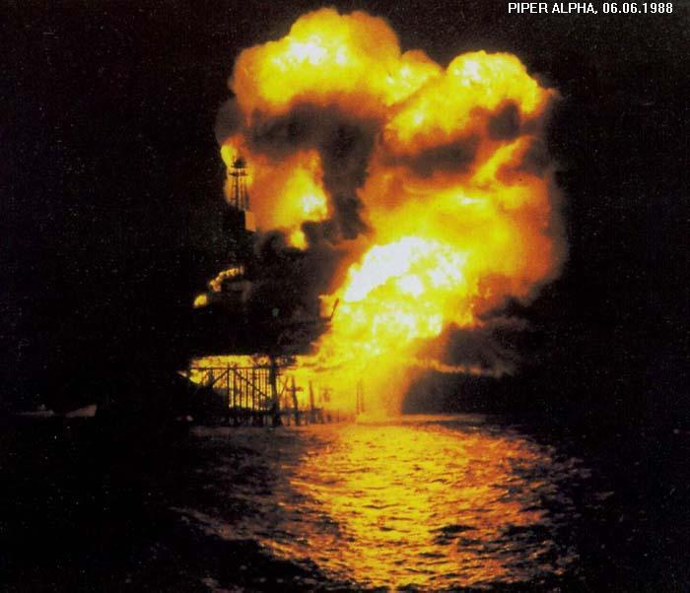
Piper Alpha (U.K.), 1988
Gas explosion & subsequent oil fire at offshore drill
167 killed, 62 rescued
Maintenance errors, poor evacuation cited
Cullen report established ALARP
Safety case regulations introduced for off-shore industry 1992
Piper Alpha rig ablaze after the explosion

Slide 8
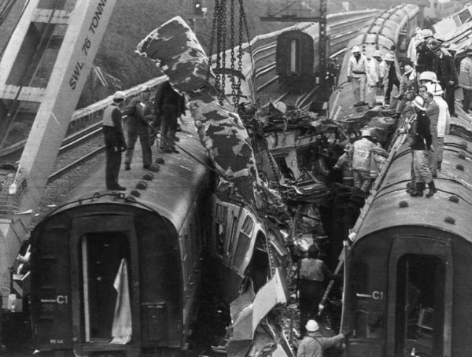
Clapham (U.K.), 1988
Signal failure causes three commuter trains to collide.
35 killed, 100 injured
Maintenance introduced wiring fault in signal box.
Public enquiry
Railway safety case regulations introduced in 1994
Wreckage from the 3-train collision

Slide 9
U.K. Defence Standard 00-56
Ministry of Defence Defence Standard 00-56, Issue 4, 2007
Replaces prior 00-55 and 00-56
Switch from prescribed processes to safety cases
Explicit Switch

Slide 10
The Safety Case
“…comprehensive and defensible argument that a system is acceptably safe to operate in a particular context.” [T. Kelly]
The safety case communicates:
  High-level safety objectives
  Evidence that objectives have been met
  Argument linking evidence to objectives
  Assumptions, justifications, and other context
Does it always communicate:
  Accurately?
  Completely?

Slide 11
The Big Picture: Claim – Argument – Evidence (CAE) framework
Claim
Argument
Evidence

Slide 12
General approach to Safety Assurance
Assurance case, e.g. based on the CAE framework:
  Top claim: e.g. “An AV in its Operational Design Domain (ODD) is safe enough”
  Assurance 2.0 (Bloomfield and Rushby) gives more prominence in Safety Assurance to (probabilistic) models (see R. Bloomfield and J. Rushby Assurance 2.0: A Manifesto. 2020, arXiv:2004.10474v2 [cs.SE] 9 June 2020.).
    Keeps the structure of traditional assurance cases
    Strengthens focus on evidence and reasoning
    Brings assurance thinking forward within life-cycle
      makes it clear what must be done and makes you do it earlier
    Supports assurance with known best practices
      reduce the bewildering choice of free form cases with “pre-validated” blocks or templates
    Probabilistic models allow us to deal with various sources of uncertainty which affect AV safety.
      Including the “unknown Unknown” (malicious actors, legislation, etc.) also cause difficulties.

Slide 13
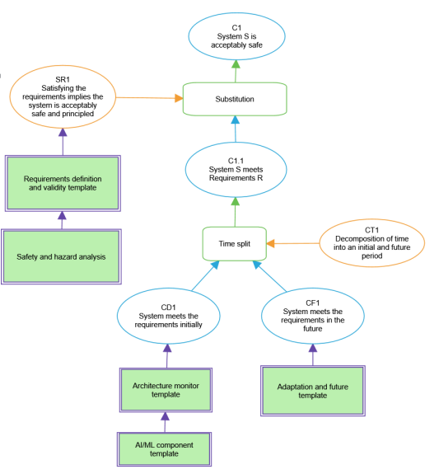
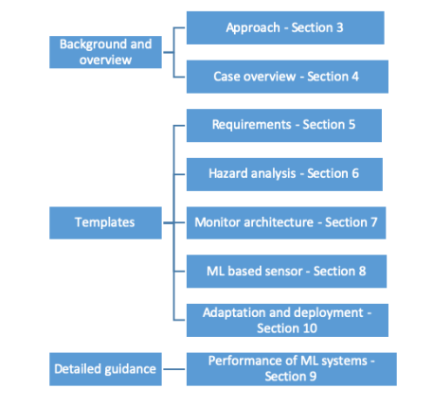
Assurance 2.0 : TEMPATES for Autonomous Vehicles

Slide 14
Assurance via compliance with standards
Safety Assurance of AV is a challenging task.
Standards address some of the concerns:
  ISO 21448 “Safety of the Intended Functionality (SOTIF)”
  ISO 26262 Series of Standards (“Road Vehicles – Functional Safety”)
    Does not deal with an AV as a system and only look at “E/E components” (i.e., its parts).
  National Guidelines, e.g., in Germany, in the US, in the UK, etc.
  ANSI UL4600 “Evaluation of Autonomous Products” (https://webstore.ansi.org/standards/ul/ul4600ed2023)
    The standard itself adopts the “Safety cases” approach to assurance.

Slide 15
Alternative methods of demonstrating safety
Empirical methods
  “Driving to safety”, proposed by researchers from RAND Corporation and further extended by colleagues at City
    Fundamentally: makes Bayesian predictions from operational data that AV is “safe enough”
    Weymo, the AV vendor owned by Alphabet (the Google’s parent company), have reported that their fleet of AVs have driven 7+ million miles already.
  Mobileye’s concept of “Responsibility-Sensitive Safety (RSS)” (https://www.mobileye.com/technology/responsibility-sensitive-safety/) has attracted serious interest in industry and in academia.
    Essentially, RSS defines a set of deterministic rules (using physics laws and geometry), which if followed by all participants in the road traffic should eliminate crashes (or at least allow for the “blame” for accidents to be decided more easily than is possible currently).
  Scenario – based testing of AV (adopted in an EU Directive on safety assessment).
  Many other alternative ways of arguing AV safety exist, too.
The problem that this talk addresses is:
How can one demonstrate that an AV is safe enough to participate in regular traffic (i.e., to be certified as “safe” for use on the public roads)?

Slide 16
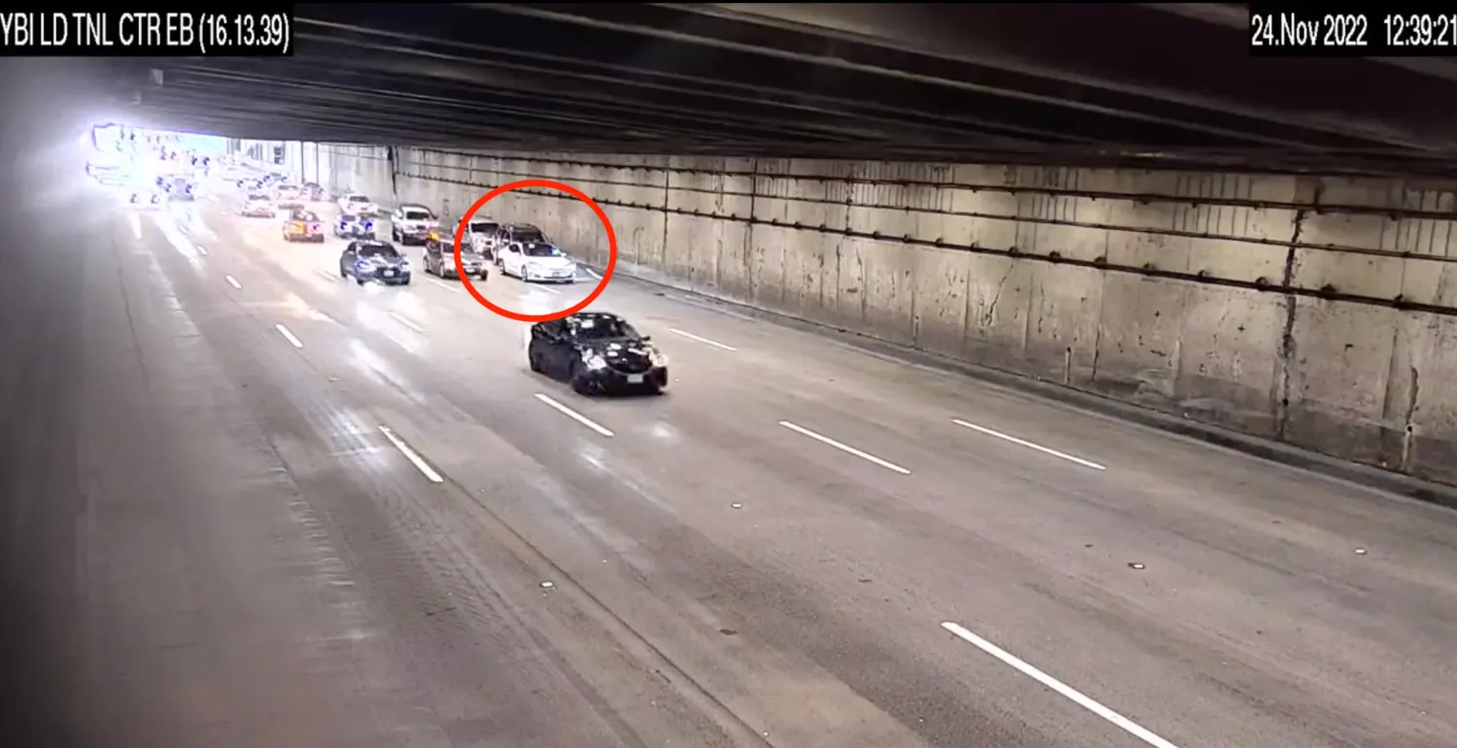
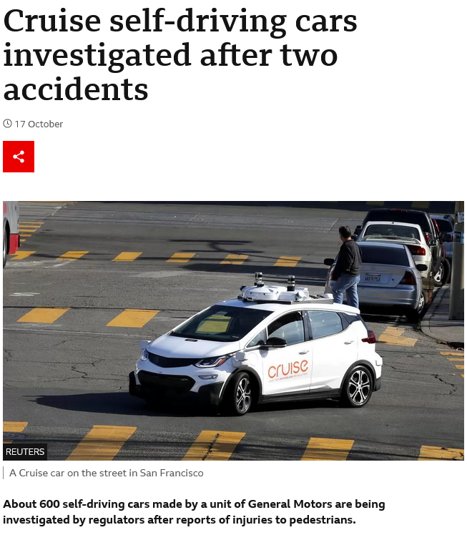
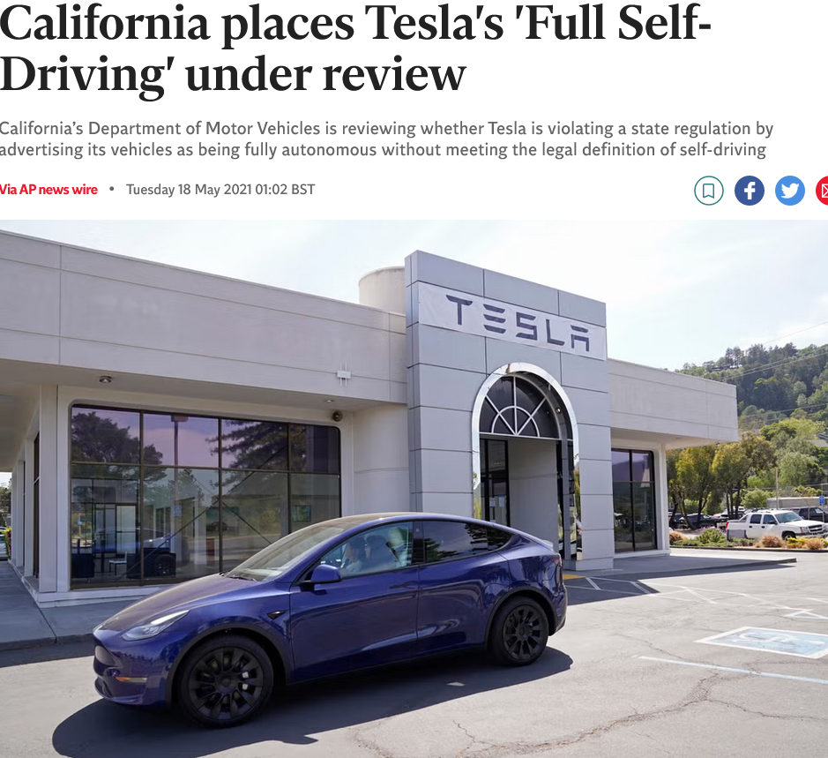
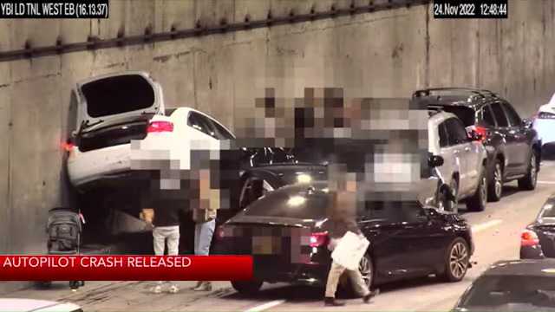
Is the problem of AV safety assurance real?
A few examples of AV failures
Tesla vehicle crashes in a tunnel:
  https://uk.video.search.yahoo.com/yhs/search?fr=yhs-tro-freshy&ei=UTF-8&hsimp=yhs-freshy&hspart=tro&p=tesla+collision+in+a+tunnel&type=Y219_F163_204671_102220#id=5&vid=e2162240e6eba0c9a122d7dd565d619e&action=view
In the news:

Slide 17
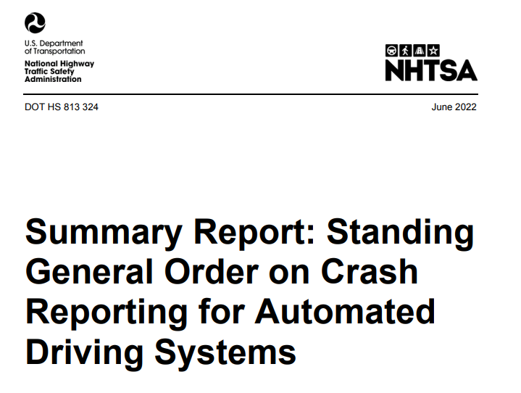
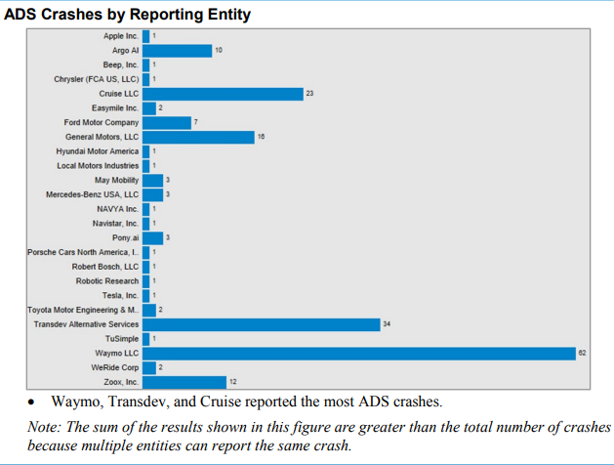
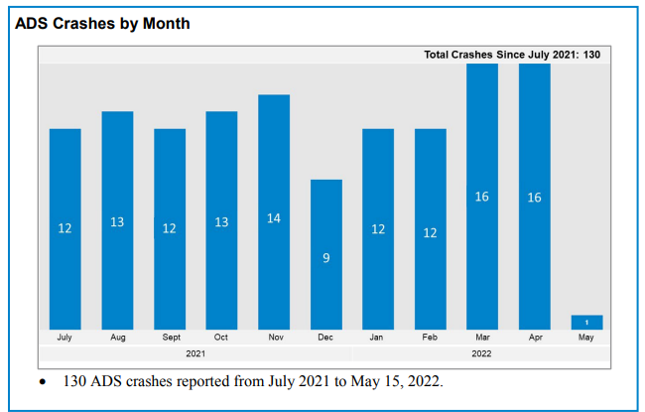
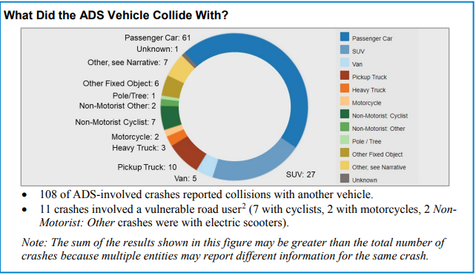
Statistics on crashes with AVs (source: NHTSA in US)
NHTSA (the National Highway Traffic Safety Administration) of the United States is responsible for collecting data and reporting on crashes of different vehicles (man driven and vehicles with different degrees of autonomy).
  SAE J3016 “Taxonomy and Definitions for Terms Related to Driving Automation Systems for On-Road Motor Vehicles,” April 2021 defines the different degrees of autonomy.
Standing General Order is the NHTSA initiative on safety of AVs.
  The report from June 2022 provides details on the crashes with vehicles equipped with ADS (Automated Driving Systems).
    130 accidents (crashes) recorded within a year.
Vehicles with an automated driving system (ADS), which some refer to as "self-driving" cars, are a future technology – not a technology you’re able to purchase and use today.
Source NHTSA: https://www.nhtsa.gov/technology-innovation/automated-vehicles-safety

Slide 18

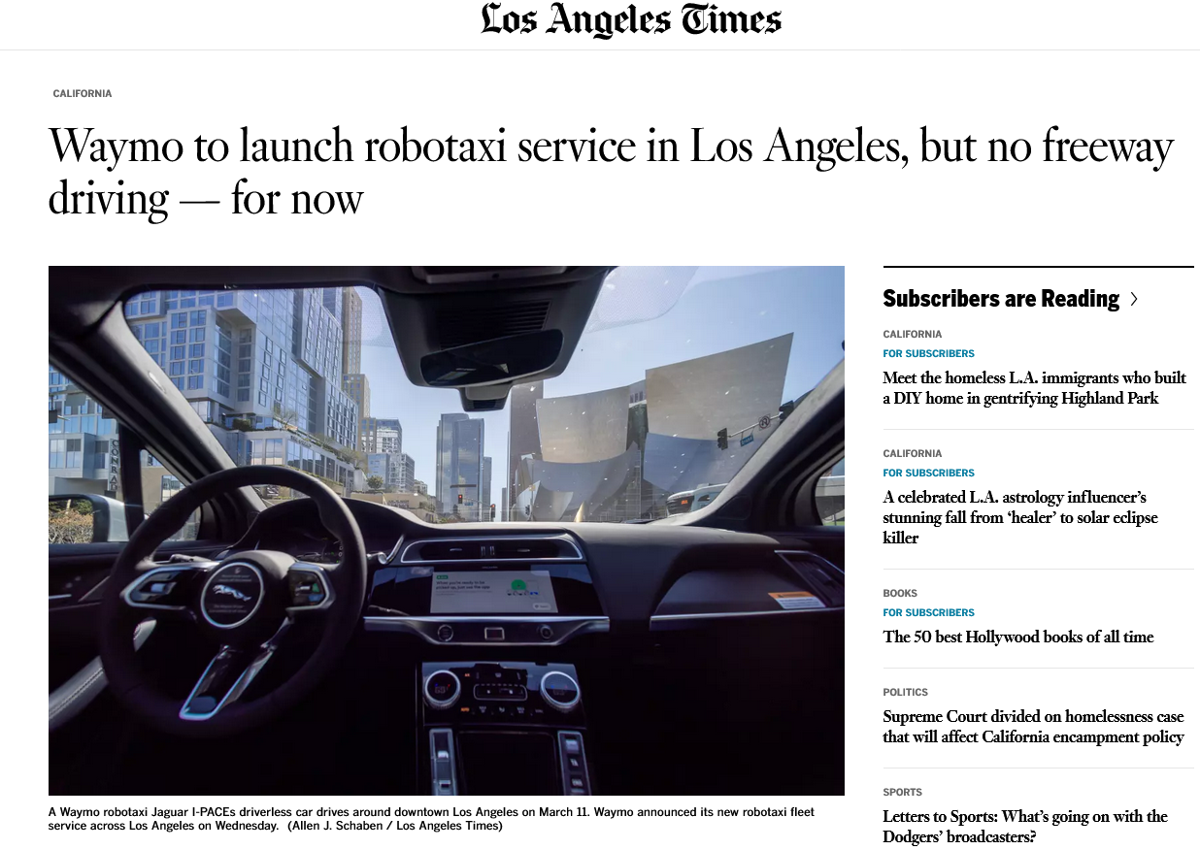
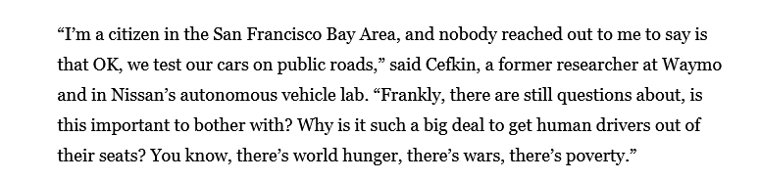
Weymo’s Robotaxi

Slide 19
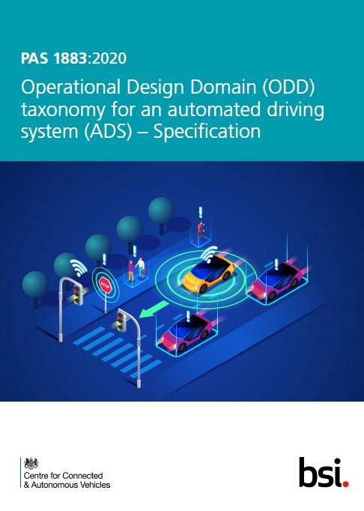
Operational Design Domain (ODD) definitions
PAS 1883 (a UK standard)
  operating conditions under which a given driving automation system or feature thereof is specifically designed to function
  This includes, but is not limited to:
    environmental,
    geographical,
    time-of-day restrictions,
    and/or the requisite presence or absence of certain traffic or roadway characteristics.
  PAS defines a set of attributes which can/should be used to define the ODD.
  The definition is taken verbatim from SAE J3016 (2018)
  ODD fundamentally constrains the scope of a claim that an AV is safe enough.
  A claim of safe operation in ANY condition is unjustifiable. Justifying a safety claim for a given ODD, however, is feasible.

Slide 20
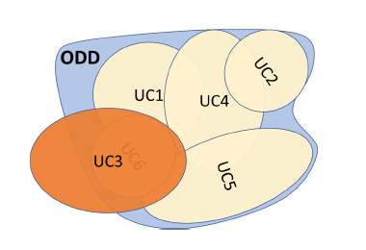
Modelling ODD (i.e., the operational environment)
  SAE’s view
  “The term ODD defines all conceivable overlapping conditions, use cases, restrictions and scenarios that an AV might encounter, even the most esoteric edge cases”.
  Common ODD factors are:
    time of day,
    weather,
    terrain and
    road features.
  But the list of ODD affecting factors gets very long, very fast
  see P. Koopman, How Safe Is Safe Enough?: Measuring and Predicting Autonomous Vehicle Safety. 2022: Independently published.

Slide 21
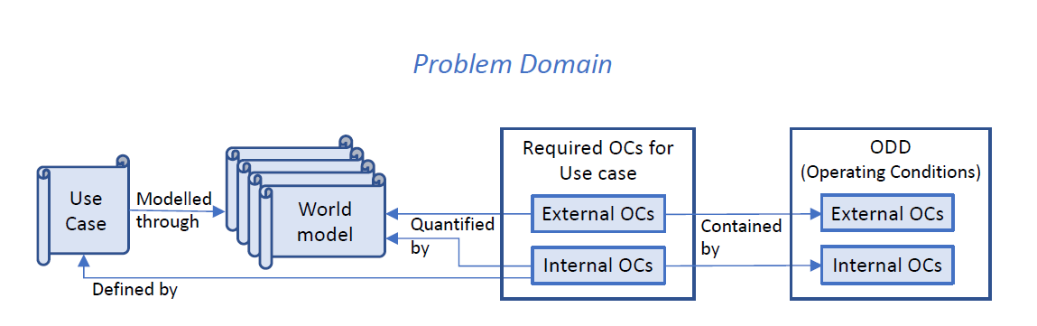
Modelling ODD (i.e., the operational environment)
  ODD as a collection of use cases (UC)
  Use Cases (UC) are seen as a collection of internal and external Operating Conditions (OCs).
Gyllenhammar, M, et al. “Towards an Operational Design Domain That Supports the Safety Argumentation of an Automated Driving System.
HAL Id: hal-02456077, https://hal.archives-ouvertes.fr/hal-02456077

Slide 22
Modelling ODD as a stochastic state-machine
A particular ODD can be characterised by a set of states of the operational environment, which characterise the operating conditions (OC).
An AV trip then can be characterised by a trajectory via the states:
      Sojourn time in an OC would be a random variable
      Moving from a state (i.e., a particular OC) to another is a random process.
      Different trips will be instances of the random process.
The process can be characterised differently:
      a Continuous Time Markov Chain
      Semi-Markov process (sojourn time in states may have an arbitrary probability distribution),
      Constructed from collected empirical data (datasets exist, which allow for such model construction, e.g., the highD dataset, referred to later in talk)
      Etc.
Some of the trips will fall within the ODD, some will violate the ODD.
      Detection of “out of ODD” is a serious technical problem.
OC₁
OC₂
OC₃
OC_{n}

Slide 23
Probabilistic Models for AV Safety Assessment

Slide 24
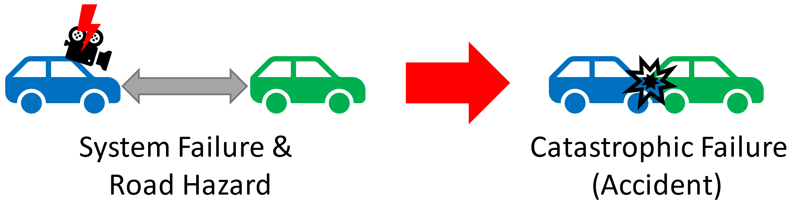
Approach to safety: Road Hazards
The view taken in the studies, presented in this talk, is that accidents are a consequence of road hazards.
  Accidents on the road are much less likely without road hazards than with road hazards.
  The AV perception system may detect hazards correctly or may fail to detect them. The presented studies look at several distinct failure modes:
    Overlooking a road hazard when it occurs. Hazard may be detected with a delay.
    “Safety monitors”, meant to guarantee AV safety may themselves fail.
    “False alarms” – flagging a situation on the road as hazardous while there is no hazard. These create hazards for the other AVs and vehicles with drivers.
We study how these failure modes impact the AV safety.
This view emphasises the importance of hazards. Traditional “functional safety” focusses on developing mechanisms to counter hazards and keep the process (chemical plan, nuclear plant, etc.) withing acceptable boundaries. Making the safety mechanisms fault-tolerant (e.g., using defence in depth) is an essential part of functional safety.

Slide 25
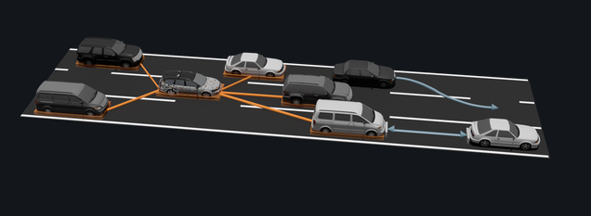
Modelling road Hazards
An AV trajectory
External (exogenous) hazards can occur on the road
  ISO 26262 suggests that these are modelled by their:
    Rate of hazard occurrence
    Duration of hazard being present on the road (i.e., hazard length in time)
We capture road hazards using a stochastic state machine.
  We then consider the implications of AV components failures which occur simultaneously with hazards.
Hazard length
Operating Condition
In this work we use probabilistic models to study the implications of AV perception system failures and failures of safety monitors on AV safety in the presence of road hazards.

Slide 26
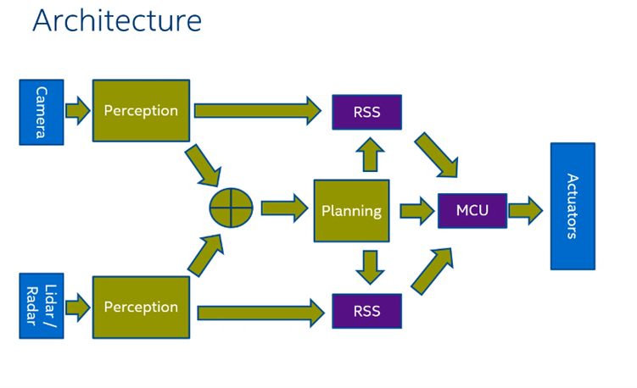
Study 1: A Basic model of Road Hazards
Operates at a relatively high level of abstraction
Does not discriminate between different types of road hazards (e.g., due too bad weather, or extreme congestion, etc.)
Accounts for:
  Failures of perception system such as overlooking manoeuvres by other vehicles on the road
    This failure may be temporal
    Rate of accident when a road hazard is overlooked is likely larger than if the hazard is detected on time.
  Failures of “safety monitors”.
  False alarms, which may also cause accidents by “surprising” other participants in the road traffic.
  https://ieeexplore.ieee.org/document/9922283

Slide 27
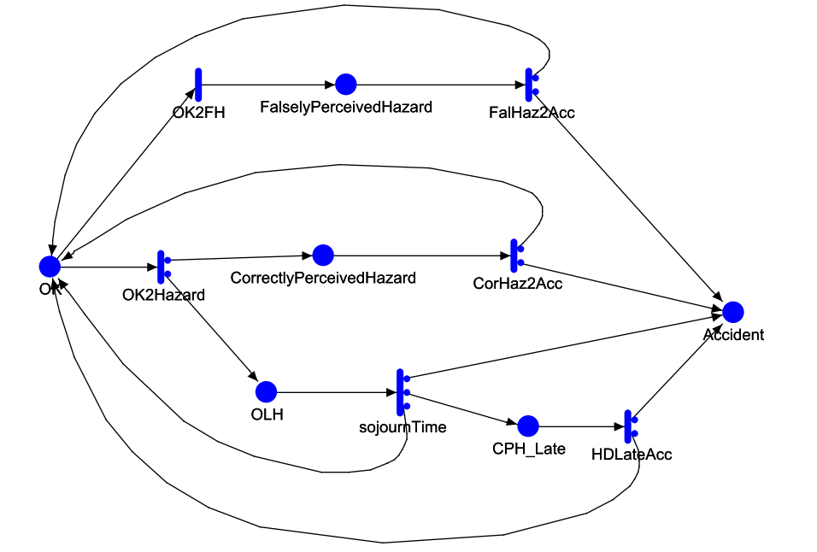
The probabilistic state-based model
The formalism of stochastic activity networks (SAN) is used to model AV safety in the presence of road hazards and failures of AV perception and safety monitors:
  The states of an AV in the model are:
    Normal (OK)
    FalselyPercievedHazard
    CorrectlyPercievedHazard
    OLH (OverlookedHazard)
    CPH_Late (CorrectlyPercievedHazard_Late)
    Accident (an absorbing state)
  Transitions between states are driven by timed activities.
    We assume (for convenience) exponential distributions for all timed activities.
  The model starts in “OK” state and makes transitions to other states until AV enters the absorbing state (“Accident”).
  Measure of interest (i.e., of AV safety) is the probability of entering state “Accident” within predefined intervals of operation (100, 1100, …, 9100 hours) since the start.
    At speed of 100 km per hour 9100 hours of operation is almost 1 million km.
  Case probabilities in the model represent branches in model behaviour, e.g., either AV perception detects a hazard correctly upon its occurrence or not. These are important model parameters.

Slide 28
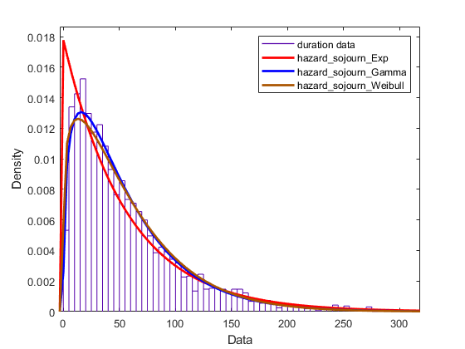
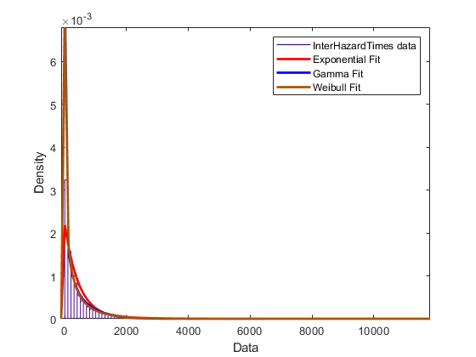
Model parameterisation: estimable from data
Some of model parameters are directly estimable from empirically collected datasets:
  Intervals between hazards (e.g., timed activity “OK2Hazard”)
  Duration of hazards (e.g., timed activity “CorHaz2Acc”, “sojournTime”, etc.)
For the study these model parameters are estimated using two publicly available datasets:
  HighD dataset – a drone-recorded dataset for human driving behaviour on German highways.
  Lyft dataset
    was used to get a ball-park estimate of the duration of perception errors.
  Further details on datasets and how they were used to estimate model parameter are given in the paper.

Slide 29
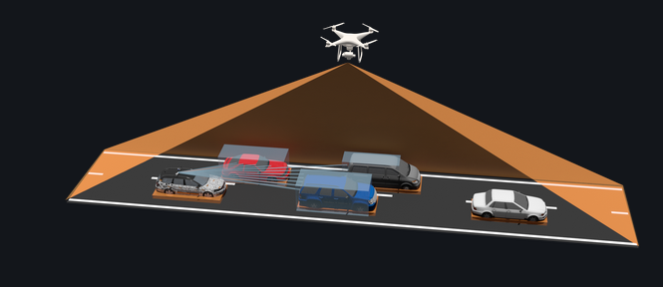
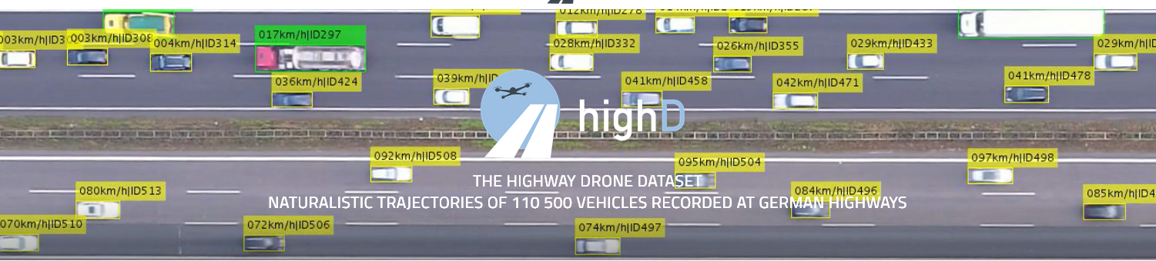
The highD dataset
The highD dataset (https://levelxdata.com/highd-dataset/) is a dataset of naturalistic vehicle trajectories recorded on German highways collected with a drone.
Traffic was recorded at six different locations and includes more than 110 500 vehicles. Each vehicle’s trajectory, including vehicle type, size and manoeuvres, is automatically extracted.
The positioning error is typically less than ten centimetres. The dataset was created for the safety validation of highly automated vehicles.
It is also suitable for many other tasks such as the analysis of traffic patterns or the parameterization of driver models.

Slide 30
Model parameters: sensitivity analysis
Parameter | Values | Description
CH2Acc_prob | 0 | Case probability 2 of FalHaz2Acc timed activity.
CorHaz_sojournTime FH_sojournTime | 856.3 | Rate of timed activities CorHaz2Acc and FalHaz2Acc
FH2Acc_prob | 0 | Case probability of CorHaz2Acc timed activity.
HDLateAcc_prob | [10⁻⁴, 2x10⁻⁴] | Case probability of timed activity HDLateAcc leading to Accident.
HDLate_sojournTime | 1000.0 | Rate of timed activity HDLateAcc.
HazardRate | 197.4 | Rate of timed activity OK2Hazard (intervals between hazards).
OH_sojournTime | [1125, 2250, 4500] | Rate of timed activity sojournTime (duration of overlooked hazard)
OLH2Acc_prob | [10⁻⁵, 2x10⁻⁵, 5x10⁻⁵] | Case probability of timed activity sojournTime leading to Accident
OLH2CHLate_prob | [0.99, 0.991, 0.995] | Case probability of timed activity sojournTime leading to CPH_Late.
falseHazardProb | 0.0 | Probability of false hazard detection.
missHazardProb | [0, 10⁻⁴, 5x10⁻⁴] | Probability of omitting a hazard given the hazard occurred
For other model parameters we conducted “sensitivity analysis” within a “plausible” range of values.
  These parameters are unknown with certainty (e.g., they are difficult to estimate empirically. No suitable datasets seem available).
“Sensitivity analysis” serves two purposes:
  Tells us which parameters matter for the analysis (i.e., if they must be estimated accurately):
    little (or negligible) effect of a parameter value on AV safety indicates that the parameter value does not matter. In this case a “ball-park” figure can be used and the effort on accurate estimation can be saved.
  For those parameters which matter, the sensitivity analysis shows the range of parameter values, which would make the AV unsafe.
    The analysis, thus, allows one to establish the requirements for the reliability of the sub-systems modelled by the respective model parameters (e.g., how good the perception system should be) so that the AV is safe.

Slide 31
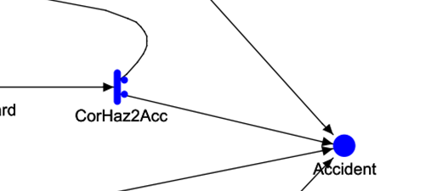
Results
The paper shows the results from 6 different studies related to AV safety.
All results are obtained by “solving” the SAN models with the chosen parameters using the numeric solvers built-in the tool (Möbius) for continuous time Markov chains (CTMC).
The studies included in the publication were arranged in two groups:
Group 1: Conducted under the assumption that if a hazard is detected immediately and correctly then an accident cannot occur:
  Case 1: Effect of the probability of overlooking a hazard on system safety
  Case 2: Effect of duration of overlooking a hazard on system safety
  Case 3: Effect of the rate of accident from the state of late hazard detection on system safety
Group 2: Assuming that even when a hazard is immediately detected correctly upon its occurrence, an accident still may occur (with much smaller probability than in Group 1)
  Case 4: Effect of the rate of accident on system safety
  Case 5: Effect of false alarms on system safety
  Case 6: Combination of case 4 and 5 above

Slide 32
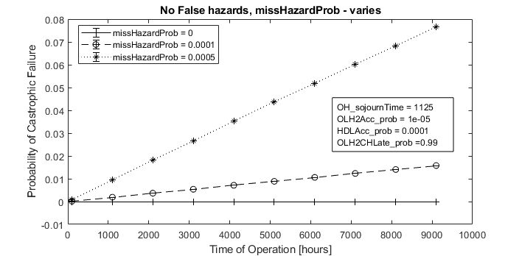
Results: Case 1
Observations
Intensity of overlooked hazards affects system safety visibly
Probability of system failure remains low 9000+ hours of operation (i.e., over a year of continuous driving).

Slide 33
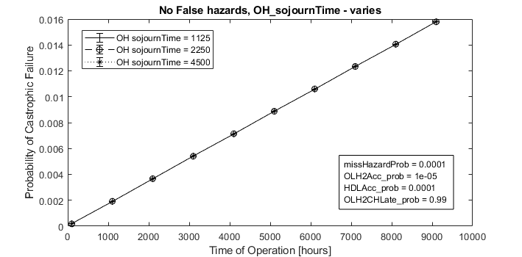
Results: Case 2
Observations
Duration of overlooked hazards does not matter
  For the chosen range of variation, of course (derived from the Lyft dataset)
Probability of system failure remains low (~1.5%) after 9000+ hours of operation

Slide 34
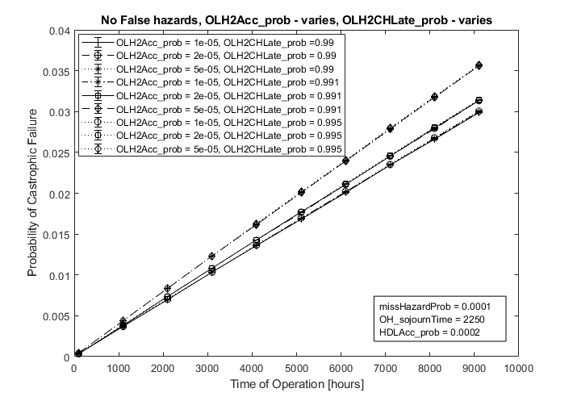
Results: Case 3
Observations
The rate of accident from late detection of hazards affects visibly the probability of accident for a mission of given size.
System safety remains good (< 4%) after 9000+ hours of operation.

Slide 35
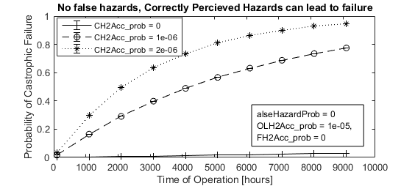
Results: Case 4
Observations
Even a tiny rate (10⁻⁶) of accident from the state of correctly perceived hazard has a dramatic detrimental effect on system safety.
AV safety becomes grossly inadequate: probability of accident reaches very significant values even for modest number of hours on the road
After 9000+ hours of operation the probability of accident reaches 0.8 and approaches 1.0 for rate of accident of 10⁻⁵ and 10⁻⁶, respectively.
This case models the impact of “safety monitors” on AV safety. Monitors must be very reliable indeed.

Slide 36
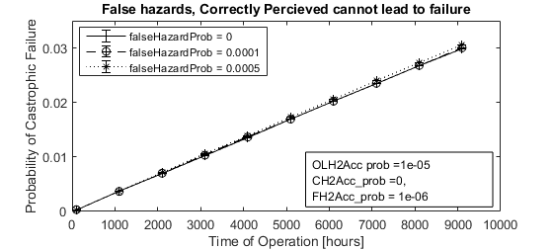
Results: Case 5
Observations
The intensity of false alarms “does not matter” much.

Slide 37
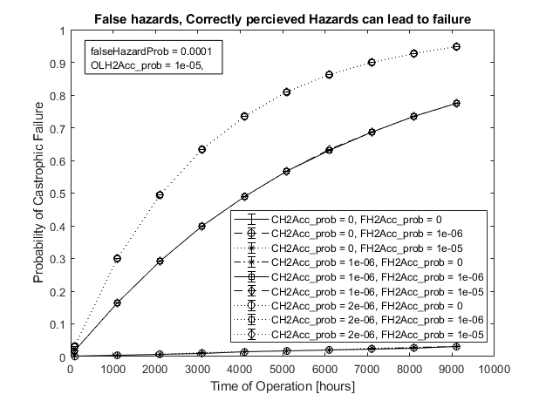
Results: Case 6
Observations
The combination of false alarms and non-zero rate of accidents from correctly detected hazards does not really show anything new:
  false alarms “do not matter”.
  Even a small values of the rate of accidents upon correct detection of accidents has a dramatic detrimental effect on AV safety.

Slide 38
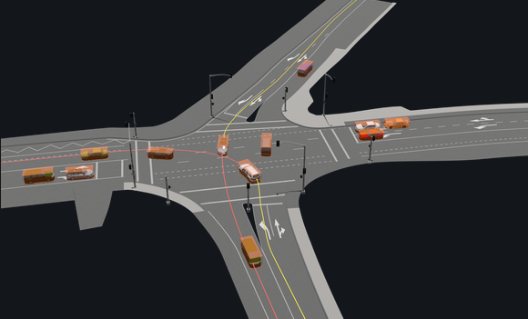
Study 2: A model of intersection (and “free” driving between intersections)
This extension is important as it accounts for ODD, mentioned earlier.
  The work shows that a complex model with ODD can be constructed, parameterised using publicly available datasets, and solved.
Operates at a more detailed level of abstraction than the basic model
  Discriminates between different types of road hazards
    Intersection/”Free driving”
    Driving “fast” vs. driving “slow”
  Discriminate between vehicle “braking” and “not braking”
    “braking” is used as a proxy for road hazards occurrence
Accounts for:
  Failure of perception system:
    Omission failure (overlooking road hazards) may be temporal (hazards may eventually be detected correctly, but with a delay)
    Rate of failure when road hazard is overlooked is likely larger than if the hazard is detected (the same assumption as in Study 1)
  Failures of safety monitors are taken into account as in Study 1.
  False alarms are NOT used in the model.

Slide 39
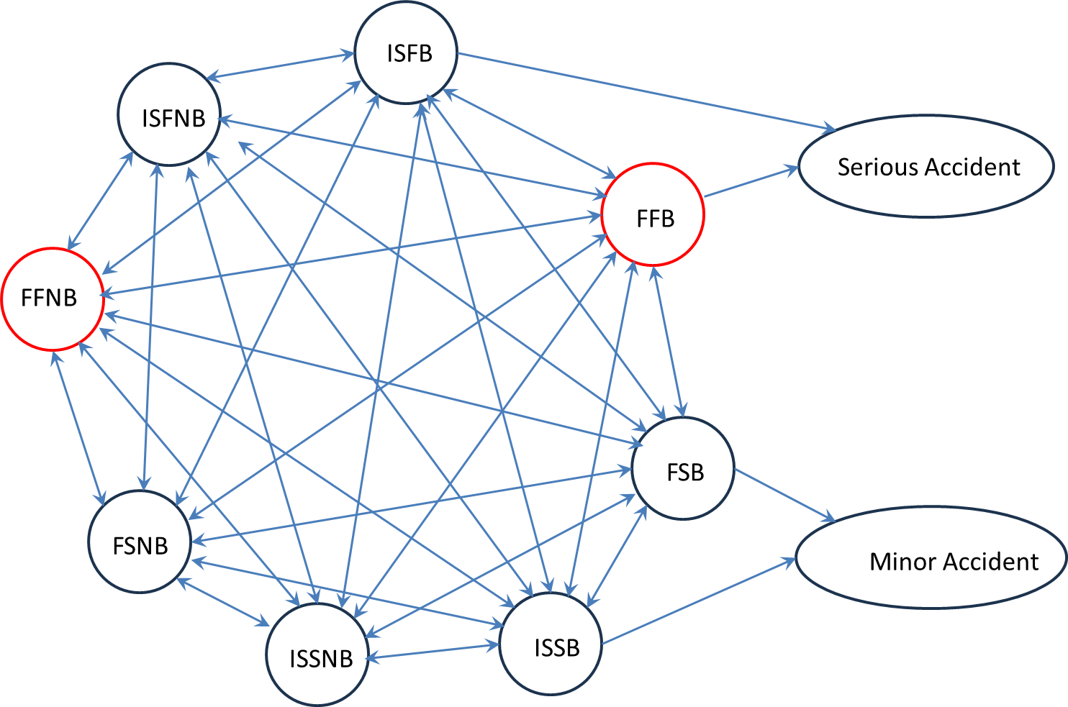
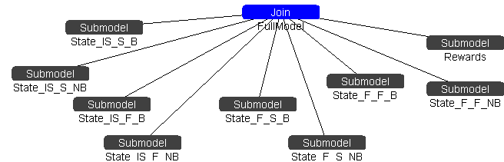
The Model
The states of the model (of the AV environment) are labelled using three binary categories:
  Location: {“free”, “intersection”}
  Speed: {“fast”, “slow”}
  Road hazard: {“braking”, “non-braking”}
With these parameters the model has 8 states as shown in the graph on the right:
    F-F-B (FFB)
    F-F-NB (FFNB)
    …
    IS –S-B (ISSB)
    IS-S-NB (ISSNB)
The vehicle spends in each state a certain period of time and then moves to one of the remaining 7 states:
  A fully connected graph of transitions between states is a plausible description
    Some transitions, however, would be illogical (and may not occur in a given data set).

Slide 40
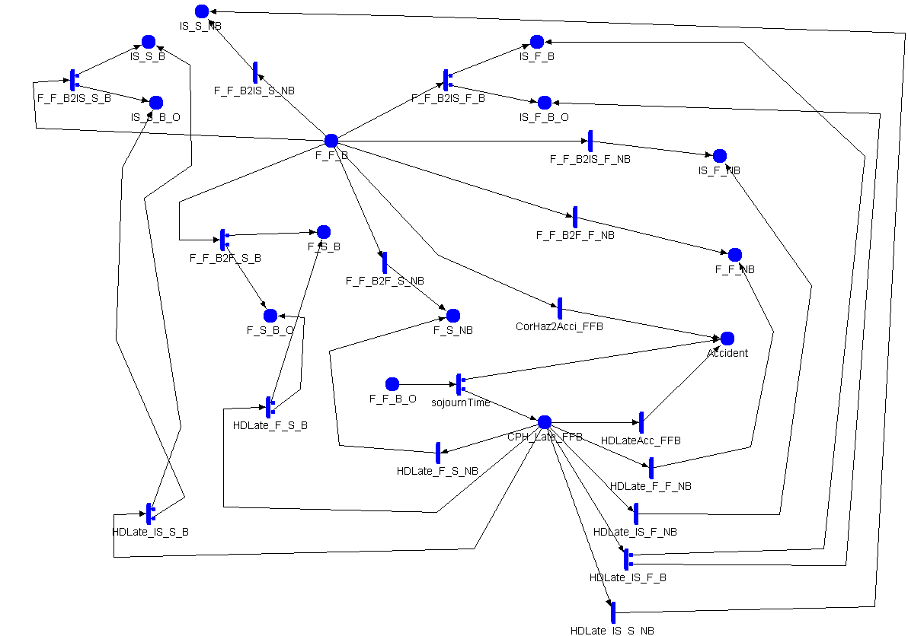
The Model (3)
FFB
Models of states with “braking” :
  F-F-B
  F-S-B
  IS-B-B
  IS-S-B
There are transitions:
to the other 7 states including
branching to “sub-states”
“-B” or “-B_O”, which indicate
if hazards in “braking” states
are detected by the perception
system or not.
Transitions to “internal sub-states”
corresponding to failures of the
perception system.
Transitions to absorbing state
“Accident” are possible.
Similar to the model used in Study 1.

Slide 41
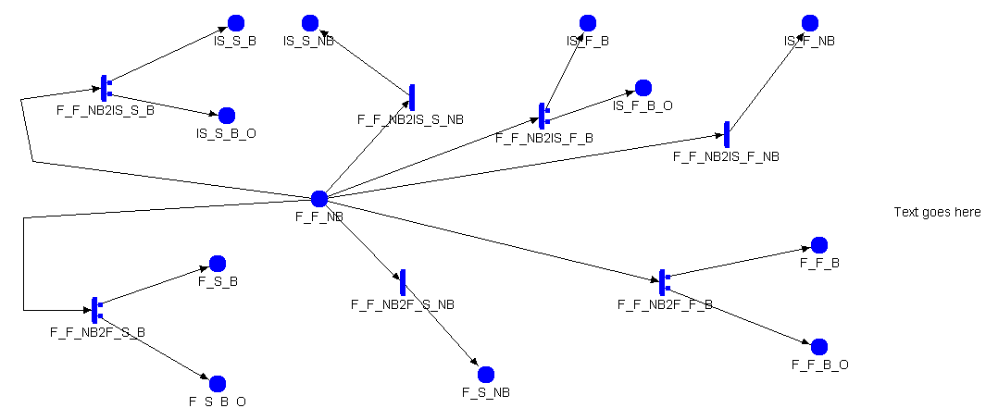
The Model (4)
FFNB
Model of the “non-braking” states
F – F - NB
F – S - NB
IS – B - NB
IS – S - NB
There are transitions:
to the other 7 states including
branching to “sub-states”
“-B” or “-B_O”, which indicate
if hazards in “braking” states
are detected by the perception
system or not.
BUT
No transitions to the absorbing
state “Accident” (this is an assumption
made in this analysis).

Slide 42
Safety measure of interest (Reward)
Measure of AV safety is the same as with the basic model: the probability that the system will enter the state “Accident” within predefined intervals of operation:
100 hours of operation
1100 hours of operation
…,
9100 hours of operation
We discriminate between 2 accident types:
Serious Accident: an accident when the vehicle drives “fast” (these can result while the model is in states FFB and ISFB)
Minor Accident: an accident when the vehicle drives “slowly” (these can result while the model is in states FSB and ISSB).

Slide 43
Model Parameters
Transitions between the 8 states characterise the 8 driving (“operating”) conditions the AV can be in.
  The rates of transition are estimated from a proprietary dataset (provided by Intel Labs for the study) and are assumed known constants in all studies conducted with the model.
Parameters characterising the imperfections of the perception system and of the safety monitors in the 4 “- B” states on the road are difficult to estimate. We opted for sensitivity analysis on them:
  Rates of catastrophic failure of the AV when road hazards are correctly and immediately recognised by the perception system. These are parameters (for all “-B” states) and characterise the reliability of the “safety monitors” in respective states (operating conditions).
  Rate of failure of the perception system to recognise a road hazard when it occurs
    In the model this type of failure occurs upon entering a “braking” state (captured by the case probabilities leading to the “- B_O” states”)
  Rate of occurrence of an Accident (Serious or Minor) while an existing road hazard is overlooked.
  Rate of occurrence of an Accident (Serious or Minor) once the road hazard is eventually correctly detected but with some delay.

Slide 44
Dataset used for model parameterisation
Parameters of the timed activities which capture the transitions between the 8 states of the environment are elicited by processing a proprietary dataset, which includes statistical data of natural driving by human drivers.
All timed activities used in the model are assumed exponentially distributed.
  A convenience assumption, which allows one to use highly efficient numeric solvers for the SAN models (part of the Mobius tool)
  The assumption can be dropped (i.e., use the empirical distributions derived from the dataset). In this case the models will be solved via Monte Carlo simulation.
  Asymptotic solutions have also been derived (based on Littlewood’s work for semi-Markov systems with an absorbing state) under additional assumptions, which seem plausible for the study.
rate_F_F_B2F_F_NB
609.87
rate_F_F_B2F_S_B
676.71
rate_F_F_B2F_S_NB
319.02
rate_F_F_B2IS_F_B
616.29
rate_F_F_B2IS_F_NB
551.1
rate_F_F_B2IS_S_B
549.09
rate_F_F_B2IS_S_NB
310.79
rate_F_F_NB2F_F_B
170.61
rate_F_F_NB2F_S_B
252.79
rate_F_F_NB2F_S_NB
361.58
rate_F_F_NB2IS_F_B
209.77
rate_F_F_NB2IS_F_NB
202.345
rate_F_F_NB2IS_S_B
361.87
rate_F_F_NB2IS_S_NB
273.315
rate_F_S_B2F_F_B
1080.0
rate_F_S_B2F_F_NB
604.64
rate_F_S_B2F_S_NB
465.98
rate_F_S_B2IS_F_B
0.0
rate_F_S_B2IS_F_NB
439.22
rate_F_S_B2IS_S_B
940.01

Slide 45
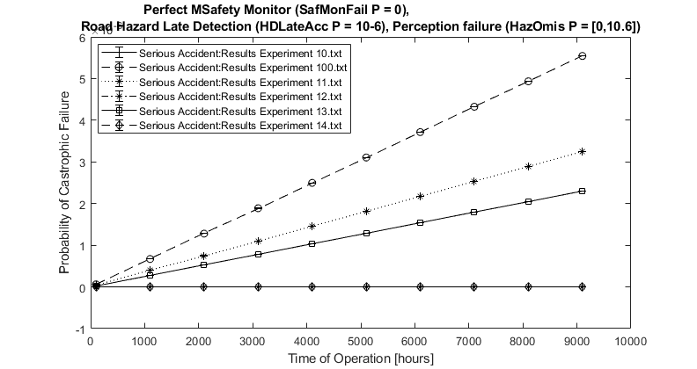
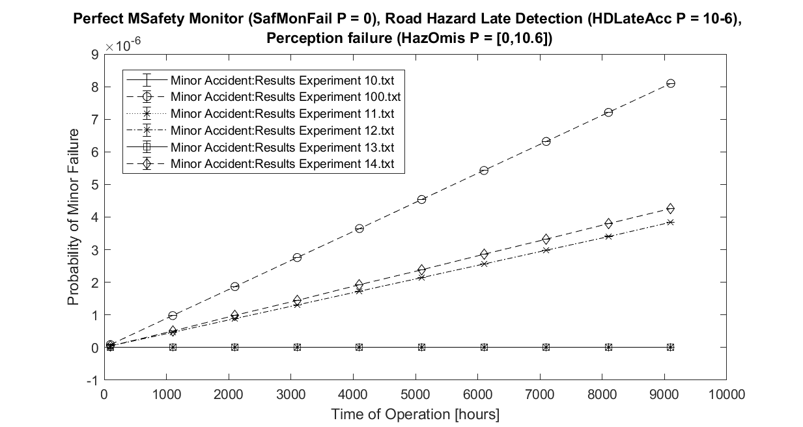
Results:
Observation 1: Perception failures in different
“non-braking” states affect system safety
differently.

Slide 46
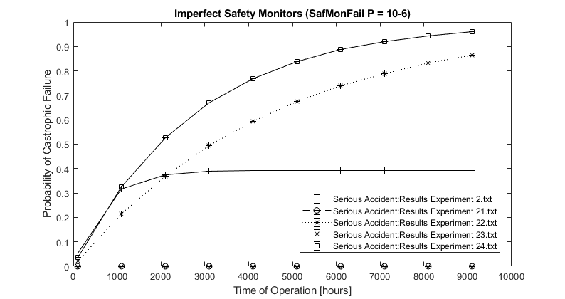
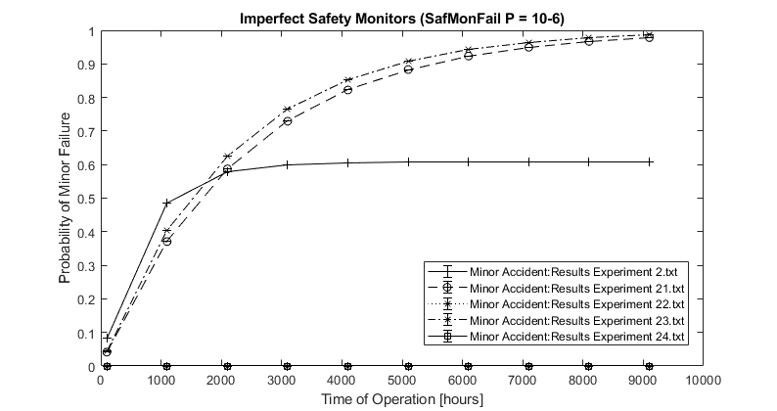
Results (2)
Observation 2: AV safety is very sensitive to intensity
of failure of Safety Monitors .
Confirmation of a well-known fact. Magnitude of the
impact on AV safety can be quantified.

Slide 47
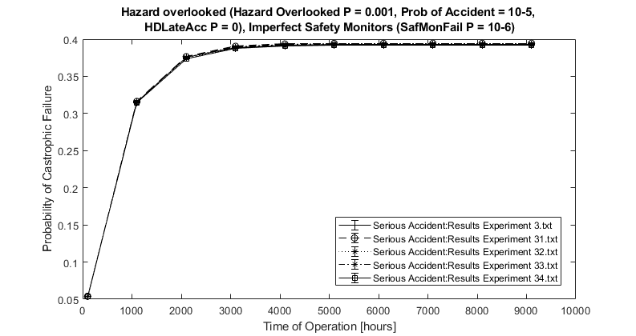
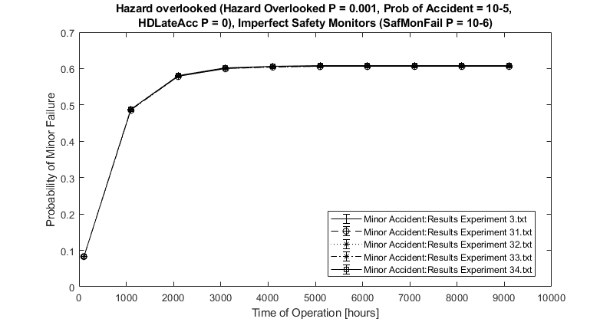
Results (3)
Observation 3: Impact on safety of “short-lived”
Omissions of road hazards is “negligible.”

Slide 48
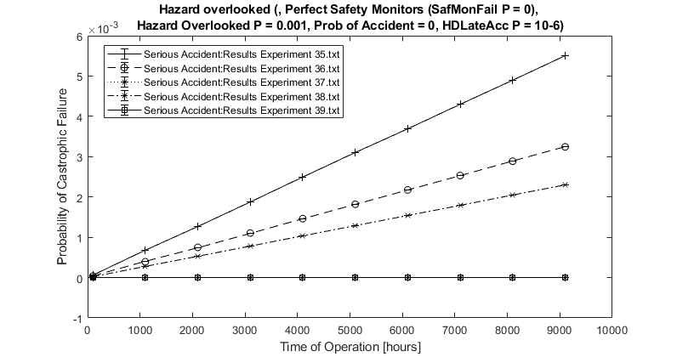
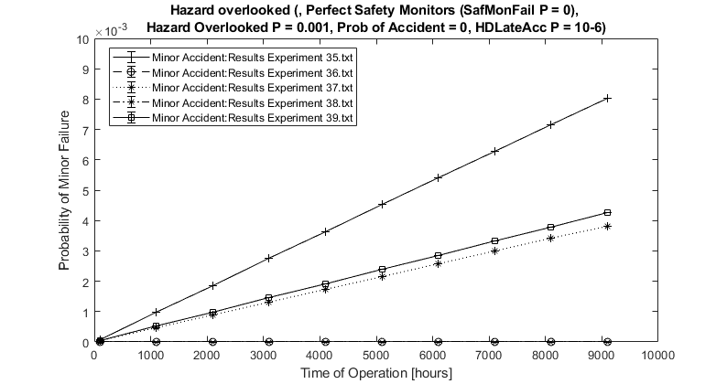
Results (4)
Observation 5: The impact of rate of accident after
a “late detection” of road hazards varies with
“non-braking” states.

Slide 49
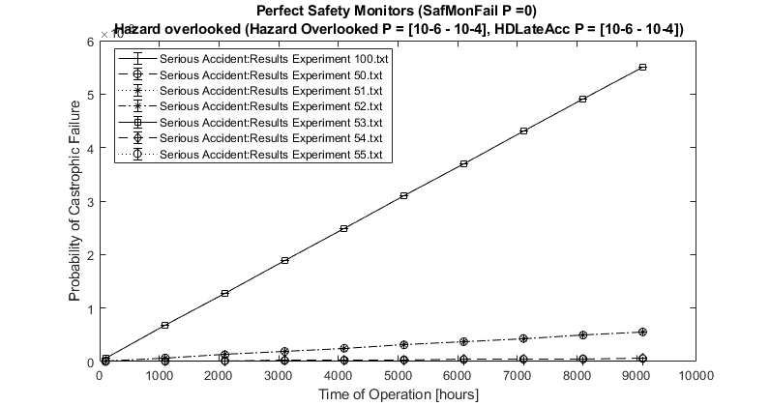
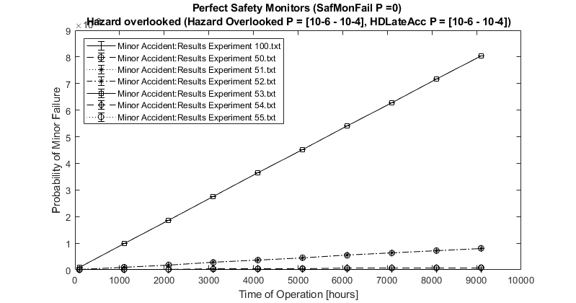
Results (5)
Observation 6: Combined effect of perception
failures and of the rate of accident after delayed
detection of hazards can be significant: the model
provides an insight and allows one to quantify the
impact on AV safety.

Slide 50
Summary of the findings from the probabilistic models
The proposed model-based approach to safety assessment of AV is feasible and provides useful insight:
  Despite complexity, many model parameters can be derived using publicly available datasets.
  “Sensitivity analysis” can be deployed for those parameters, which cannot be estimated
    the impact of reliability of essential components such as AV perception and safety monitors on AV safety can be quantified.
    The findings from the sensitivity analysis can be used to establish reliability requirements on the AV perception and safety monitors.
Feasibility of the method is demonstrated on two studies which operate at different level of abstraction. Some of the observations are non-obvious:
  Duration of overlooking a hazard (e.g., initially omitting an obstacle on the road) for a short time (1 – 3 sec) does not seem to affect visibly the AV safety;
  False alarms (studied in the basic model), do not worsen the system safety visibly, either.
Perception system’s reliability affects system safety significantly.
Unreliability of “safety monitors” has the most dramatic impact on AV safety.
  The results demonstrate a constructive way of establishing reliability targets on “safety monitors” so that AV safety can be assured.

Slide 51
Driving to Safety

Slide 52
Overview of the “Driving to Safety” Approach
“Driving to safety” has been developed recently by researchers from the RAND corporation in the US:
  N. Kalra and S. Paddock, “Driving to safety: How many miles of driving would it take to demonstrate autonomous vehicle reliability?” Transportation Research Part A: Policy and Practice, 2016. 94: p. 182-193.
  A method, based on Bayesian inference, which allows one to compute the amount of AV driving (e.g., in miles) required to reach levels of AV safety comparable with the safety of man-driven vehicles.
    The required amount of driving is prohibitively high (10s of millions of miles without an accident), which motivates the need for innovative methods for AV safety assessment.
  The initial publication (above) triggered interest among many, including several colleagues at City, University of London, who developed a “Conservative Bayesian Inference (CBI)” method:
    CBI spells out formally how one can compute conservatively the number of miles required for “driving to safety”.

Slide 53
Driving to Safety technical Weaknesses
The models known to date of “driving to safety” have a number of conceptual weaknesses:
  They rely on a univariate Bayesian inference model:
    the measure of interest is the “probability of accident per mile of driving (PAMD)”, which allows for easy comparison of the AV safety with the safety of the man-driven vehicles.
      statistics on man-driven cars exist, e.g., from NHTSA reports.
    This univariate model ignores ODD (and indeed the “common sense”) and implicitly assumes that PAMD is the same for all driving conditions, which is clearly implausible: PAMD varies (possibly very significantly) over different operating conditions (e.g., sunny day vs. heavy rain, etc.).
  The known models only consider the special case of “driving with no accidents”. Given the statistics on vehicles with ADS (shown earlier), this case of driving millions of miles with no accident is of limited/no use.
  Different stakeholders’ perspectives on AV safety are not addressed:
    “Driving to safety” addresses the AV vendor needs only: it uses the evidence from the entire deployed fleet of AV vehicles of a particular make and model.
    The needs of the owners/users of individual AV vehicles require different approach and the data from the fleet of AV should be used differently.
      Different AVs are used differently (intensity of use will be different, the mix of operating conditions will be different, etc.). These differences must be accounted for in the inference.

Slide 54
Driving to Safety Advances based on own work
I have been working on addressing the weaknesses of the previous work on “driving to safety”. This is work in progress, near completion.
The essence of my work is on replacing the univariate model with a multi-variate one (“white-box” inference model), which accounts for a given ODD which consists of a set of operating conditions. Multivariate Bayesian inference is the essence of the approach, which builds on own previous work:
  R. Pietrantuono, P. Popov, and S. Russo, Reliability assessment of service-based software under operational profile uncertainty. Reliability Engineering & System Safety, 2020. 204: article 107193.
High level observations:
  Black – box predictions may be overoptimistic (in comparison with the “white-box” multivariate prediction), contrary to the claims by the proponents of the “conservative Bayesian Inference”.
    They seem to optimise for conservatism starting with a “wrong” model.
  Not only the vendor, but also the owners of individual AV vehicles, too, can potentially benefit from data sharing by the AVs in the entire deployed fleet of AV vehicles, under a number of additional plausible assumptions.

Slide 55
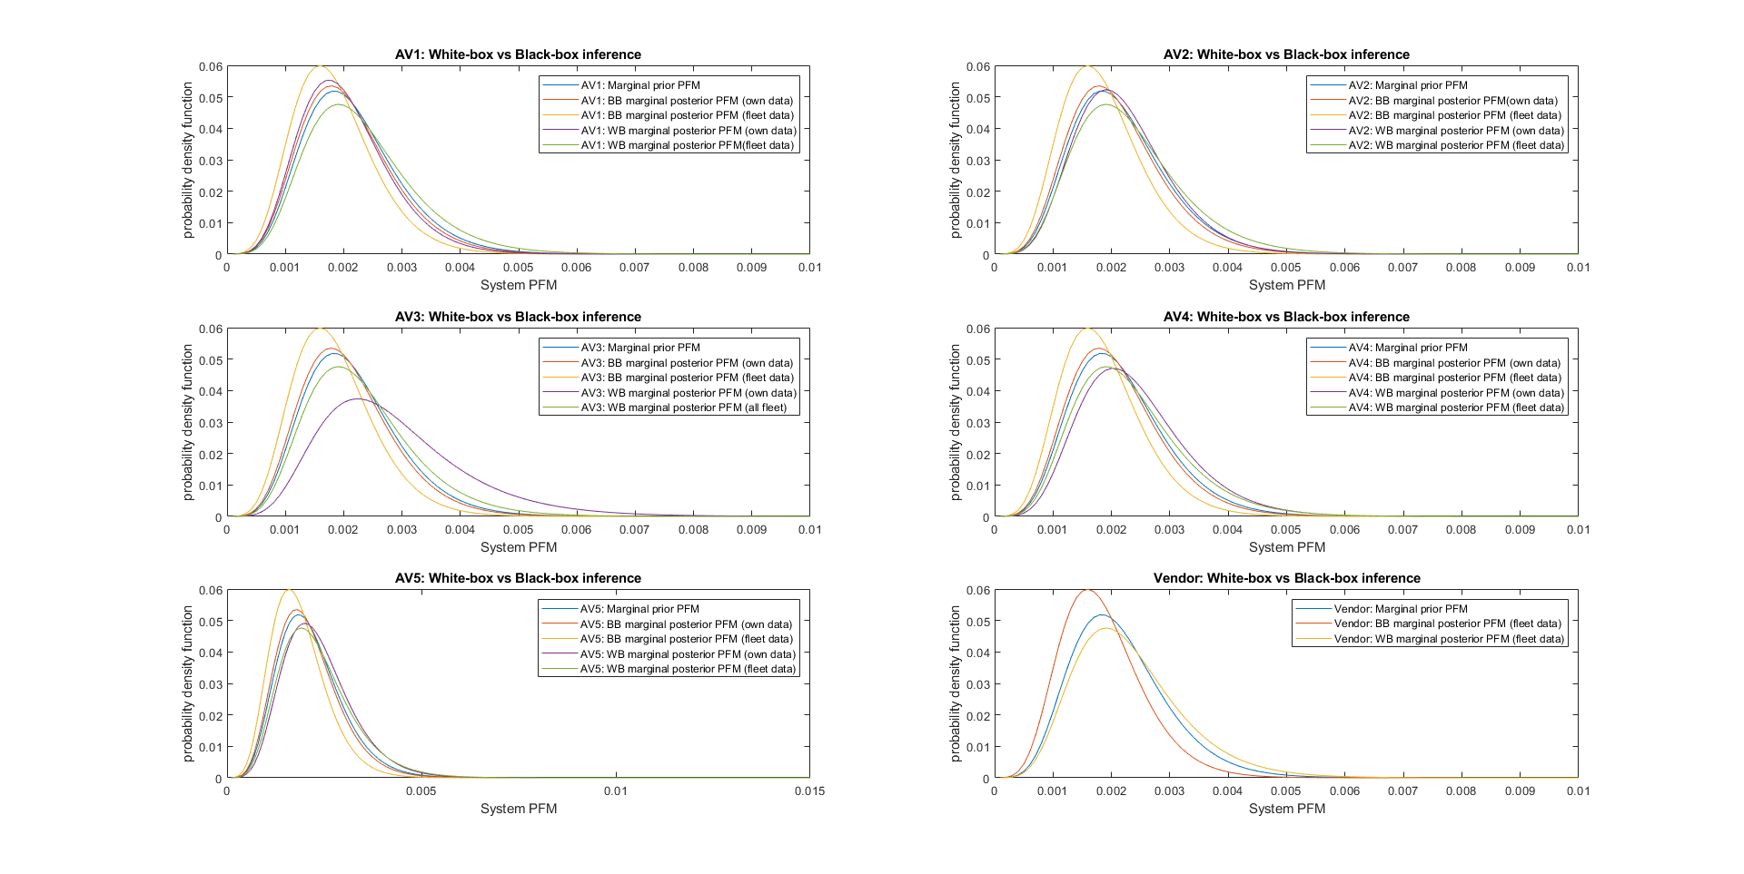
Examples from own recent work

Slide 56
Conclusions
Methods for AV safety assessment and assurance are under very active development.
AV safety assurance, based on the traditional safety justification, is currently problematic.
  Reliance on “expert judgment” is hard, especially given that critical AV components such as perception, planning, etc., rely on machine learning (ML). Such components often do not have a formal specification and may be evolving over time (e.g., via ML retraining) , hence cannot be subjected to the scrutiny typical for safety engineering.
The trends in safety assurance (e.g., the aforementioned Assurance 2.0) are towards using models and automation in safety reasoning more extensively than is done now.
Probabilistic models (state-based, Bayesian inference, etc.) seem particularly well-suited to face the challenges of AV safety assurance:
  A probabilistic model of the entire AV as a system, placed in hazardous environment, allows one to assess the impact of (un)reliability of different sub-systems (perception system, safety monitors, etc.) and establish “reliability targets” for each of these sub-systems which will allow for safety claims to be justified.
    Often work on a particular component (e.g., perception), is undertaken to assess if it is safe (e.g., ANSI UL4600 seems to recommend this view) without the system context (of the entire AV or indeed of the entire ecosystem of vehicles on the road both AVs and man-driven).
    Safety is a system property.
  Assessing the achieved levels of safety by an AV from operational data is possible using Bayesian inference. The inference, however, should rely on a model aligned with the specifics of the AV domain, and should include ODD.

Slide 57
Questions
Thank you!

Slide 58
ISFB
ISFNB
Serious Accident
FFB
FFNB
FSB
FSNB
Minor Accident
ISSNB
ISSB

