Slide 1
Threat Analysis and Risk Assessment of Cyber-Physical Attack in Additive Manufacturing
Dr Mahender Kumar
Research Fellow
SCSRG, WMG,
University of Warwick
United Kingdom
Dr Gregory Epiphaniou
Reader
SCSRG, WMG,
University of Warwick
United Kingdom
Prof Carsten Maple
Professor
SCSRG, WMG,
University of Warwick
United Kingdom

Slide 2
Content
Additive Manufacturing Process Chain
Cyber-physical attacks instantiation in AM
Existing Cyber attacks in Industries
Challenges and problem statements
Methodologies
Assets and threats Identification
Threat estimation
Threat impact
Likelihood
Risk Estimation
Experiment result
Threat result
Risk
MITRE CVEs
Conclusion

Slide 3
Additive Manufacturing Process
Material
CAD
Model
CAM software
Toolpath
Command file
3D Printer
Completed part
.STL file
Quality analyst
Internet

Slide 4
Cyber-physical attack instantiation in AM
Attacker
Material
CAM software
Altered part
CAD
Model
.STL file
Toolpath
Command file
3D Printer
Quality analyst
Internet

Slide 5
Existing Cyber attacks in Industries
Stuxnet at Iran’s nuclear program
Most famous kinetic cyber attack and considered game-changing in the industry.
It involved a complex targeted worm that executed zero-day exploits on operating systems and software for managing Programmable Logic Controllers (PLC).
It caused losses of tens of billions of dollars.
Sewage attack in Maroochy Shire
Causing a sewage system failure
Wasting millions of liters of untreated sewageinto the water system.
Sabotage attack on blueprint of propeller
Belikovetsky et al. investigated the susceptibility of additive manufacturing to cyber attack.
Data breach in US (2020)
1000 data breach cases were reported in the United States alone, with over 155.8 million persons affected by the data exposures.
Vulnerability of additive manufacturing
AM is considered the second most vulnerable industry to cyber attack after the financial sector.

Slide 6
Challenges and Problem statements
Challenges
Cybersecurity risks
Unauthorized access
IP theft
Product counterfeiting
Securing AM processes
Problem statements
Vulnerabilities in the AM supply chain.
Lack of comprehensive security standards.
The need for a proactive cybersecurity approach in AM.

Slide 7
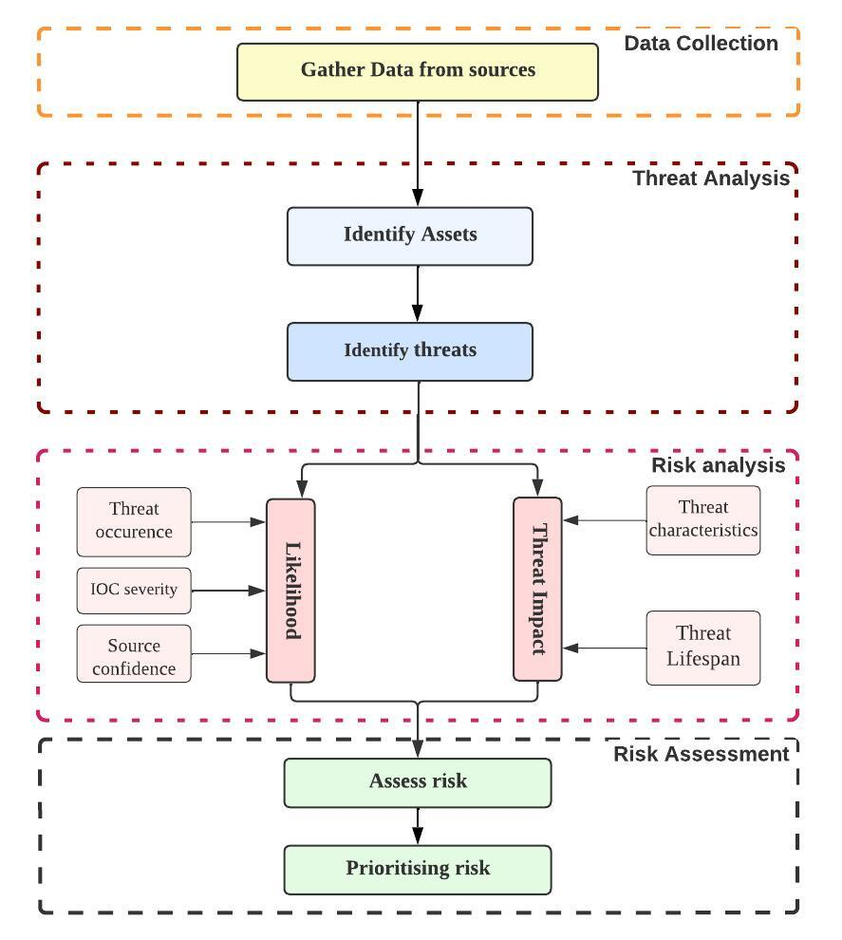
Methodology
Data collection from multiple sources.
Identification of assets and threats in the AM supply chain.
Risk analysis based on threat impact and likelihood.
Prioritising risk matrix

Slide 8
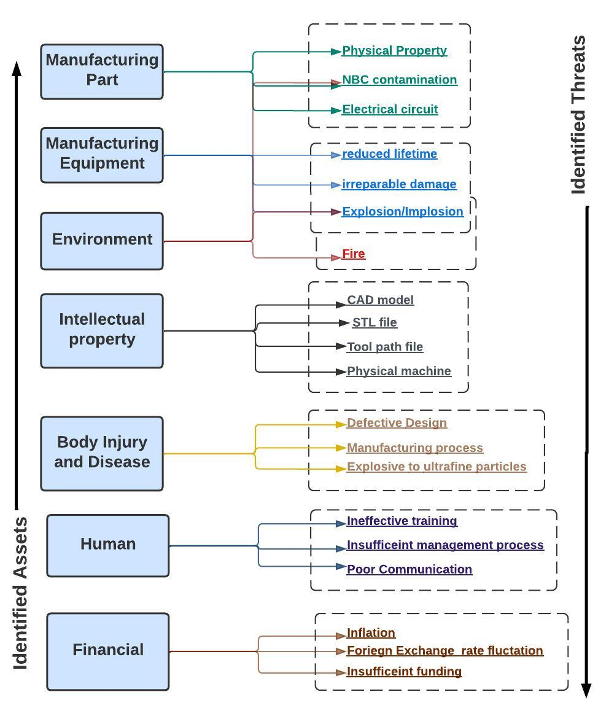
Assets and Threats Identification

Slide 9
Threat Characteristics
Target Precision
Area of Impact
Collateral Damage
Stealth
Attack Repeatability

Slide 10
Threat Estimation
Identified Threats | Targeting precision | Area of Impact | Collateral damage | Stealth | Attach repeatability
Physical property threat to 3D object | High | Critical | Critical | Medium | Critical
NBC threat to 3D object | Low | High | High | Low | High
Electronic circuit threat to 3D object | High | High | Low | High | High
Reduced lifetime threat to 3D equipment | Medium | Low | Low | Medium | Medium
Irreparable damage threat to 3D equipment | Medium | Low | Low | Medium | Medium
E/I threat to 3D equipment | Medium | Medium | Medium | Low. | Low
E/I threat to the environment | Low | Medium | Medium | Low | Low
Fire threat to the environment | Low | Medium | Medium | Low | Medium
NBC’s threat to the environment | Low | Medium | Medium | Medium | Medium
CS&IP risk in CAD model phase | High | High | High | Medium | Medium
CS&IP risk in .STL file | High | High | Low | Medium | Low
CS&IP risk in Toolpath | High | High | Medium | Low | Low
CS&IP risk in the physical machine | High | High | Low | Medium | Low
BI&D threat due to defective design | Medium | Critical | High | Medium | High
Defects during the manufacturing process | High | Critical | Critical | Medium | High
BI&D threat due to exposure to ultrafine particle | High | High | High | Low | Low
Threat due to Ineffective training plan | High | High | Medium | Low | Low
Threat due to insufficient management support | High | High | Low | Medium | Low
Threat due to poor communication | Medium | Critical | High | High | Low
Inflation threat | Medium | Medium | High | Low | Low
Foreign exchange rate fluctuation | High | High | Low | Medium | Low
Insufficient financing | High | High | High | Medium | Low

Slide 11
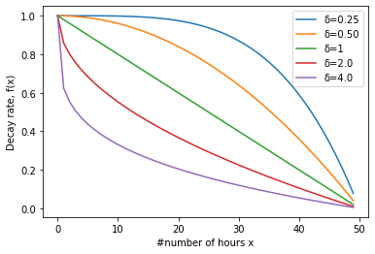
Threat Estimation: Impact
$${Imp}_{aggr}= w_{tp}X_{tp}+w_{ai}X_{ai}+w_{cd}X_{cd}+w_{s}X_{s}+w_{ar}X_{ar}$$
$${Imp}_{i}=\left(10\left(X_{cd}+X_{ai}\right)+X_{tp}+X_{s}+X_{ar}\right)∗f\left(x,δ,τ\right)$$
Where, decay function
$$f\left(x,δ,τ\right)=\max\left(0,1−{\left(\frac{x}{τ}\right)}^{\frac{1}{δ}}\right)$$

Slide 12
Threat Estimation: Likelihood
$${Likelihood}_{i}=w_{R}{Rel}_{i}+{w_{s}Sev}_{i}+w_{O}{Occur}_{i}$$
Where,
$${Rel}_{i}=\frac{w_{ex}p_{ex}+w_{t}p_{t}+w_{c}p_{c}}{w_{ex}+w_{t}+w_{c}}$$
Trustworthiness of data source (${Rel}_{i}$)
Frequency of IOC provided by the data source (${Sev}_{i}$)
IOC severity assigned by the data source (${Occur}_{i}$)

Slide 13
Risk Assessment
$$Risk_{i}={Impact}_{i}×{likelihood}_{i}$$
Risk level | Threat level
Threat impact |  | 0 | 1 | 2 | 3 | 4
 | 0 | Unknown | Unknown | Unknown | Unknown | Low
 | 1 | Unknown | Low | Low | Low | Medium
 | 2 | Unknown | Low | Medium | Medium | High
 | 3 | Unknown | Low | Medium | High | High
 | 4 | Low | Medium | High | High | Critical

Slide 14
Experiment Results: Aggregated threat impact and likelihood levels
Identified Threats | Impact score | Impact value | Likelihood score | Likelihood value
Physical property threat to 3D Object | 28404 | 4 | 11 | 4
NBC threat to 3D Object | 13833.8 | 4 | 11 | 4
Electronic circuit threat to 3D Object | 4026 | 3 | 8 | 3
Reduced lifetime threat to 3D equipment | 50 | 1 | 5 | 2
Irreparable damage threat to 3D equipment | 50 | 1 | 5 | 2
E/I threat to 3D equipment | 657.2 | 2 | 6 | 2
E/I threat to the environment | 629.3 | 2 | 6 | 2
Fire threat to the environment | 657.2 | 2 | 6 | 2
NBC threat to the environment | 685.1 | 2 | 8 | 3
CS&IP risk in the CAD model phase | 14070.5 | 4 | 11 | 4
CS&IP risk in .STL file | 3483.1 | 3 | 9 | 3
CS&IP risk in Toolpath | 3977.2 | 3 | 9 | 3
CS&IP risk in the physical machine | 3239.1 | 3 | 9 | 3
BI&D threat due to defective design | 21171.5 | 4 | 11 | 4
BI&D due to defects occurring during the manufacturing process | 27746.5 | 4 | 9 | 3
BI&D threat due to exposure to ultrafine particle | 6417.2 | 3 | 8 | 3
Threat due to Ineffective training plan | 3977.2 | 3 | 9 | 3
Threat due to insufficient management support | 3483.1 | 3 | 9 | 3
Threat due to poor communication | 20527.15 | 4 | 9 | 3
Inflation threat | 3733.2 | 3 | 7 | 2
Foreign exchange rate fluctuation | 3483.1 | 3 | 7 | 2
Insufficient financing | 6472.1 | 3 | 8 | 3

Slide 15
Experiment Results: Risk Estimation
Identified Threats | Impact score | Risk value | Risk level | Rank
Physical property threat to manufacturing parts | 28404 | 16 | critical | 1
BI&D threat due to defective design | 21171.5 | 16 | critical | 2
CS&IP risk in the CAD model phase | 14070.5 | 16 | critical | 3
NBC threat to manufacturing parts | 13833.8 | 16 | critical | 4
Defects occurring during the manufacturing process | 27746.5 | 12 | High | 5
Threat due to poor communication | 20527.15 | 12 | High | 6
Insufficient financing | 6472.1 | 9 | High | 7
BI&D threat due to exposure to ultrafine particle | 6417.2 | 9 | High | 8
Electronic circuit threat to manufacturing parts | 4026 | 9 | High | 9
CS&IP risk in Toolpath | 3977.2 | 9 | High | 10
Threat due to Ineffective training plan | 3977.2 | 9 | High | 11
CS&IP risk in STL file | 3483.1 | 9 | High | 12
Threat due to insufficient management support | 3483.1 | 9 | High | 13
CS&IP risk in the physical machine | 3239.1 | 9 | High | 14
NBC’s threat to the environment | 685.1 | 6 | Medium | 15
Inflation threat | 3733.2 | 6 | Medium | 16
Foreign exchange rate fluctuation | 3483.1 | 6 | Medium | 17
Fire threat to the environment | 657.2 | 4 | Low | 18
E/I threat to the environment | 629.3 | 4 | Low | 19
E/I threat to manufacturing equipment | 657.2 | 4 | Low | 20
Reduced lifetime threat to manufacturing equipment | 50 | 2 | Low | 21
Irreparable damage threat to manufacturing equipment | 50 | 2 | Low | 22

Slide 16
Framework validation on MITRE CVEs
CVEs | Description | CVE score | Impact Level | Likelihood Value | Risk level
CVE-2021-21480 | Malicious code Injection | 9.9 | 4 | 4 | Critical
CVE-2020-8479 | XML External Entity Injection vulnerability | 9.8 | 4 | 4 | Critical
CVE-2020-8481 | Information Disclosure vulnerability | 10 | 4 | 2 | High
CVE-2017-9632 | Missing Encryption of Sensitive Data | 9.8 | 4 | 2 | High
CVE-2017-9630 | Improper Authentication | 9.4 | 4 | 3 | High
CVE-2019-1590 | Insecure TLS client authentication | 8.1 | 3 | 3 | High
CVE-2021-2238 | Unauthorised network access | 8.1 | 3 | 3 | High
CVE-2018-13804 | Unauthorised network access | 8.1 | 3 | 3 | High
CVE-2020-8471 | Weak File Permissions | 7.8 | 3 | 3 | High
CVE-2022-2975 | Weak permissions | 7.7 | 3 | 3 | High
CVE-2009-4046 | Multiple SQL injection vulnerabilities | 7.5 | 3 | 4 | High
CVE-2009-4037 | Multiple SQL injection vulnerabilities | 7.5 | 3 | 4 | High
CVE-2022-20817 | Unauthenticated, remote attacker impersonate another user’s phone | 7.4 | 3 | 3 | High
CVE-2018-19436 | Blind SQL injection | 7.2 | 3 | 4 | High
CVE-2021-27600 | Malicious code injection into HTTP parameter | 5.4 | 2 | 4 | High
CVE-2015-8329 | Weak encryption | 5 | 2 | 1 | Low
CVE-2016-7157 | Denial of Service | 4.4 | 1 | 1 | Low
CVE-2014-4820 | Cross site scripting | 4.3 | 1 | 2 | Low
CVE-2019-0267 | XSRF attacks | 8.8 | 3 | 2 | Medium
CVE-2016-2389 | Remote attackers read arbitrary files in the Path parameter | 7.8 | 3 | 2 | Medium
CVE-2020-8475 | Denial of Service vulnerability | 7.5 | 3 | 2 | Medium
CVE-2020-8476 | Elevation of privilege vulnerability | 7.5 | 3 | 2 | Medium
CVE-2022-39802 | path traversal vulnerability | 7.5 | 3 | 2 | Medium
CVE-2022-30467 | Denial of Service | 6.8 | 2 | 2 | Medium
CVE-2007-5148 | Multiple PHP remote file inclusion | 6.8 | 2 | 2 | Medium
CVE-2019-13945 | Unauthorised physical access | 6.8 | 2 | 3 | Medium
CVE-2022-3432 | Vulnerability by driver | 6.7 | 2 | 3 | Medium
CVE-2021-3972 | Vulnerability by driver | 6.7 | 2 | 3 | Medium
CVE-2021-3971 | Vulnerability by driver | 6.7 | 2 | 3 | Medium
CVE-2022-30466 | Replay attack | 6.5 | 2 | 2 | Medium
CVE-2016-4016 | Cross-site scripting | 6.1 | 2 | 3 | Medium
CVE-2021-27615 | Unavailability of HTTP security header | 5.4 | 2 | 2 | Medium
CVE-2016-1561 | Password-less authentication | 5 | 2 | 2 | Medium

Slide 17
Conclusion
We identified assets and Threats in AM process
We evaluated threat based on the threat characteristics
We assess risk and prioritise them.

