Slide 1
Interconnected safe and secure systems
Peter Popov,
City, University of London,
RiTICS Spring Showcase 2019
14th October 2019

Slide 2
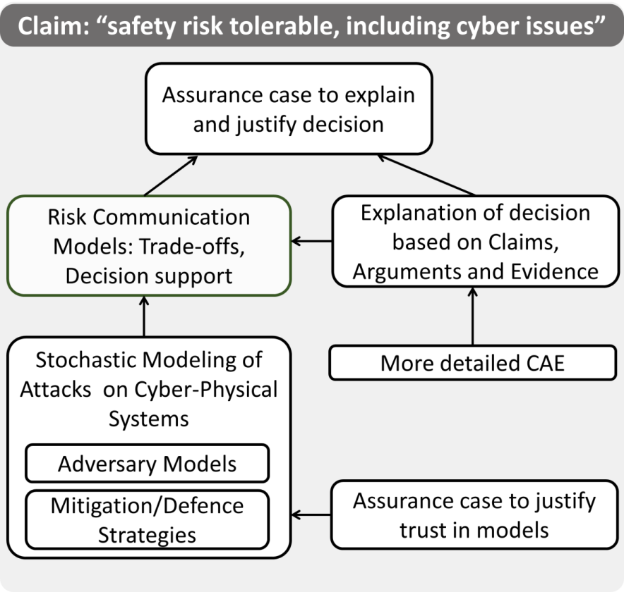
Overview of CERDICS (RITICS - 1)
Stochastic models of systems and adversaries
Decision analysis and communication based on Claims, Arguments, Evidence

Slide 3

Outline
What we delivered in IS3
  WP 1 “Consultation and outreach”
    Safety and Security – Workshop with CINEF
  WP2: Model based analysis
    Examples of models useful in “co-engineering” for safety and security
  WP3: Safety and Security Decision Making
    Change of tempo in safety-case lifecycle to account for security (e.g. how to make safety cases robust to software patching)
    Trade-offs and synergies.
  IS3 was completed on the 30th of June. Some of the modelling work continues.

Slide 4
Combined safety and security analysis ≠ S + S
Combined analysis is not just safety-only + security-only analyses.
A truly combined SSP analysis requires an explicit and credible model of dependencies between the properties of interest, e.g.:
  Conflicting Safety and Security requirements lead to the need for trade-off analysis:
  successful attacks may impair safety against accidental faults, e.g. by eliminating the safe state (real attacks on safety are well documented)
    “If it is not secure it is not safe”
  strengthening security controls often may affect performance (e.g. response time)
    and increases the likelihood of missing a hard real-time deadline
Credible trade-off analysis is impossible without a credible combined analysis
Notes:
Combined analysis will often lead to having to revise (some of the ) requirements and establish new requirements, which are feasible and acceptable. Often, trade-off analysis will be required – trading improvement in one non-functional property (e.g. integrity) at the expense of worsening another property (e.g. performance)

Slide 5
Quantitative Combined SS analysis (2)
Hazard analysis to identify the possible mechanisms how security threats may impact safety (or performance) is complemented by:
  Judgement about the likelihood of various events
    Attack occurrence
    Attack success probability
  An explicit model of how successful attacks affect reliability/performance of components. Some examples include:
    the functionality of a safe state is blocked (eliminated)
      We know of real attacks which led to safe-state being compromised (eliminated)
    the rate of failure of compromised software components increases, thus increasing the likelihood of unsafe system failures.

Slide 6
Quantitative Combined SS analysis (3)
Common mistakes in constructing models for combined SS analysis:
  Safety is demonstrated in “trusted” environment
  Security controls are added (e.g. to meet security requirements), but their impact is limited to checking if the additional overhead due to these security controls is tolerable.
    E.g. that hard real-time constraints are NOT violated satisfied under “normal conditions”
In IS3 we took a different approach:
  Security controls are not perfect. They may have flaws, they may be subject to successful attacks and become compromised, too.
  Anticipate compromises everywhere and study the implication of each compromise.
  Recovery from a compromise is not instantaneous, i.e. it takes time:
    “proactive recovery” has been demonstrated as a very efficient defence against unknown attacks. But it is expensive in terms of recovery time!
  Likelihood of attacks and probability of success are subject to uncertainty.
    In IS3 we demonstrate that probabilistic models are useful even under parameter uncertainty, e.g. by establishing bounds on model parameters.

Slide 7
Model of Dependence: Example 1
λ
sf
Safe failure
OK
λ
usf
  Model of system safety in “trusted environment”
λ
µ
Unsafe failure
  How much worse is system safety in adverse environment?
    It depends on how we model the adverse environment?
      Model 1: All successful attacks lead to unsafe state.
      Model 2: Attacks lead to a compromised state, from which transitions are possible to safe/unsafe state or to OK (e.g. if we deploy “proactive recovery”).
    The outcomes of trade-off analysis will be affected significantly by the choice of dependency model (1 or 2 above).
  Models of system safety in “adverse environment”

Slide 8
Model of Dependence: Example 2
Consider the case when reliability of a software component is reduced by a successful attack which compromises software integrity.
  An example: alteration of a threshold value of a software-based protection device (e.g. of a power line)
  Model the effect of a successful attack on software reliability:
  λ_{clean} ≤ λ_{µ1}, λ_{µ2}, …, λ_{µn},
    Successful attacks increase the rate of software failure.
  Validating a safety goal would be dependent on:
    security goal set for attacks.
    attack effect on software reliability.
  Parameterisation becomes harder.
A similar model of dependence on security, applies to performance, too
  Successful attacks may increase the response time of a s/w component
attack
Sw component
Adversary
Popov, P.T., Models of reliability of fault-tolerant software under cyber-attacks, (ISSRE 2017).
Model of attacks validated recently on NORDIC-32.

Slide 9
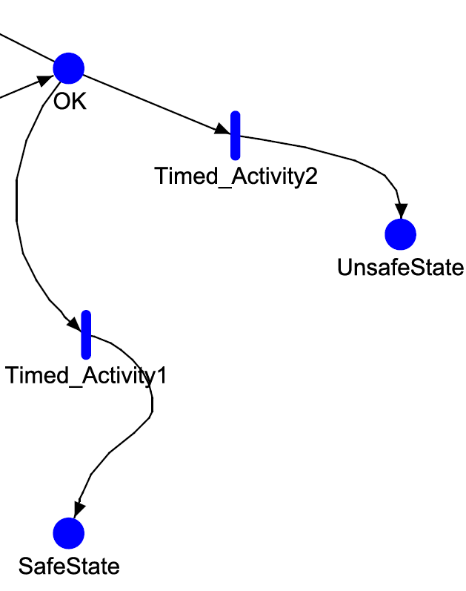
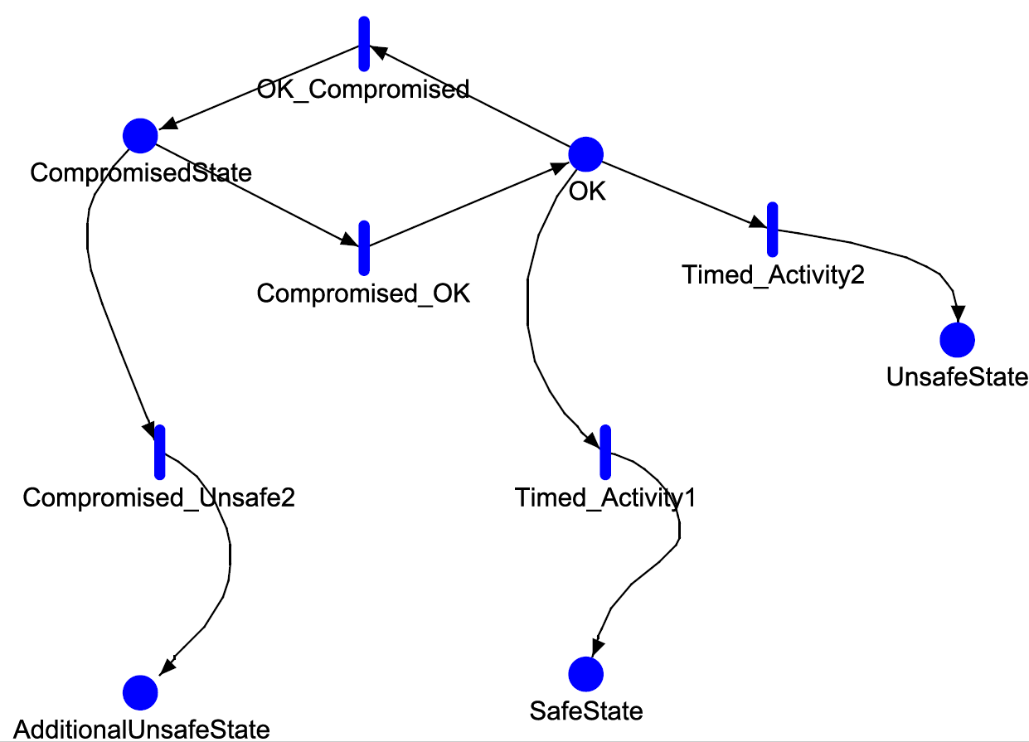
Model of Dependence: Example 3
The safe state may be eliminated as a result of a cyber attack.
  λ_{UF} | NonC SS ≤ λ_{UF} | Com SS
  UF – unsafe failure.
  NonC- non-compromised safe state
  Com SS – compromised safe state.
  Clearly, the effect of removing the safe state is an increased rate of unsafe failure.
Setting a safety goal for unsafe failure is simple, but its validation is dependent on the security goal set for the security event “compromising the safe state”.
This particular problem is recognised in IAEA guidelines.
A safety model in trusted environment
A safety model in adverse environment
Popov, P.T., Stochastic Modeling of Safety and Security of the e-Motor, an ASIL-D Device., (SAFECOMP 2015).

Slide 10
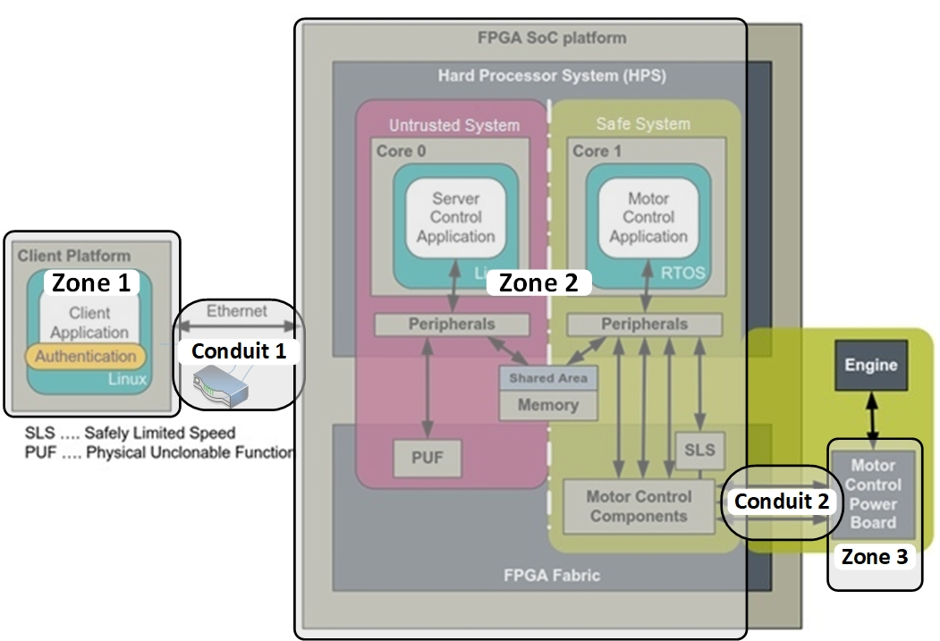
Models for SS analysis in practice
A case study 1: A virtual prototype of an Industrial Drive (EU ECSEL AQUAS project).

Slide 11
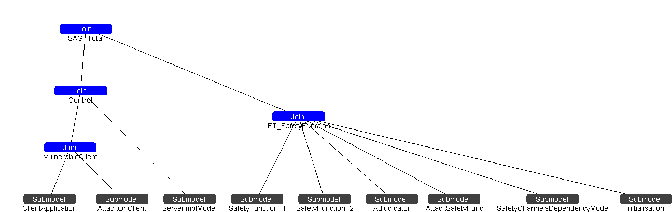
A SAN (stochastic activity networks) model
Modelled all zones (with some simplifications)
Modelled 2 attacks:
  Attack on the client application: when client compromised, the failure rate increases.
  Attack on the safety function (bringing the device to a safe state, i.e. stop the motor). Safety function is implemented as a 2-channel sub-system:
    An attack on a safety channel affects either the coverage or the probability of false alarm.
    Attacks may be on a single channel or simultaneously on both channels.
Sensitivity analysis (rate of attacks, probability of success of attacks) completed. Looked at the effect of “cleansing” to mitigate the consequences of successful attacks.
  Numbers suggests that cleansing is quite effective! The “owner” of the prototype convinced that the client application should be designed with cleansing.
Full report on the study and some results from sensitivity analysis can be found at:
https://www.staff.city.ac.uk/~ptp/IS3_FinalReport/SAG/IndustrialDrive.zip

Slide 12
Models for SS analysis in practice
A case study 2 A prototype of a Autonomous Unmanned Vehicles (drones) used for surveillance (EU ECSEL AQUAS project).
Adversary

Slide 13
A SAN (stochastic activity networks) model
Modelled the effect of traffic via DDS generated as a result of unauthorised access to DDS
The effect of a successful attack depends on number of messages handled simultaneously by DDS:
  As a result of increased load on DDS the “latency” (i.e. a round trip delay) of a message from a drone to the ground station may exceed the acceptable delay of 2 seconds.
Full report on the study and some results from sensitivity analysis can be found at: https://www.staff.city.ac.uk/~ptp/IS3_FinalReport/ATM/ATM.zip

Slide 14
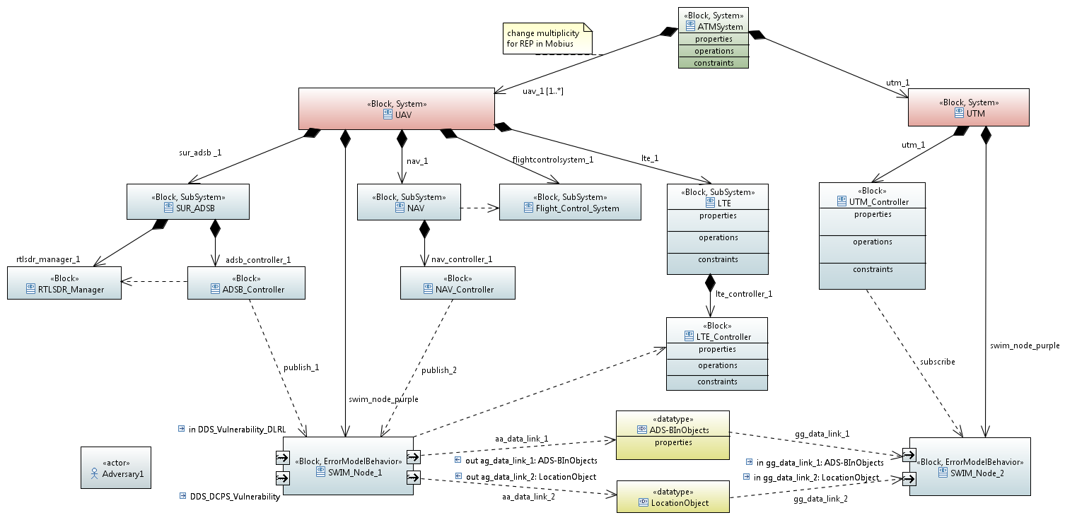
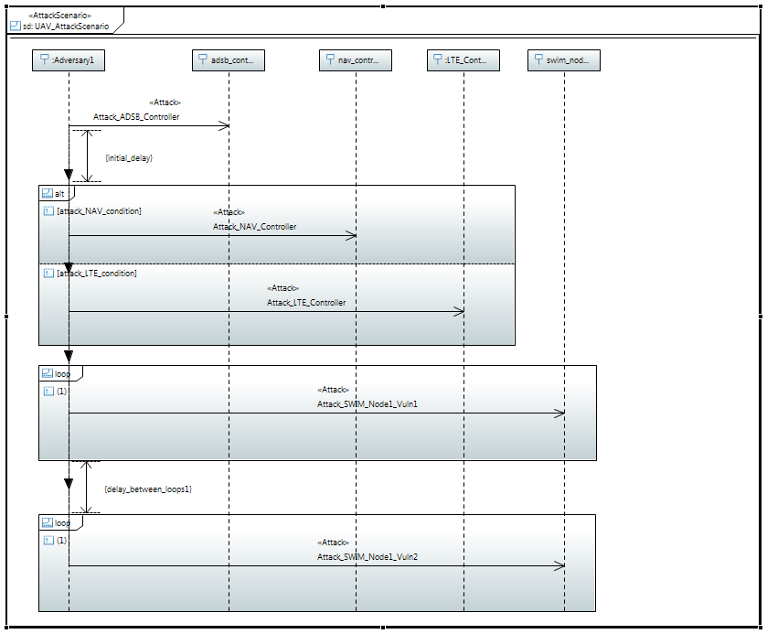
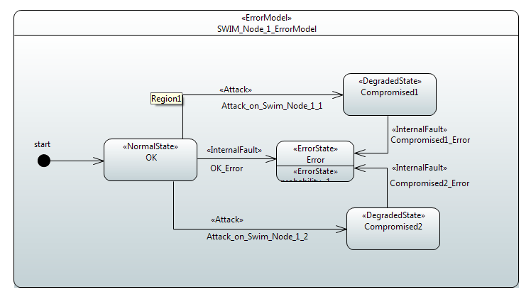
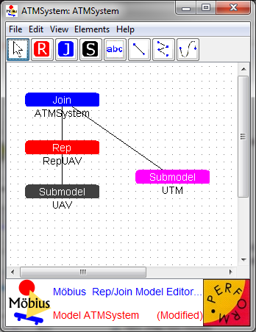
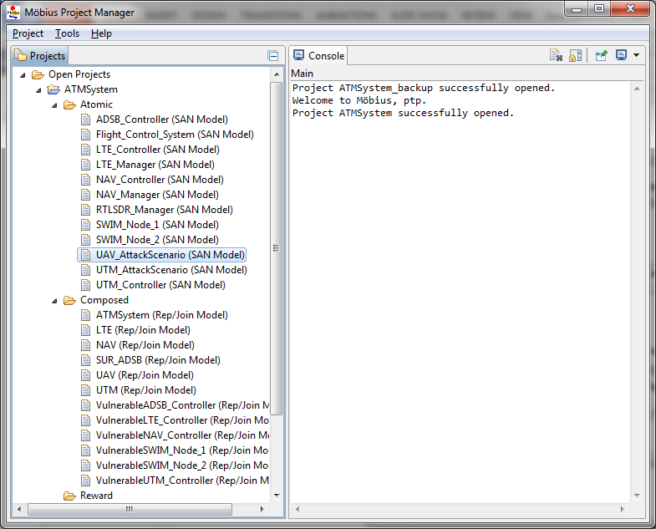
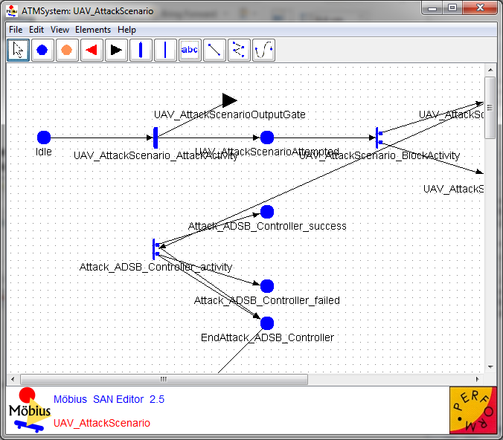
System development and SS analysis:
Deriving SAN models from SysML model
This work is ongoing!

Slide 15
Questions

