Slide 1
Predicting Cyber Attacks in the Entangled Cyberspace
Ruth Ikwu
Digital Economy & Cyber Security
research group, Brunel University London
RITICS Showcase, 18th October 2018 Nova South, London
E: Ruth.Ikwu@brunel.ac.uk

Slide 2
INTRODUCTION
A proactive framework to predicting cyber-attacks.
The cyber analytics space is currently dominated by mono-dimensional linear analysis.
Our framework conceptually fuses multiple sources of evidence across cyberspace to predict events in subsequent stages of the kill-chain.
Current techniques are limited in their ability to understand the dynamics of entanglements related to cyber-incidents.
We provide a multi-dimensional phased analysis of the traditional kill-chain model using structural vector auto-regressive models.

Slide 3
CONCEPTUAL FOUNDATIONS
The entangled cyberspace is a seamless integration of evidence sources across cyberspace to predict stages of the kill-chain.
The entangled cyberspace in theory is the fusion of three conceptual foundations:
A sequential phased model for perpetrating cyber-attacks.
A multi-dimensional characterization of cyberspace.
A structural model for integrating and simultaneously analysing multiple sources of evidence.

Slide 4
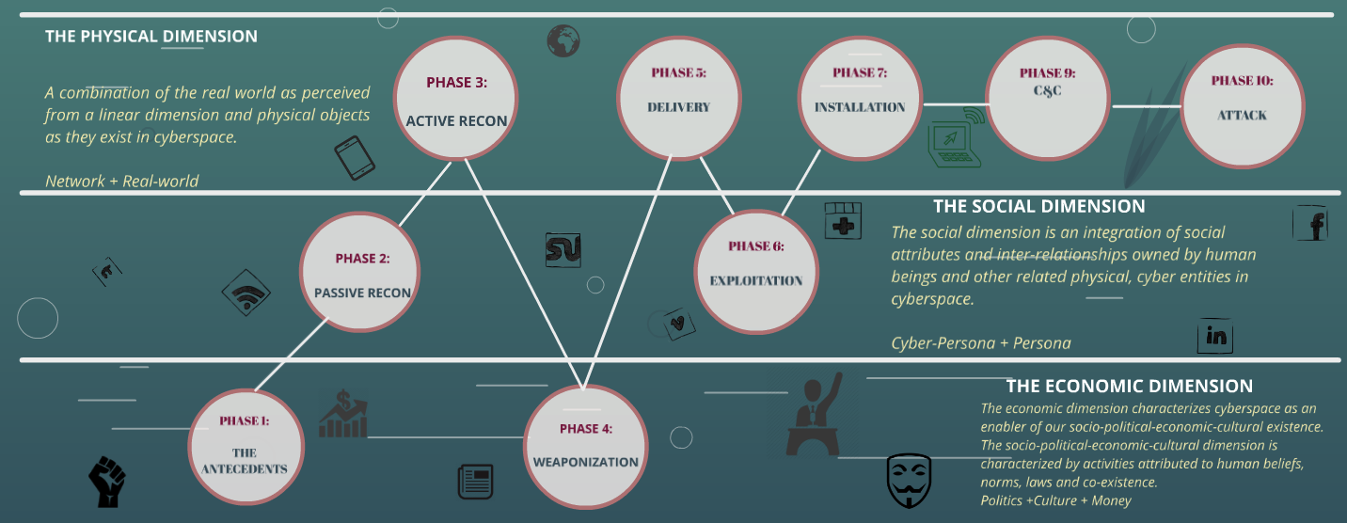
THEORETICAL FRAMEWORK

Slide 5
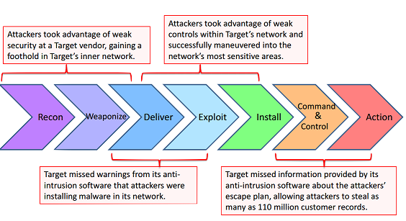
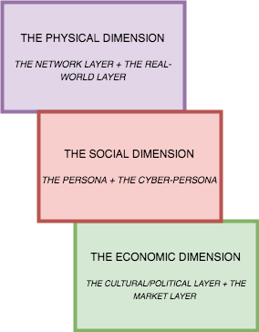
CF I & CF II
a combination of the real world as perceived from a linear dimension and physical objects as they exist in cyberspace
Antecedents
an integration of social attributes and inter-relationships owned by human beings and other related physical, cyber entities in cyberspace
+
A real-world trigger to cyber-incident influenced by social, economic, political or cultural factors
characterizes cyberspace as an enabler of our socio-political-economic-cultural existence. The socio-political-economic-cultural dimension is characterized by activities attributed to human beliefs, norms, laws and co-existence.
The Attack Kill-Chain
The Multi-Dimensional Cyberspace

Slide 6
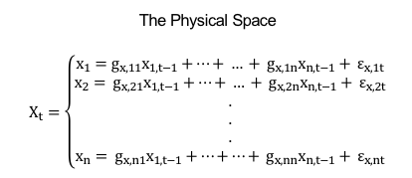
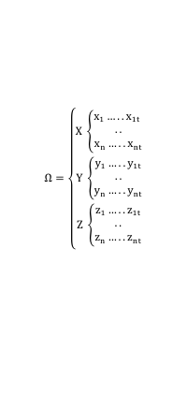
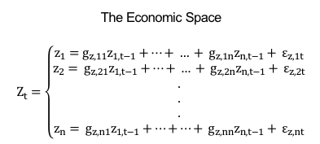
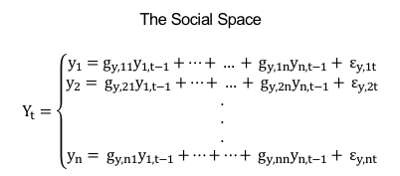
CF III: VECTOR AUTO REGRESSIVE REPRESENTATION OF CYBERSPACE
$$Cyber Data Space= \left({\begin{aligned}Physical Space \\ Social Space\end{aligned} \atop Economic Space}\right)$$
The Physical Space
$$X_{t}=\left\{\begin{aligned}x_{1}=g_{x,11}x_{1,t−1}+…+ … + g_{x, 1n}x_{n,t−1}+ ε_{x,1t} \\ x_{2}= g_{x,21}x_{1,t−1}+…+ … + g_{x, 2n}x_{n,t−1}+ ε_{x,2t} \\ . \\ . \\ . \\ x_{n}= g_{x,n1}x_{1,t−1}+…+…+ g_{x, nn}x_{n,t−1}+ ε_{x,nt}\end{aligned}\right.$$
The Social Space
$$Y_{t}=\left\{\begin{aligned}y_{1}=g_{y,11}y_{1,t−1}+…+ … + g_{y, 1n}y_{n,t−1}+ ε_{y,1t} \\ y_{2}= g_{y,21}y_{1,t−1}+…+ … + g_{y, 2n}y_{n,t−1}+ ε_{y,2t} \\ . \\ . \\ . \\ y_{n}= g_{y,n1}y_{1,t−1}+…+…+ g_{y, nn}y_{n,t−1}+ ε_{y,nt}\end{aligned}\right.$$
The Economic Space
$$Z_{t}=\left\{\begin{aligned}z_{1}=g_{z,11}z_{1,t−1}+…+ … + g_{z, 1n}z_{n,t−1}+ ε_{z,1t} \\ z_{2}= g_{z,21}z_{1,t−1}+…+ … + g_{z, 2n}z_{n,t−1}+ ε_{z,2t} \\ . \\ . \\ . \\ z_{n}= g_{z,n1}z_{1,t−1}+…+…+ g_{z,nn}z_{n,t−1}+ ε_{z,nt}\end{aligned}\right.$$
$Ω=\left\{\begin{aligned}X \left\{\begin{aligned}x_{1}….. x_{1t} \\ .. \\ x_{n}…..x_{nt}\end{aligned}\right. \\ Y \left\{\begin{aligned}y_{1}…..y_{1t} \\ .. \\ y_{n}…..y_{nt}\end{aligned}\right. \\ Z \left\{\begin{aligned}z_{1}…..z_{1t} \\ .. \\ z_{n}…..z_{nt}\end{aligned}\right.\end{aligned}\right.$
An n X n VAR for each identified dimension of cyberspace

Slide 7
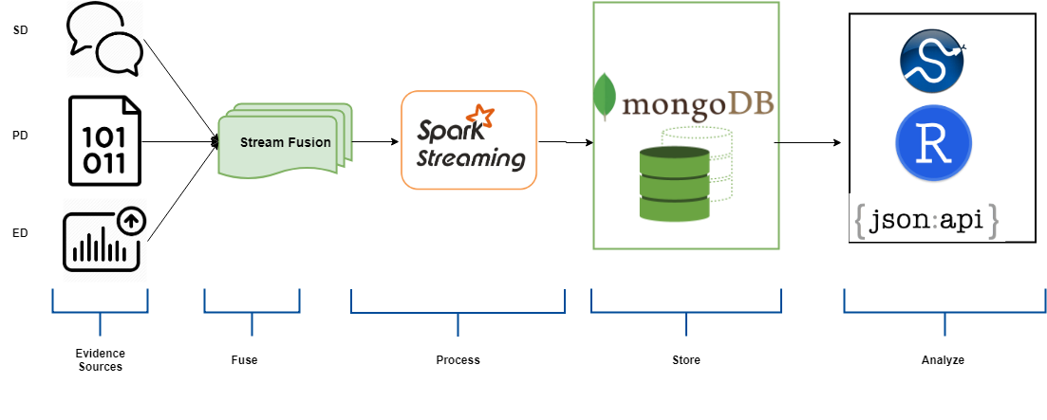
IMPLEMENTATION
Timeline Integration

Slide 8
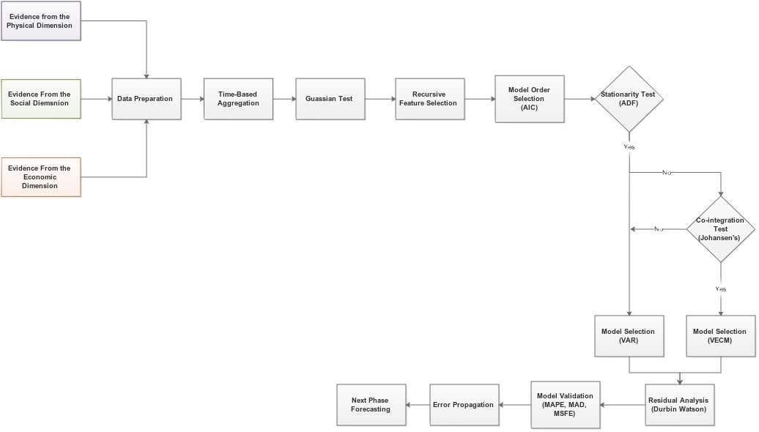
PHASED ANALYTICAL APPROACH
Pre-Test and Processing
Data Collection & Prep
Model Selection
v
Next Phase Prediction
Evaluation
v
vc

Slide 9
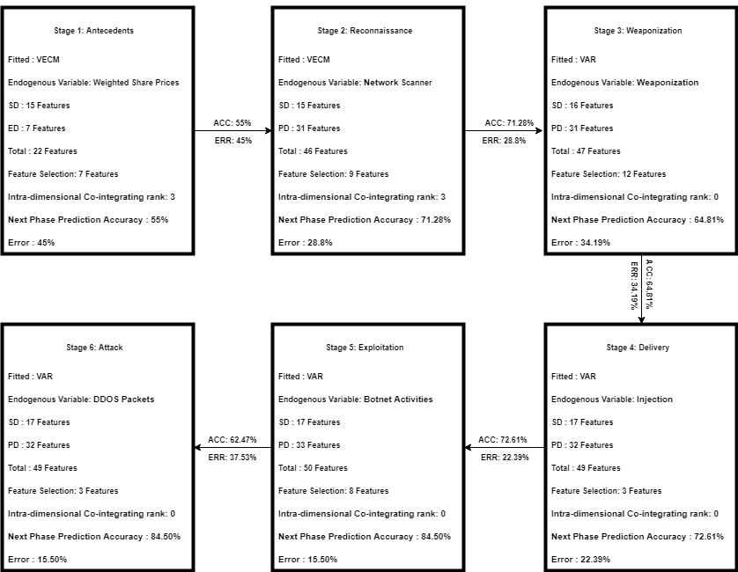
RESULTS
Stage 1:
Antecedents
Stage 2:
Antecedents → Recon
Stage 3:
Recon → Weaponization
Stage 6:
Exploitation -> Attack
Stage 4:
Weaponization → Delivery
Stage 5:
Delivery → Exploitation

Slide 10
FINDINGS
Findings
Analytical Characterization of the kill-chain.
Analytical proactivity in cyber situational awareness.
Integration of predictive feature scope beyond the network layer.
Antecedents of cyber-incidents.
Multi-source data fusion implementation cyber analytics.

Slide 11
IMPACT
Implementing Proactive controls for protection of industrial control systems.
Understanding the dependencies of entities and events within the cyber-operating environment.
Enhancing Situational awareness by understanding the dynamics of these entanglements in a multi-dimensional, multi-level cyberspace.

Slide 12
THANK YOU FOR YOUR TIME!!

