Slide 1
AIR4ICS
Agile Incident Response
for
Industrial Control Systems
#air4ics
Prof. Helge Janicke (heljanic@dmu.ac.uk)
Get in touch: cybertech.support@dmu.ac.uk
See what we are up to: @DMU_CyberTech
Read our blogs: http://cybertech.our.dmu.ac.uk/
Visit us on: www.dmu.ac.uk/CTI

Slide 2






AIR4ICS - Overview
Objectives
Investigators
Steering Committee and Contributors
Deliver an Agile Incident Response framework (AIR4ICS)
Apply and adapt agile management methods to the context of incident
Evaluate AIR4ICS using an experiential learning
Provide exposure and integration for RITICS and aligned industry.
H. Janicke
R. Smith
Y. He
F. Ferra
Research Fellow
Timeline: Feb’19 – Jun’20
Funding: £250k (tbc) and £161k+ in kind
Notes:
Deliver an Agile Incident Response framework (AIR4ICS) that is tailored to the particular challenges of Industrial Control Systems to address the cyber physical nature and impacts of IR.
Apply and adapt agile management methods to the context of incident response to bring the benefits of a cross-functional team together with a continuously adaptive and value driven approach to incident response.
Evaluate AIR4ICS using an experiential learning platform to conduct three war-gaming exercises, bringing together RITICS partners, industry and CNI operators with direct value to beneficiaries.
Provide exposure and integration for RITICS and aligned industry research through the coordinated integration of research outputs in the war-gaming exercises.

Slide 3
Key motivations for AIR4ICS
“Agile means we plan for Uncertainty”
Incident Response, in particular for Industrial Control Systems is characterised by high-levels of uncertainty and unpredictability.
Incident Response in ICS is a team effort that must bring together business, OT experts, IT, SOC, … to be effective.
Agile approaches bring together a cross-functional team to deliver in short time-frames with a reduced overhead in sign-offs and less stove-pipes.
Agile approaches embrace continuous improvement and iterative adaptation to maximise value in the current context.

Slide 4
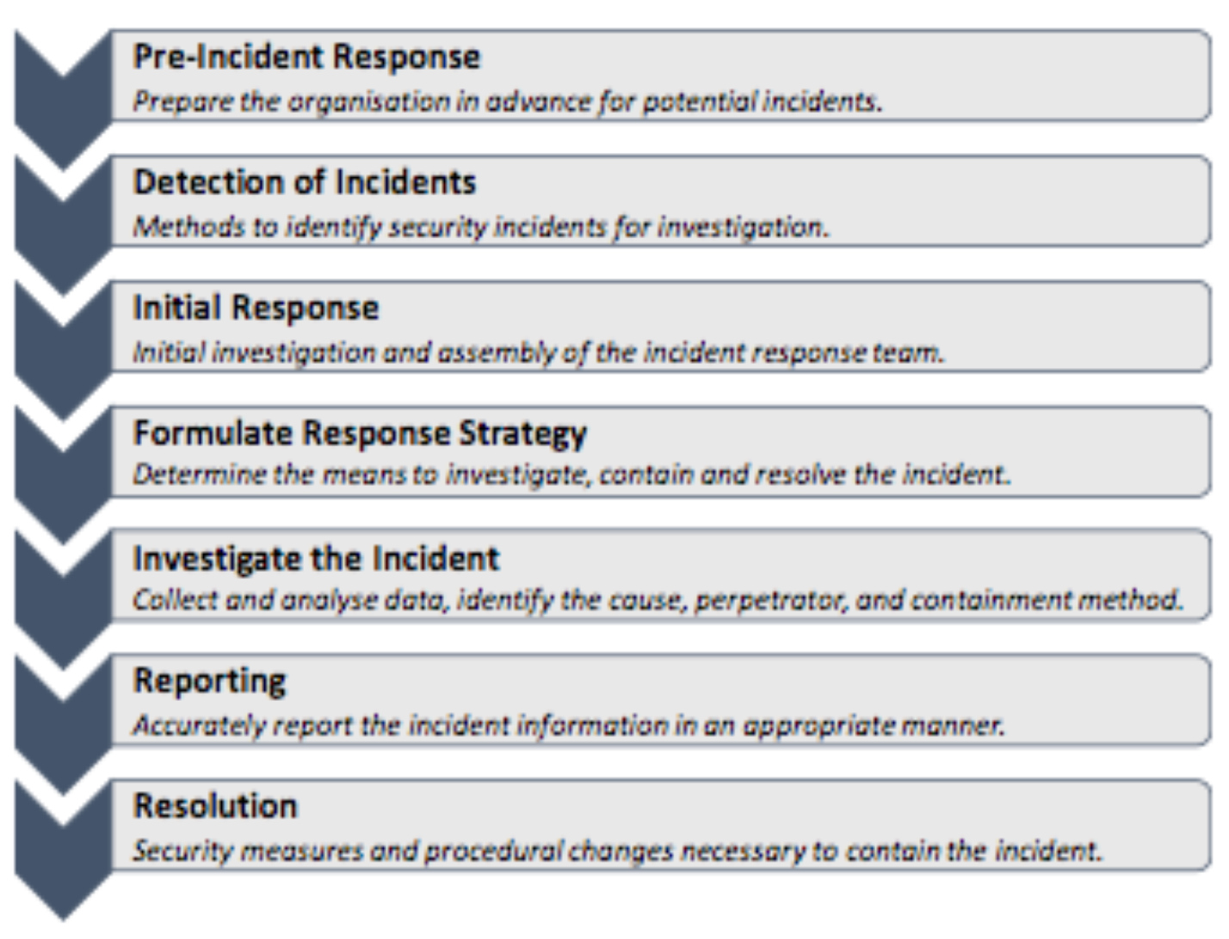
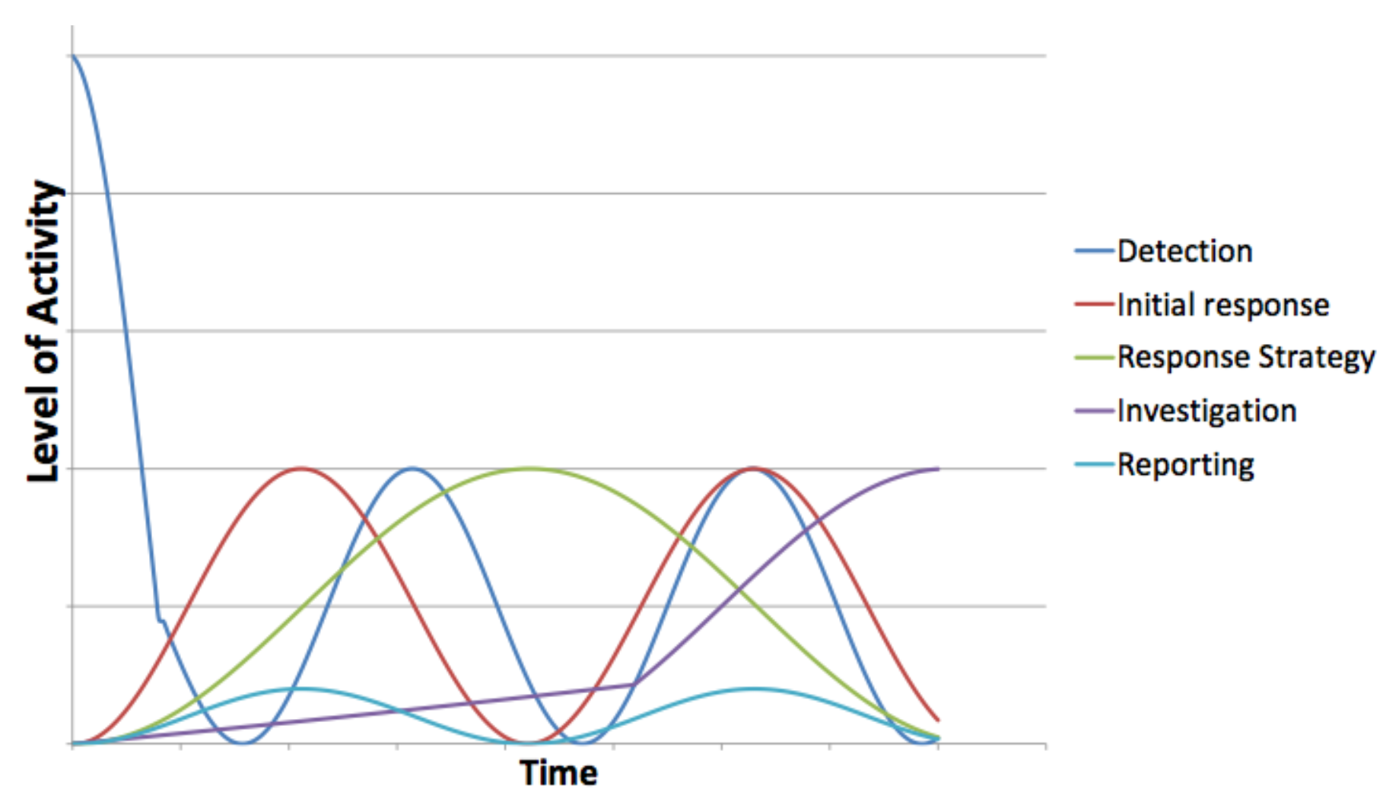
Scope

Slide 5
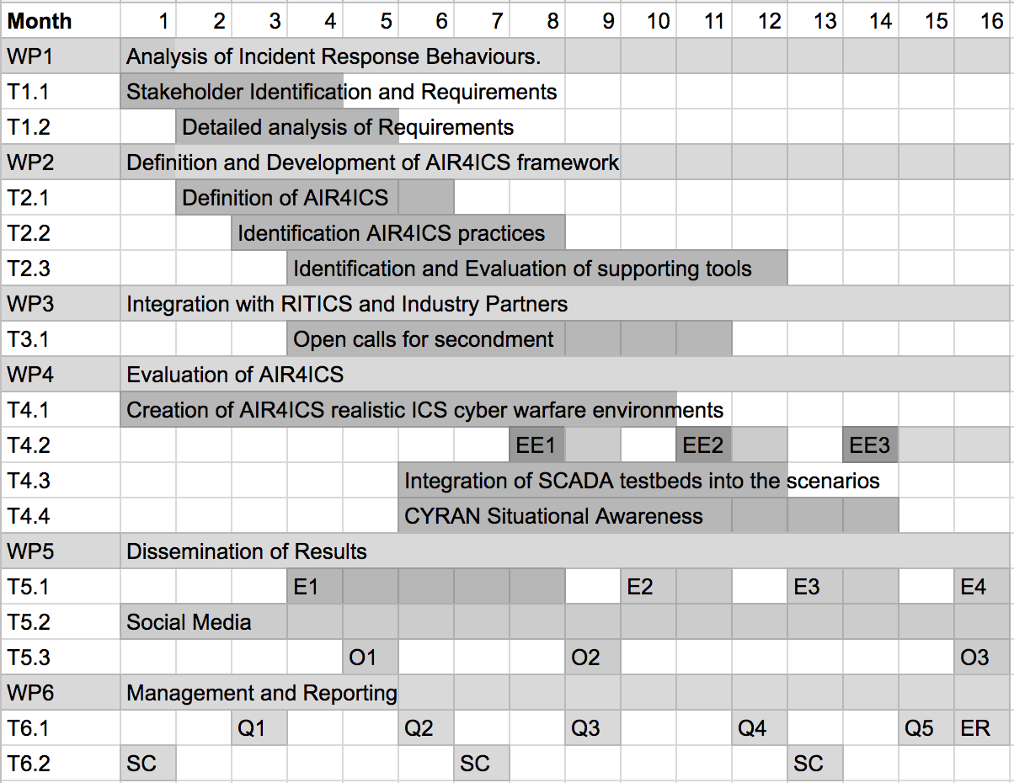
Workplan

Slide 6
Potential Impact and Beneficiaries
The new framework and training will provide a transformative, more dynamic and pro-active approach to incident response used by the teams defending the UK’s critical assets and can inform UK guidance on NIS.
The framework will allow the derivation new operational processes and procedures for industrial companies, allowing them to migrate from a reactive to proactive defence posture when dealing with incidents.
There exists a discrepancy between the cyber security readiness level of CNI organisations dependant upon sector. The framework will facilitate change regardless of where an organisation currently sits.
CNI operators affected by NIS
NCSC
RITICS Community
Concrete other interests since submitting the proposal: BSI, Deloitte,

Slide 7
How you can engage with AIR4ICS
WP1 – we are identifying pressure points for current IR in ICS through a series of interviews. Additional contacts through the RITICS community, NCSC who would be able to participate are welcome.
WP3 – we are creating a war-gaming scenarios for a number of evaluation events using our CYRAN cyber range infrastructure. If you wish to integrate your existing tools, or have specific research requirements which you would like to integrate in these, please do get in touch.
WP4 – we have three evaluation events as part of this project. For the exercises we would look for industry participant to participate as an incident response team. We would welcome any links and suggestions.
WP5 – Dissemination, we are obviously keen on spreading this work widely – any collaboration with related projects or events are of course welcome.

Slide 8
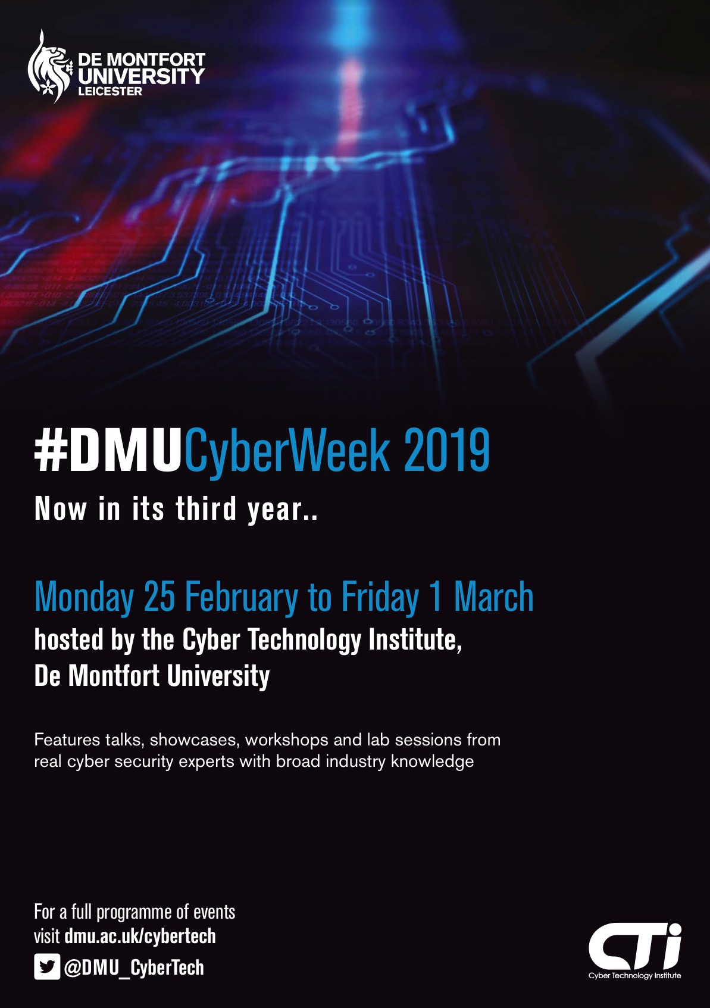

Take part in our events
Annual Distinguished Lecture Series (7/11/2019 – Paul Spirakis)
Weekly Research Seminar Series
Professional Guest Lectures in Cyber Security
International Symposium on ICS and SCADA Cyber Security Research
#DMUCyberWednesday
#DMUCyberWeek
Cyber Peacekeeping at ECCWS’19
Cyber Security Challenge UK ….

Slide 9
Engage with us
#air4ics
E: cybertech.support@dmu.ac.uk
W: www.dmu.ac.uk/cybertech
Follow us: @DMU_CyberTech

