Slide 1
Network Discovery in Industrial Control Systems
Charlie Rutherford
c.rutherford.2@research.gla.ac.uk
Office: 0141 330 7232
University of Glasgow

Slide 2
Network discovery, a (very) brief introduction
Definition: Processes to discover hosts on a computer network and information about those hosts.
Active & Passive scanning, Host detection, OS detection, port scanning, service detection
Useful security-related information as specific vulnerabilities are tied to OS, software versions etc.
Can be used to find valuable information for both attackers and defenders

Slide 3
Network discovery in ICS
So far not a lot of public peer-reviewed research on this topic, more public work in enterprise IT domain.
Some complications in ICS: Serial protocols, strange network topologies, unsupported protocols, fragile network components in devices, safety-critical environments, also lack of understanding of how and when to apply current tools to networks relating to security policies and standards.

Slide 4
Some scanning safety concerns
Network effects: Active scans can send 1000s of packets onto network, can cause increases in latency, retransmissions, dropped packets etc. This is unacceptable in safety-critical or real-time environments. Passive scans can also potentially cause latency and bottlenecks, especially on older hardware.
Device effects: Some devices can react in unpredictable ways when scanned. There have been cases of devices becoming unusable after being scanned on certain ports. Obviously this can be a problem for safety.

Slide 5
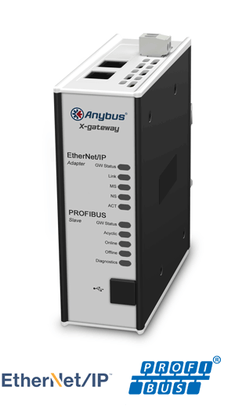
What’s been done at Glasgow?
Recreating vendor discovery methods from programming software using packet crafting software (Scapy).
Attempts at doing discovery on serial network showed that PLC on serial network can be manipulated from Ethernet network through a gateway, more work needs done to show discovery.
Initial work to examine impact of using IT scanning tools Nmap & Nessus on ICS testbed, and developing scanning methods for ICS with fewer side effects.
Image credit: HMS Industrial
Networks AB

Slide 6
Where does my research fall in the Purdue model?
Layer 5
Not really interested, can apply ‘traditional’ IT discovery techniques
Enterprise network/ Internet
Layer 4
Local Business
Layer 3
DMZ
Layer 2
Our area of interest/research
Supervisory layer
Layer 1
Control layer
Layer 0
Process I/O

Slide 7
What’s next?
More thorough examination of the effects that existing tools have on control networks: impact of scanning on network, use cases for different levels of “aggressiveness” of scans, investigation of potential safety related problems and solutions
Closer look at ICS application level protocols Ethernet/IP and CIP (ABB), Profibus and ProfiNet (Siemens), Modbus TCP (generic), to see the benefits of leveraging vendor discovery techniques, consolidating into a toolset. Work on Industrial wireless and serial discovery methods.

Slide 8
Thanks Any questions?
Charlie Rutherford
c.rutherford.2@research.gla.ac.uk
Office: 0141 330 7232
University of Glasgow

