Slide 1




WELCOME

Slide 2
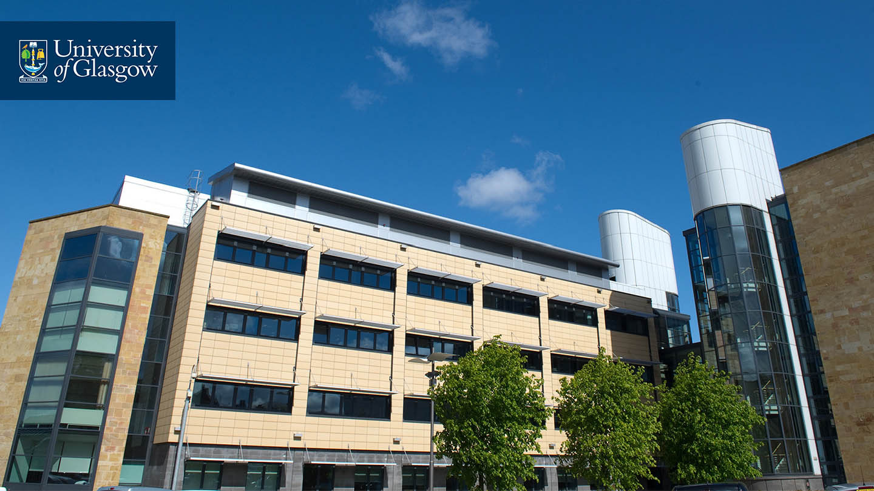
Developing Pedagogy to Optimise Forensic Training in Safety Related ICS

Slide 3
Background
Pedagogy – the theory and practice of teaching and how these influence student learning.
The Research Institute in Science of Cyber Security (RISCS) workshop stressed the role GCHQ Research Institutes must play in influencing best practice in this area.
The researchers expressed their concern that research findings tend to disappear into a vortex, which they call “The Void”.
Well summed up by the CISO of a global organisation, who told them that academic research was generally not well disseminated outside of academic circles and did not reach him in a form that’s useful in the real world.
We have found that there is little or no empirical work on effective approaches for training professional systems engineers.

Slide 4
Background
Very few courses on ICS address forensics.
They will include Kali Linux as a tool box but little else.
Now with NIS requirements industry need to be able to identify when they have been attacked.
This can be very difficult in an IT environment but it is even harder in an ICS environment.
Courses also need to be able to explain the consequence of investigation actions and appropriate steps for safety and safety related systems.
There is significant gaps in this area.

Slide 5
Way Ahead
We need to look at how we are using ICS test beds.
What are the engineers getting from time on the test beds?
What are we (UK) getting for these investments?
Is the existing setup actually producing the skill set industry and the country needs.
The US DoD have done some work in looking at SCADA test beds and the proficiency of the teams in the exercises.
The results showed that the teams were not meeting the expectations of the NIST 800-61 standard.
Does the NIST standard need to be reviewed against actual response times.
It is important that the research is build on actual experiences so that realistic timelines can be set.

Slide 6
Phase 1
In Phase 1 we will consider 3 groups:
      Cyber Apprentices
      Engineers from the UK CNI
      GCHQ RIs
The Cyber Apprentices into the lab to work along side the students.
      It will also allow the Apprentices to get direct insight into the research being carried out and get time to experiment on the devices.
      The aim is to give them hands on time with the tool sets we have been developing and getting feedback from the users.
We are not worried if they “break” something because that’s part of working in the lab, we can always re install code.
We also plan to open up the lab to plant computer specialists from the UK CNI and GCHQ RIs to observe the interaction in peer learning between the groups and the students.

Slide 7
Phase 2
In this phase we plan to analysis the work done in Phase 1.
Also consider the work done at Stanford/UNO on IT forensic training courses to see how this can be adopted to this research.
Looking to develop some of the Stanford work along side the ICS cyber security question set developed by UK CNI.
The aim is to design, deliver and review pure peer forensic courses suitable for the 3 different groups studied in Phase 1
Present a strategy for establishing the scientific basis needed to ensure validity of future pedagogy to increase the UK resilience of UK CNI.
Finally building on existing contacts with US DHS and ENISA to host an international workshop at Glasgow Uni on this topic.

Slide 8
Future
Need to identify effective training in forensics for different levels of expertise and skills.
How we provide CISOs with an overview of ICS forensic techniques.

Slide 9




THANK YOU
#UofGWorldChangers
@UofGlasgow

