Slide 1
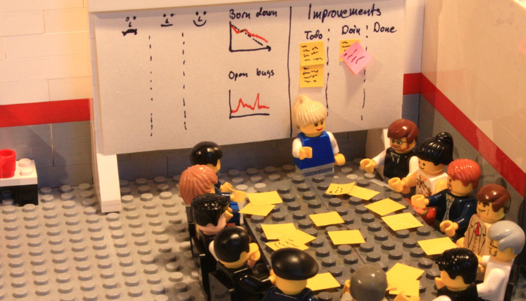
Decisions & Disruptions
Notes:
Here to report latest Decisions & Disruptions findings
You’ve probably seen me hanging around with a box of lego at various events
Game developed to explore how orgs go about making OT and IT/IS choices
Traditional interviews were not working, people would talk to us off the record but never on the books
Game provides alternative approach - providing participants with generic lego-based organization that they can relate to

Slide 2


A Study of Security Decisions in a Cyber-Physical Systems Game
Notes:
This is the latest paper to finally make it out of the publication machine based on dataset 1.

Slide 3


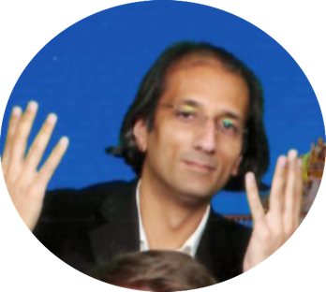


Sylvain Frey
University of Southampton, UK
(Now at Google DeepMind)
Maria Pinto-Albuquerque
Instituto Universitario de
Lisboa, Portugal
Awais Rashid
University of Bristol, UK
Syed Asad Ali Naqvi
Lancaster University, UK
Pauline Anthonysamy
Google Zurich, Switzerland
Notes:
Written by these lovely people

Slide 4
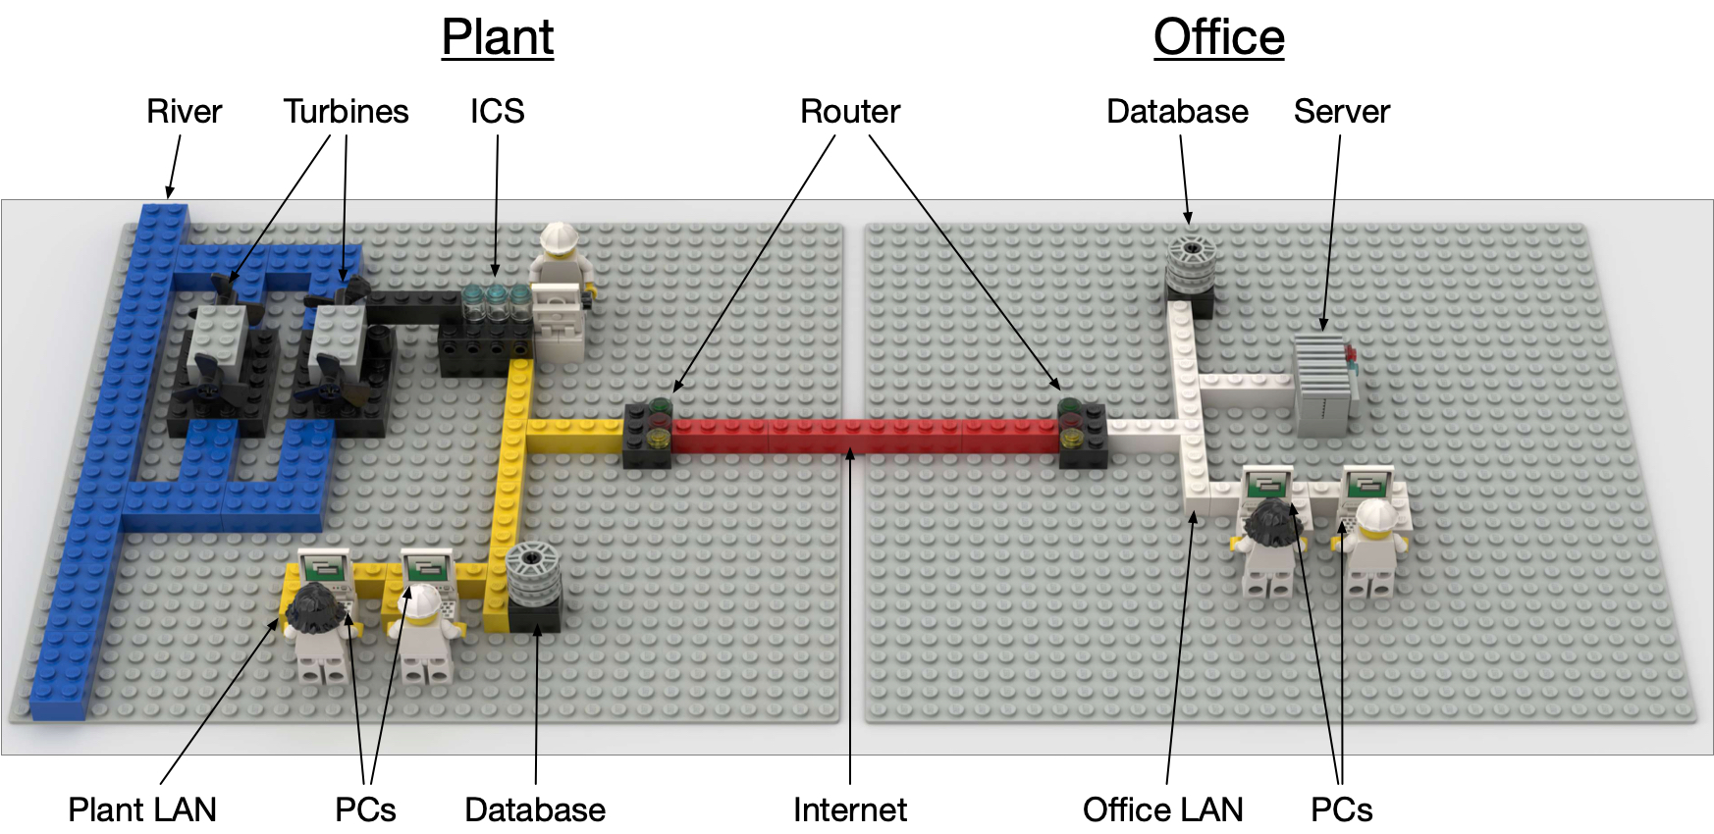
Notes:
What the game looks like
This is what participants are presented with at the start of the game

Slide 5
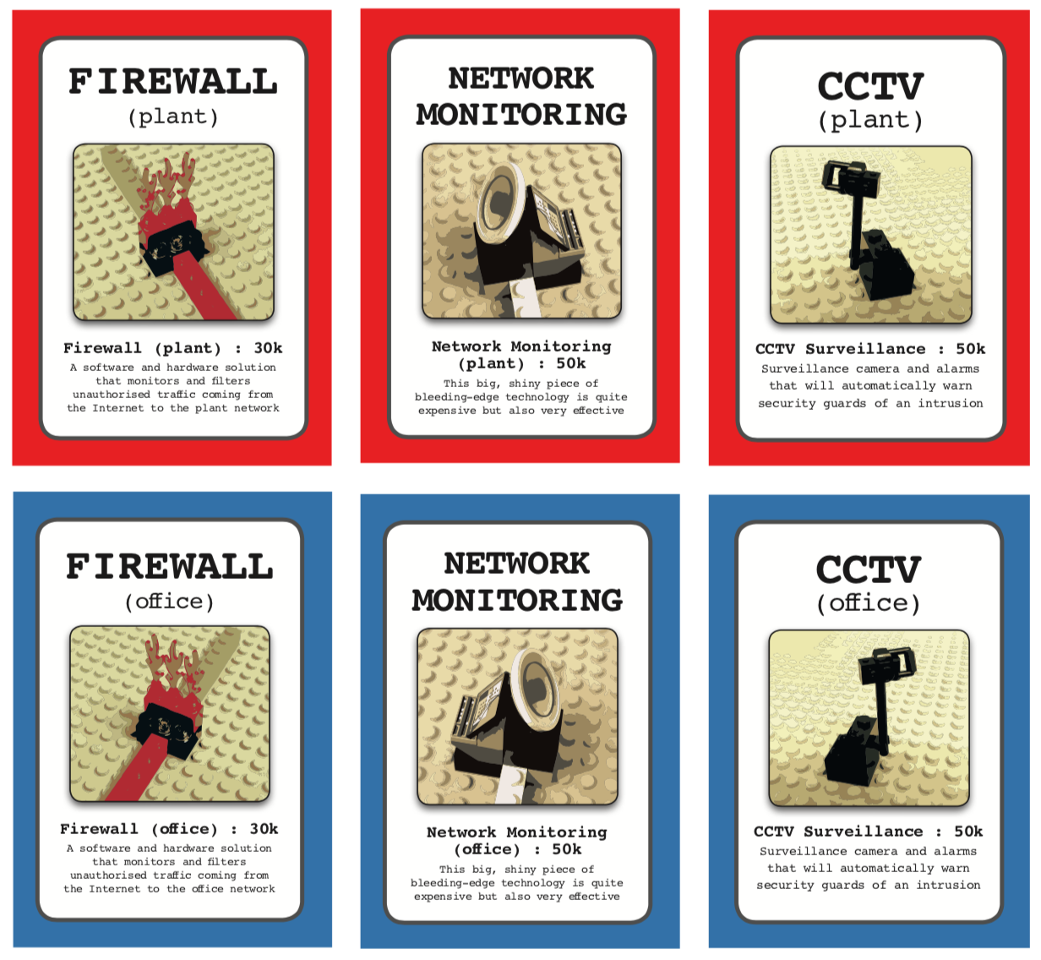

Slide 6
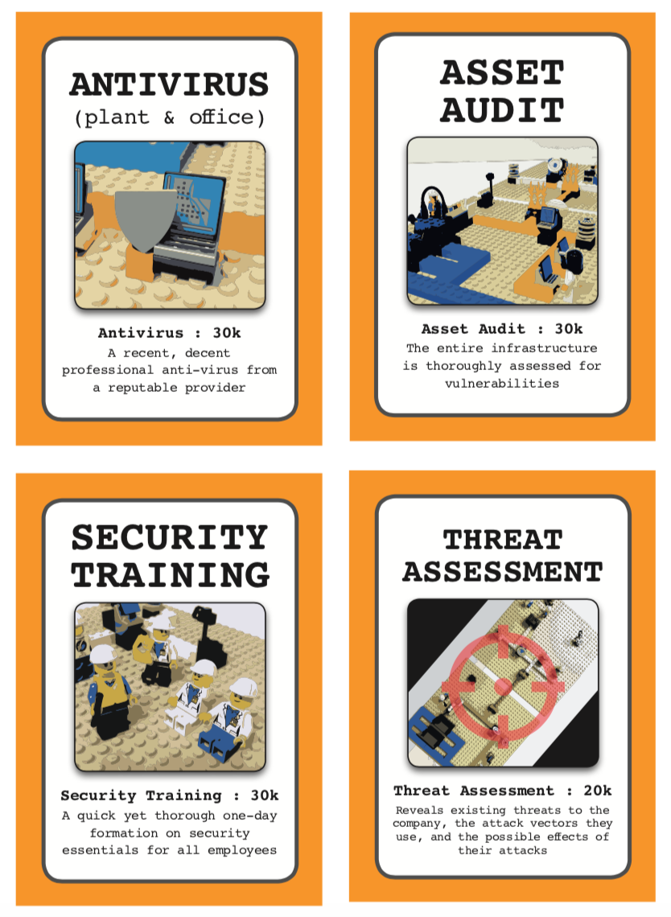

Slide 7

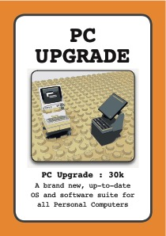

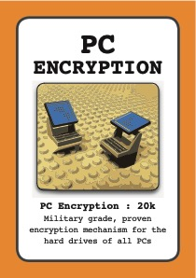
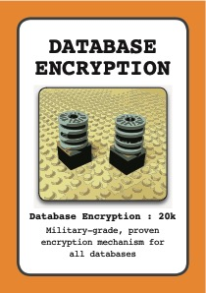

Slide 8
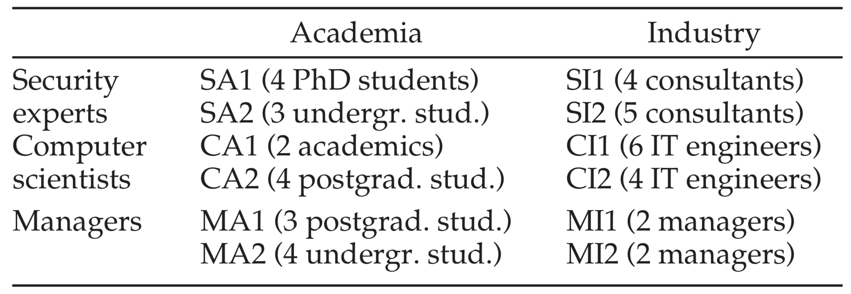
43 Players, divided into 12 homogeneous groups
Notes:
Participants in study
43 players, across 12 teams from Academia and industry
Different backgrounds, some managers, others computer scientists (not security) and others so called ‘security experts’
Transcripts created from the teams gameplay and their decisions at the end of each round evaluated.
Now then, what did we find…..

Slide 9
The best players are …?
Notes:
Overall game scores: number of attacks successfully defended against
Total of 33 attacks typically used by Script Kiddies and Organised Crime Groups
The + symbol shows the average score, with Comp Sci, then Mangers and Security Experts last.
Not an absolute measure of security skill, but perhaps an indicator of sorts
The security experts seem to do worst of all….

Slide 10
“We are security experts, we don’t need a threat assessment.” Team SA1
“You told us what we already knew.” Team SI1
Notes:
- So called experts very complacent when faced with an unusual approach, assume they know everything.

Slide 11
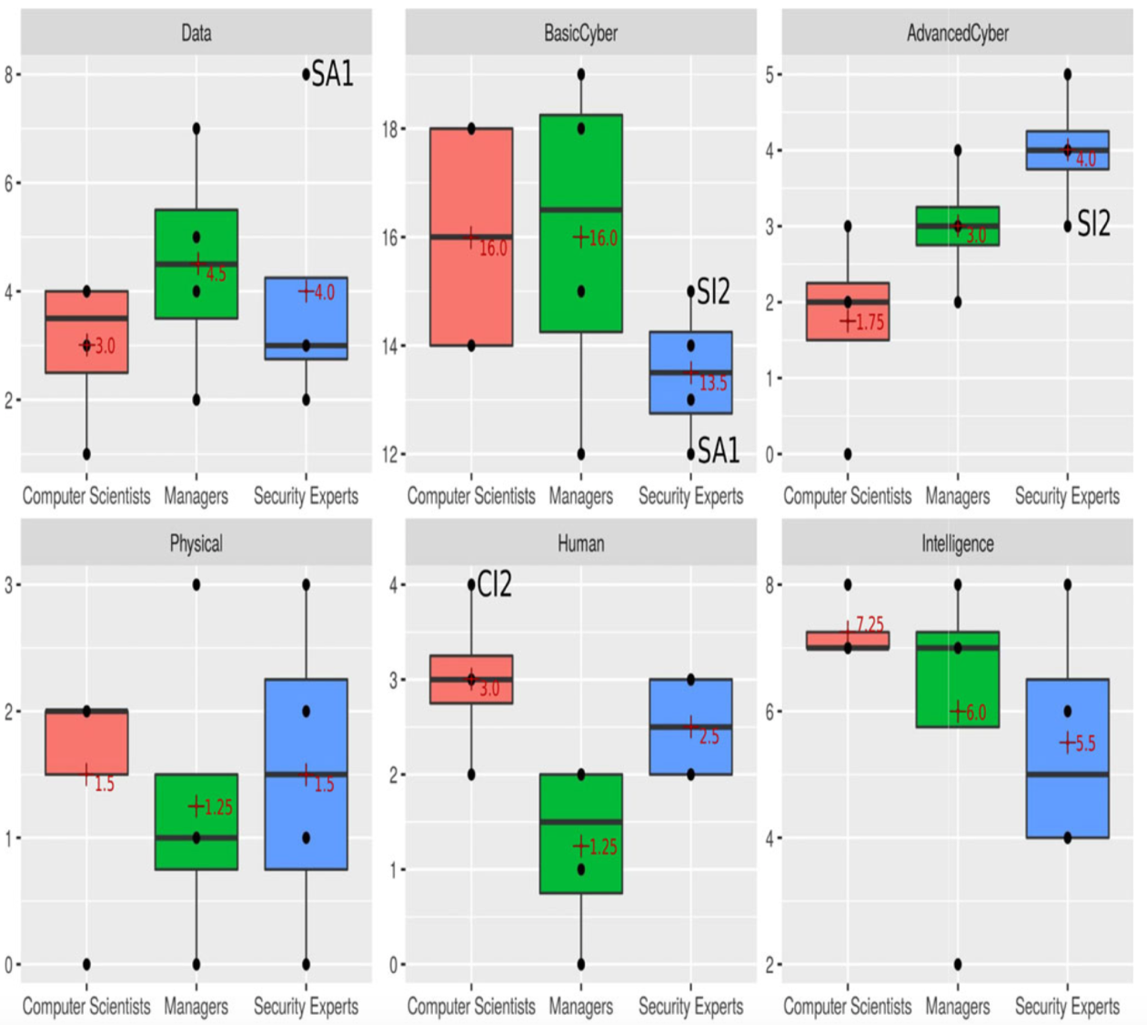
Notes:
Level of interest scores - based on round that defense is played: Round 1 = 4, Round 2 = 3 etc.
Data (protection) = Encryption of PCs and DBs
Basic cyber security = Firewalls, Antivirus, Patches (PCs, Server, Controller)
Advanced cyber security = Network monitoring
Physical Security = CCTV
Human Factors = Security Training
Intelligence gathering = Asset audit + Threat assessment

Slide 12
Security Experts
+ + Advanced cyber protection
− − Basic cyber protection
− − Intelligence gathering
Computer Scientists
+ + Intelligence gathering
+ + Human factors
− − Advanced cyber protection
− − Data protection
Managers
+ + Basic cyber protection
+ + Advanced cyber protection
+ + Data protection
− − Human factors
Notes:
- So, the way that people discuss their decisions varies wildly:
- Managers spend a lot of time discussing the value of data and the need to protect it
- They (managers) are also more interested in ensuring basic cyber hygiene than advanced options
- The security experts are definitely more concerned with advanced cyber security investments (network monitoring)
- Managers actually neglect physical security
- Ditto the human side of security, meanwhile the computer scientists and security experts pay attention to both
- Everyone pays some credence to gathering intelligence information, they have a tendency toward making informed choices (even if the so called experts don’t like the information they receive).

Slide 13
Procedure-driven
“We should start with an asset audit, then we can know what we are protecting and invest accordingly.”
Experience-driven
“I have never seen an IT infrastructure without a firewall.”, “Remember the news last week? They got owned by a phishing email, we should care about it.”
Scenario-driven
“What if someone got access to our database? We need to encrypt it.”
Intuition-driven
“I like the antivirus.”
Notes:
Characteristics of decision making process:
Procedure-driven
Experience-driven
Scenario-driven
Intuition-driven

Slide 14
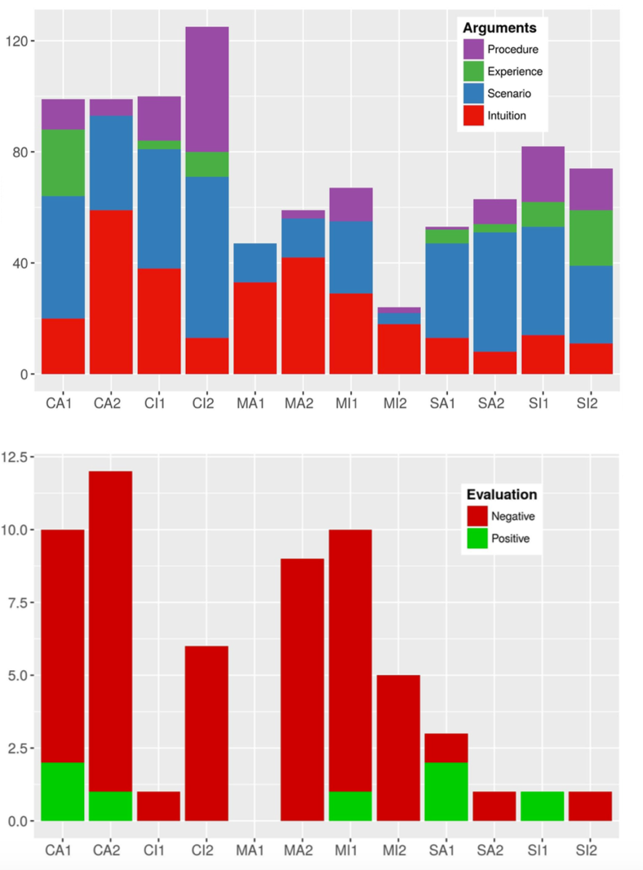
Analysis of arguments used
Measure of self-confidence in suggestions
Notes:
Analysis of arguments from transcripts
Chart 1: The proportion of argument types (procedural, experience based, scenario driven or intuitive)
Chart 2: Whether evaluations are largely positive or negative by team
The best players are not the ones you think….
TO DO: Find link to core three takeaways

Slide 15

Characteristic game play styles
Balance is key
The Beginner’s Syndrome
Notes:
- Major take away no 1: Balance is key

Slide 16

A little knowledge is a dangerous thing
Beware of the champion!
For better or worse
Notes:
- Takeaway no 2.

Slide 17

The “tunnel vision” syndrome
“This company’s data has little value: you could publish it all.”
“I don’t feel the encryption is any priority even though there has been a data breach.”
Notes:
- Takeaway no.3.

Slide 18
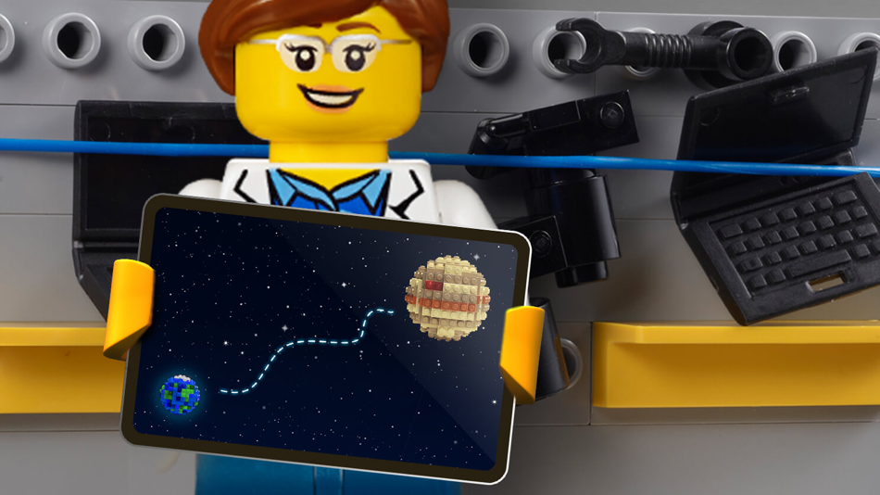

Notes:
History to date:
Original development and data gathering completed by Dr Sylvain Frey ~ 50 people
Since those initial sessions the game has assumed a life of it’s own
Adopted by metropolitan police, they now have 10 trained game masters and their own kit
Many of the Regional Organised Crime units are getting in on the action as well.
The exercise has been run with 700+ individuals in some 50+ organizations including various gov. groups, charities and FTSE 100 companies.
I’ve been busy, there have been too many sessions to run and too much data to process – papers in the pipeline that you will have to wait for.

Slide 19
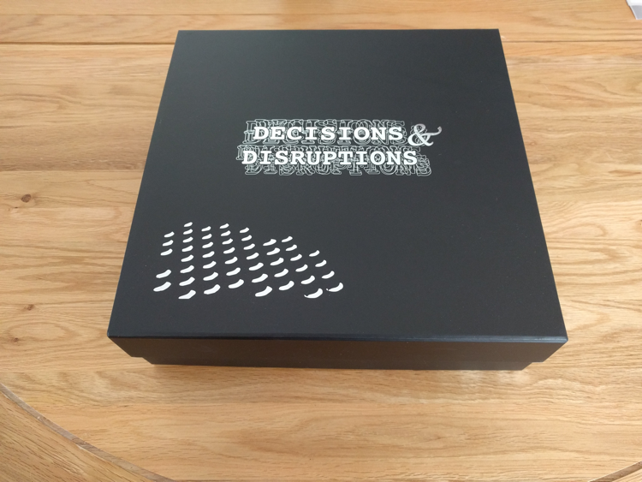
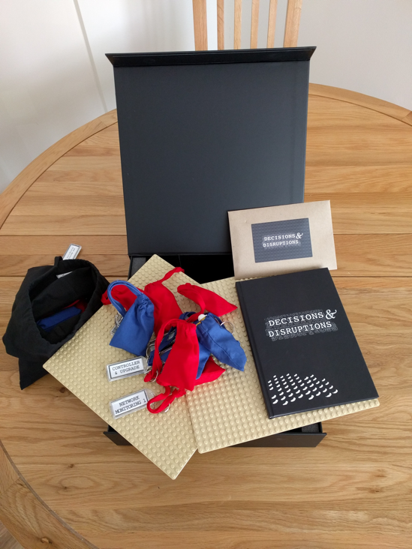
www.decisions-disruptions.org

Slide 20
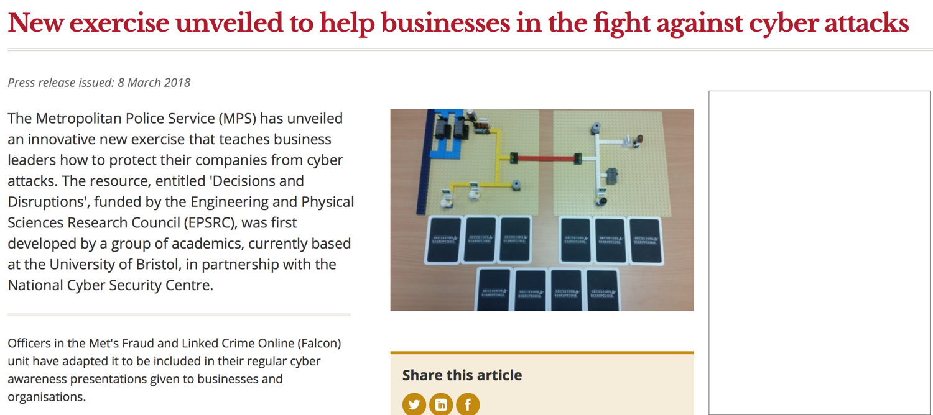

Slide 21
Full paper
Sylvain Frey, Awais Rashid, Pauline Anthonysamy, Maria Pinto-Albuquerque, and Syed Asad Naqvi
The Good, the Bad and the Ugly: A Study of Security Decisions in a Cyber-Physical Systems Game.
IEEE Transactions on Software Engineering (Pre-print is online)
EPSRC Grant: EP/M002780/1

Slide 22
ben.shreeve@bristol.ac.uk

